Slide 1
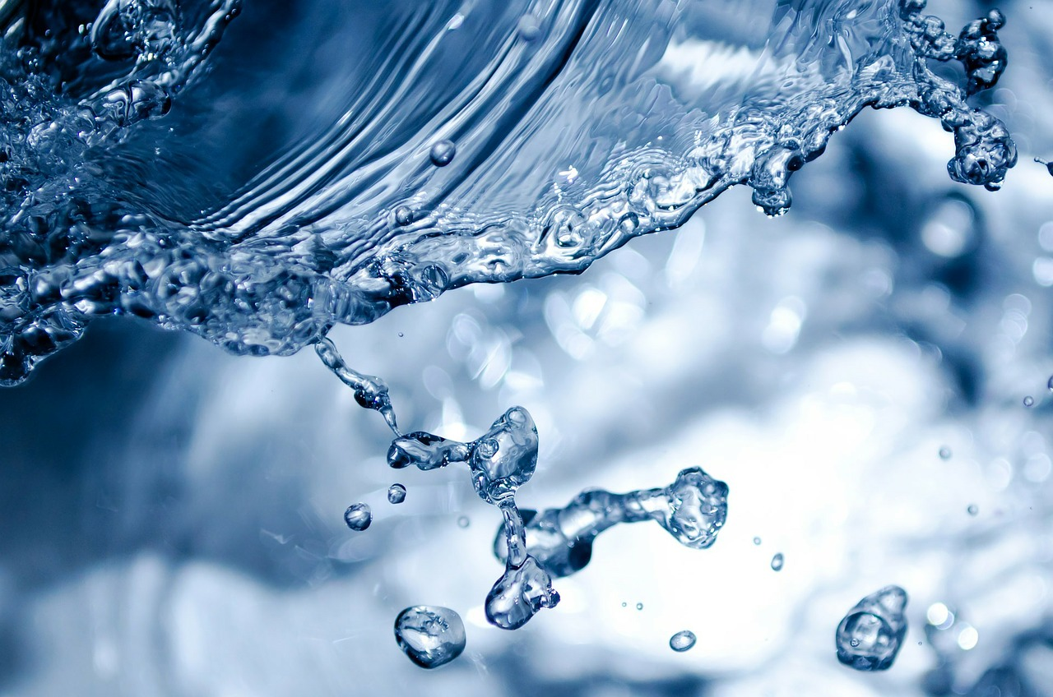

TAVINA S.p.A.- ITALIAN NATURAL MINERAL WATER
Pr P
Products of Italy

Slide 2
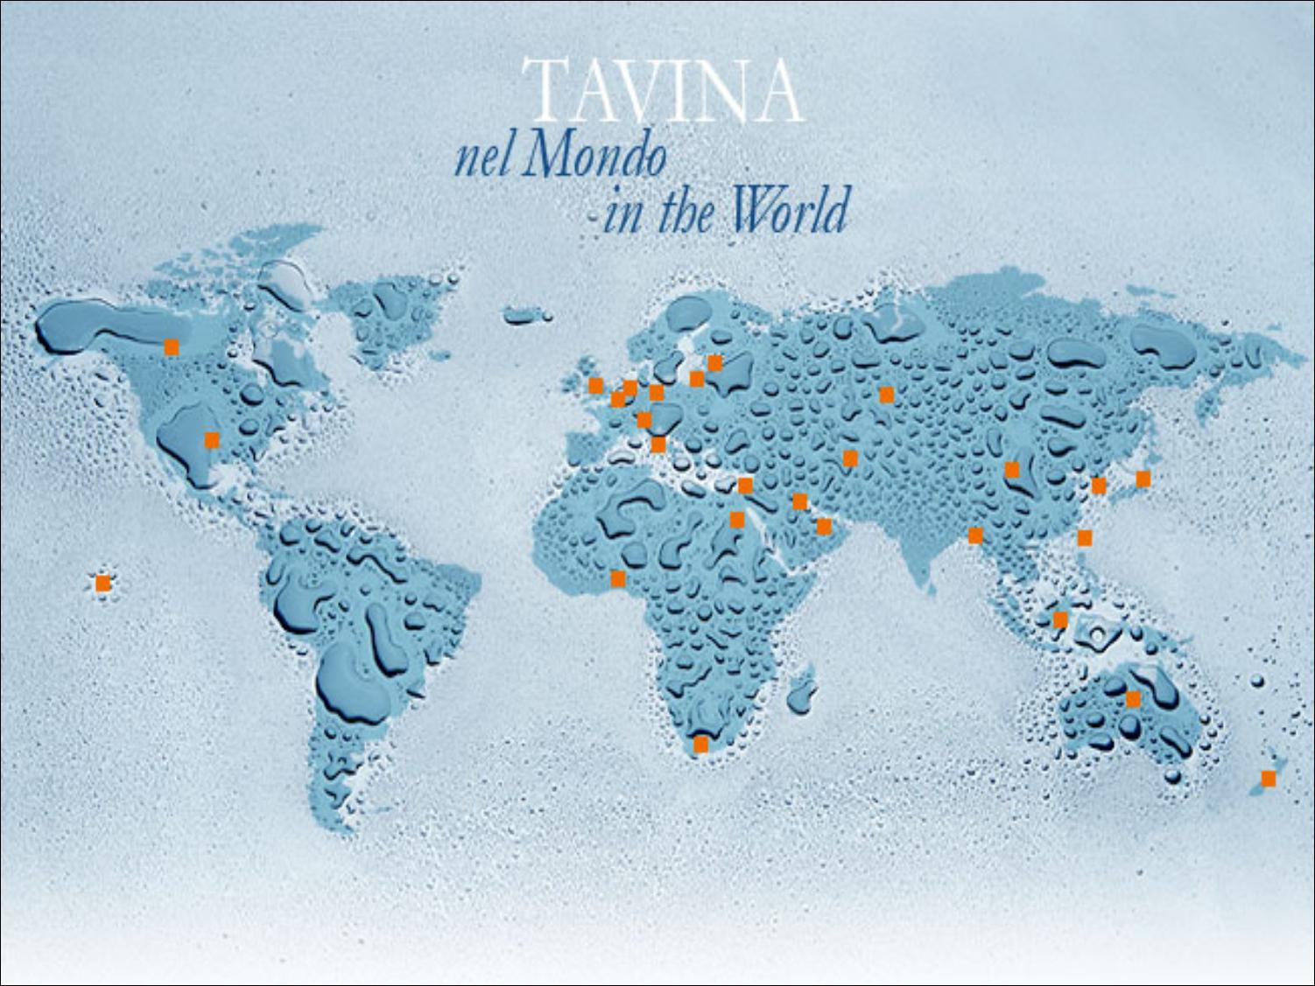
In 2024 exports were more than 55% of total sales

Slide 3
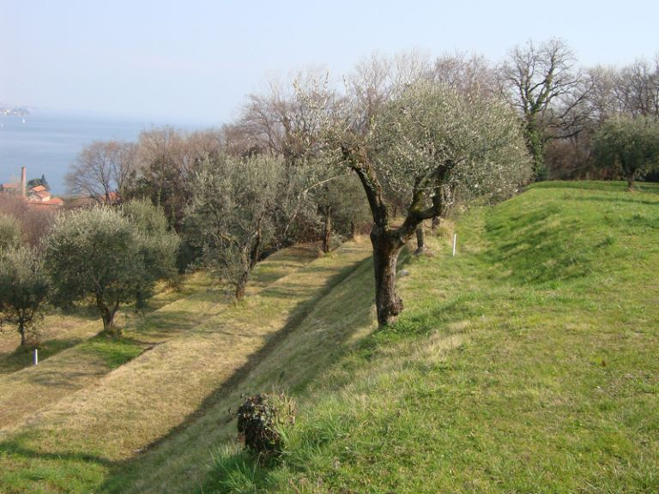

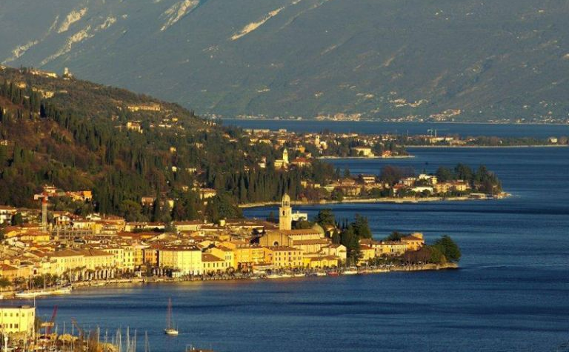
SOMETHING ABOUT OUR HISTORY
Grattarolo, a poet of the XVI century, in his Historia of the Coast recalls the legend of the healthy waters that gush abundantly from a spring on the east side of Salò.
According to legend, numerous nymphs used to live in this special place: one of them, called Tavine, gave the name to the location and the company as well.
Tavina, Linda and Allegra natural mineral waters gush naturally pure from sources in an ancient glacial basin in the Lombard Alps, in the protected Natural Park of the Alto Garda, characterized by a strong presence of olive trees and vineyards.
In this area there’s no pollution and that guarantees a high quality of the water.

Slide 4
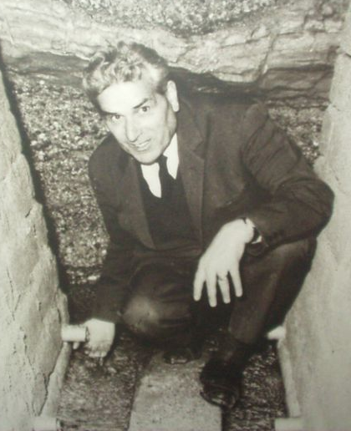

Tavina: the Company
Founded in 1967 by Mr Amos Tonoli, Tavina’s been grewing up for more than 50 years focusing on flexibility and high-quality standards, which allows to face both market and retailer’s needs. Reaching its goal of being the first 4.0 in Italy, Tavina has just built a new plant, one of the most modern in the water bottling sector.
New concept
New machinery & production facilities
Forefront equipment
Automatic warehouse & systems
Energy savings - Photovoltaic energy
The new plant is situated in an area of 20.000 m2, able to guarantee great volumes of production, improving quality and services. Tavina has been on the market for almost 50 years. It raises up to 95 employers during the summer season, with a production of 270 million bottles per year and a turnover of 43,6 million – compared to 26 million in 2014!

Slide 5
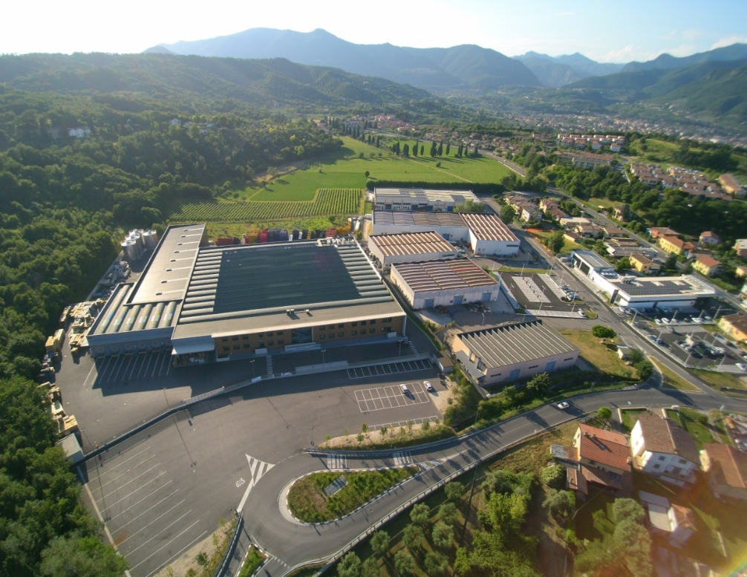
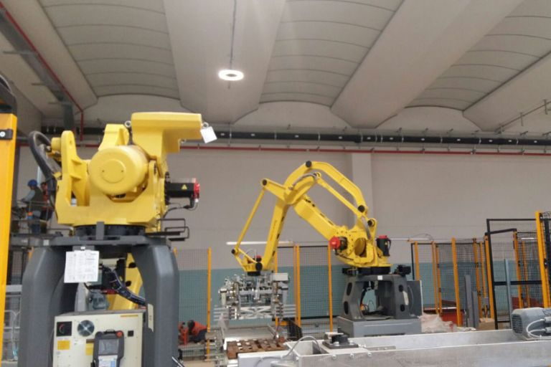
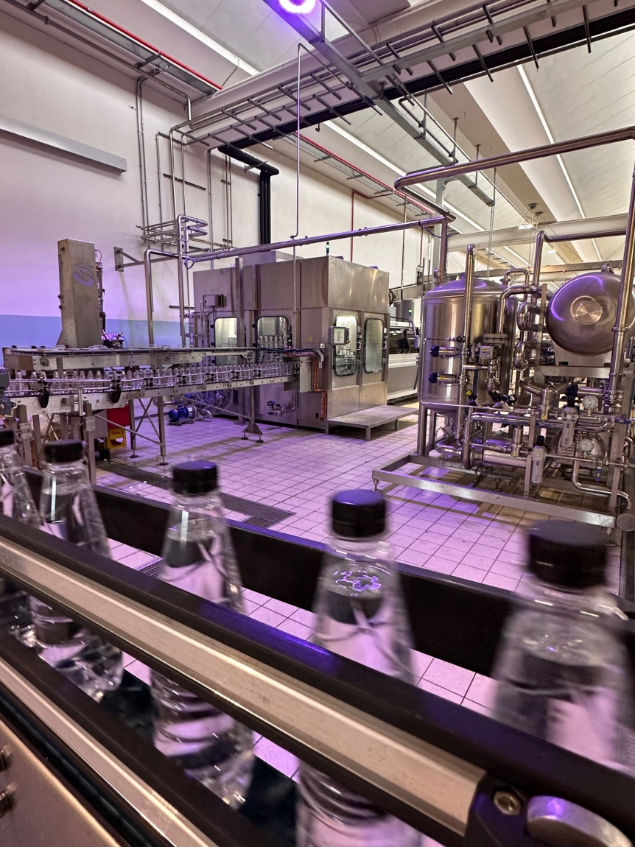
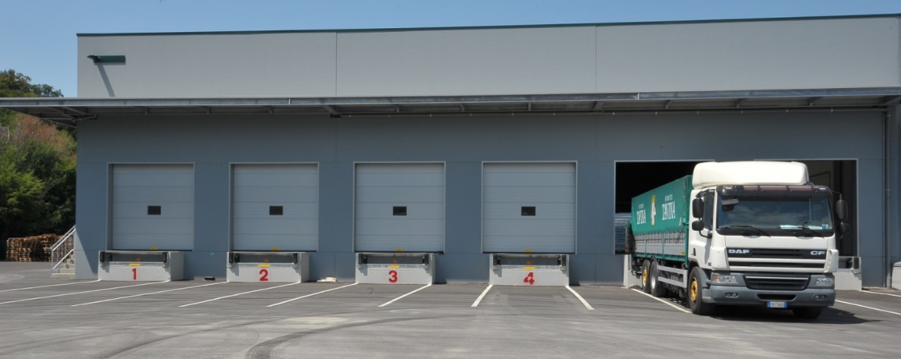

Slide 6

Efficiency and sustainability are the pillars that guide our choices towards the use of clean energy!

Slide 7
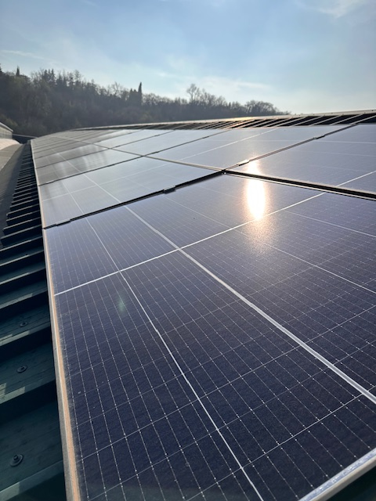

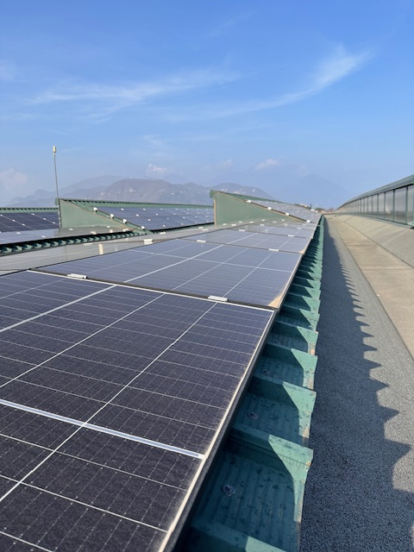
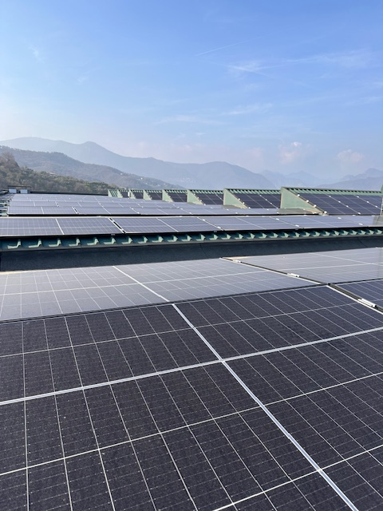
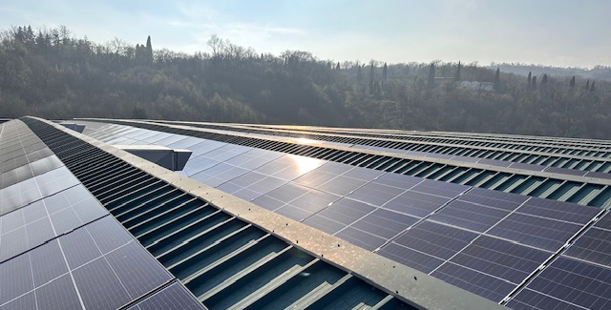
NEW INVESTMENT: the expansion of the photovoltaic system guarantees, in addition to energy savings, a production of 900 megawatts!

Slide 8
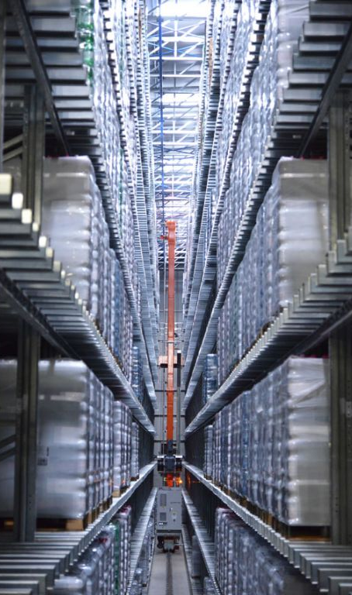
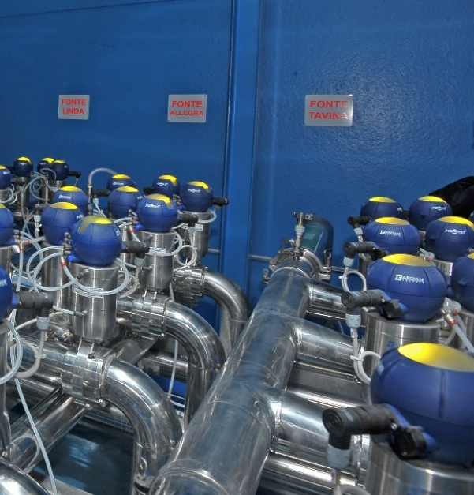
PRODUCTIVE CAPACITY & QUALITY CONTROLS
GLASS - production capacity of 50.000 bottles/hour
PET - production capacity of 60.000 bottles/hour
Beyond the directives required by law, Tavina makes further quality controls.
1st control at the spring
cooperation of a Hydrological technical Director who constantly verifies all the quality standards requested
controls on the final product, by external chemical laboratories
daily drawings and controls concerning the production process and on the finished product, by the internal biological staff
high qualified technology, e.g. the HACCP (analysis of risks and critical points of control)
  For the production process and products, Tavina has the FSSC22000, IFS and KOSHER OU-P CERTIFICATIONS.
  Every day we work to preserve the environment and the purity of our water. Our products are the result of a constant research in order to improve food safety, security and customer satisfaction.

Slide 9
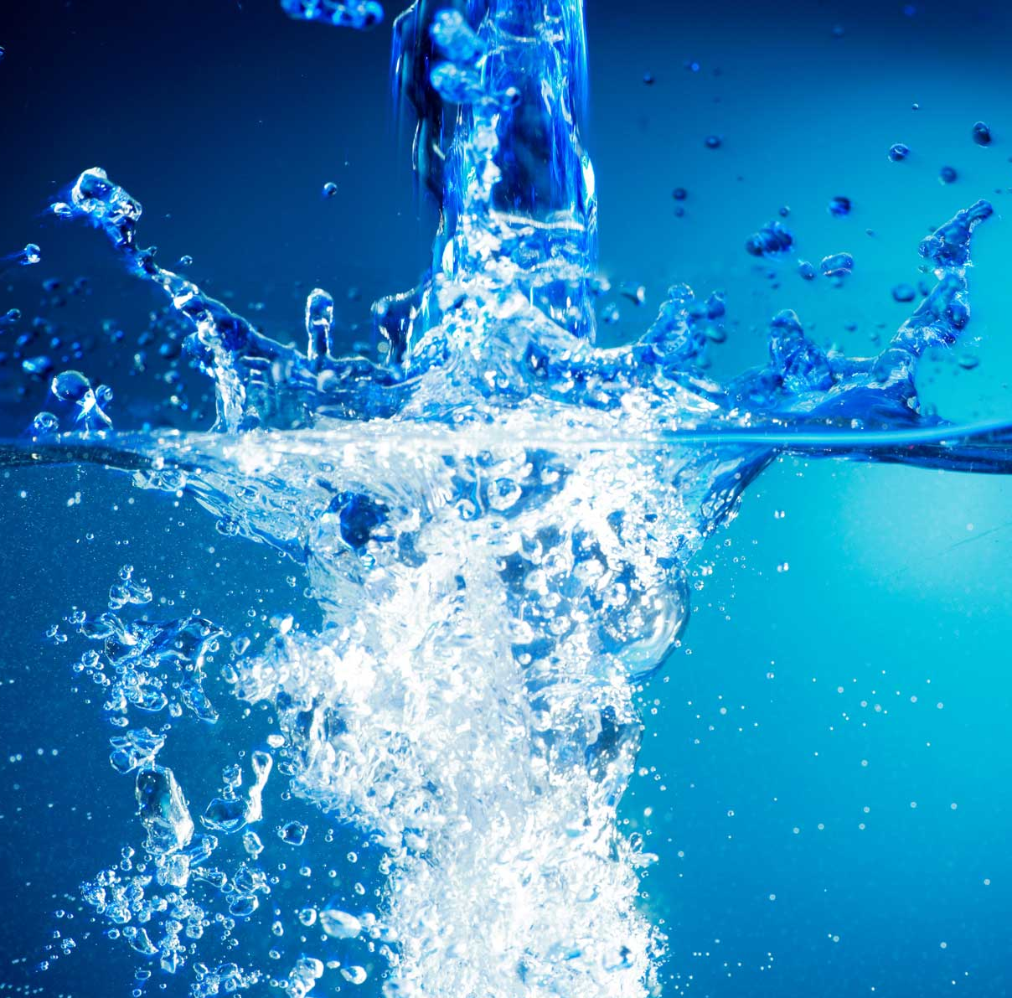
WATER, FOOD PAR EXCELLENCE
Water is the primary component of every living being as it is, on average, 60% of the body weight: so it is an essential element for proper functions of our body.
Water is a source of precious nutrients that enable the body’s physiological activities, becoming an healthy natural dietary aid. For everyone it’s very important to drink water, apart from age, sex and any medical condition.
MAIN HEALTHY MINERALS IN WATER
Calcium: bones and teeth composition, blood clotting, nerve transmission regulation, muscular contraction.
Magnesium: important for brain, nerves and muscles’ activities.
Sodium: body fluids constituent, it regulates neuro-muscular function.
Chloride: body fluids constituent, hydro-saline regulator.
Potassium: cells’ important component, it regulates nervous-muscular, cardio-vascular and gastrointestinal functions.
Sulphates: one of the constituent elements of some vitamins and proteins.
Fluoride: essential for teeth health and prevention tooth decay.

Slide 10
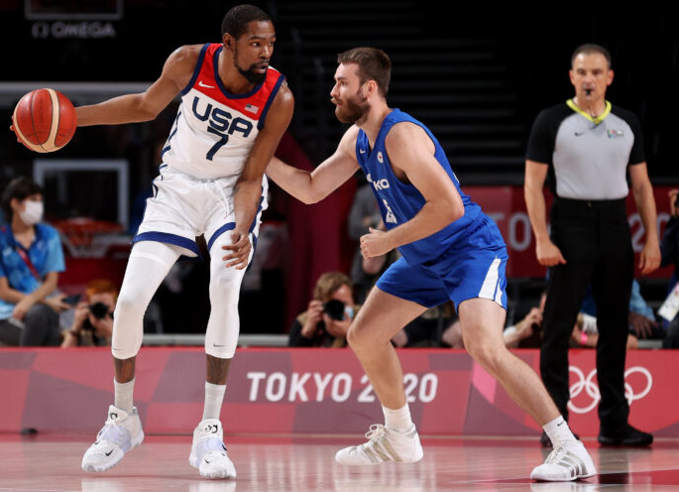







Properties
Legally recognised by the Italian Ministry of Health
Decree n. 3269 dated 12/30/1999 and n. 3478 dated 01/21/2003
Suitable for low sodium diets
Stimulates proper digestion
Suitable for new-born diet
It may have diuretic effects
Decree n. 29 dated 02/03/1993
Suitable for low sodium diets
Stimulates proper digestion
It may have diuretic effects
Decree n. 3282 dated 01/21/2000 and n. 3961 dated 04/26/2010
Suitable for low sodium diets
Suitable for infants’ food preparation
Quality controls
It may have diuretic effects
Decree n. 4168 dated 19/01/2015
Particolary pleasant for its mineral composition, good taste end healthy
Suitable for low sodium diets

Slide 11

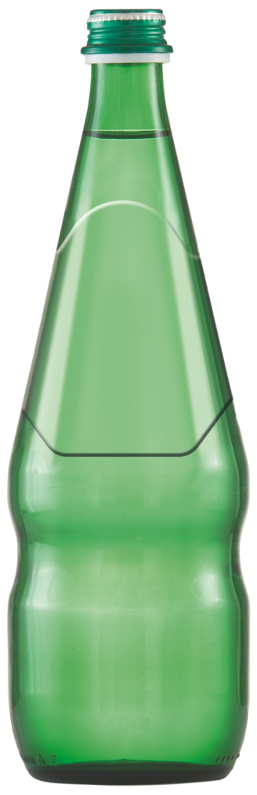
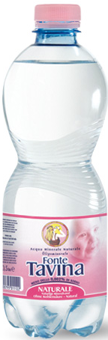
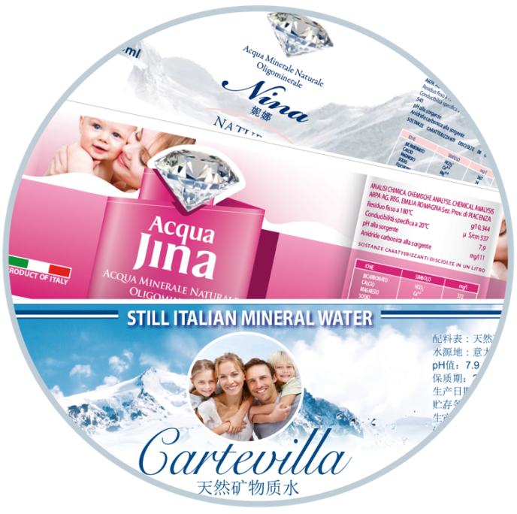
PRIVATE LABEL?
Customize your label
as you like!

Slide 12
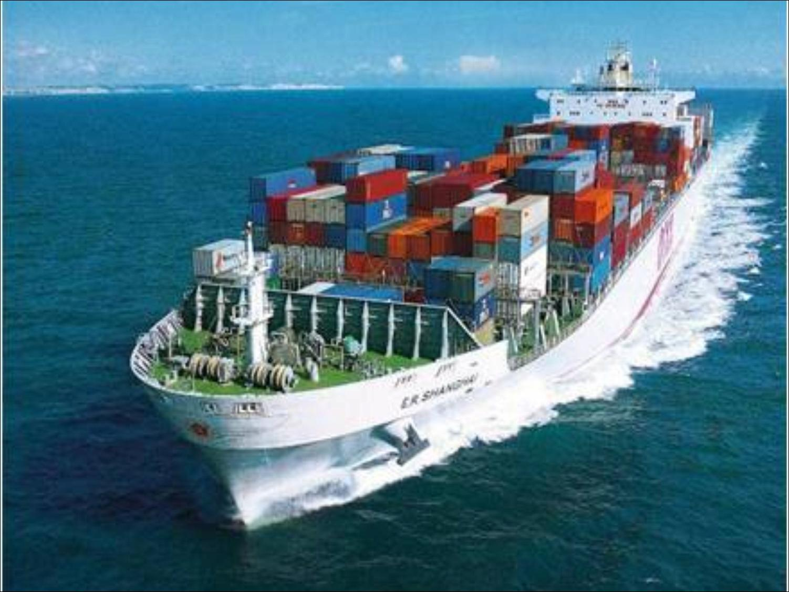
The logistic service is one of Tavina’s strengths: always punctual and efficient, it ensures the best success for both customer and company.
Tavina can also easily guarantee the traceability of all its products.

Slide 13

















MAIN CUSTOMERS

Slide 14

Tavina S.p.A.
Rot. Cav. Amos Tonoli, 2
25087 Salò (BS) – ITALY
Vat number: 00569100985
Romina Ricchini
Export. Dept.
Tel 0365/441530 Fax 0365/441566
email: fonte@tavina.it
Skype: rominatavina

