Slide 1

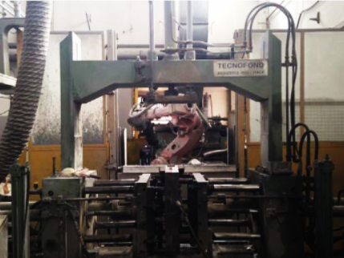
FONDERIA L.E.A. SRL
Founded in 1998, L.E.A. Foundry, boasts an accomplished tradition in
aluminium die gravity casting

Slide 2
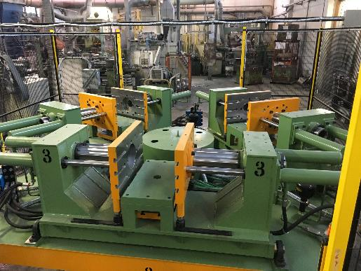
FONDERIA L.E.A. SRL
PROCESS
MOLD DESIGN AND IMPLEMENTATION
Starting from the 3D design we create the mold which is produced by partner companies with whom we established an interchange of know-how
CASTING
ALUMINIUM DIE GRAVITY CASTING
ALUMINUM DIE CASTING FOUNDRY
2 holding furnaces
3 melting furnaces
Melting capacity 1000 kg /hour and able to merge different types of aluminium
4 islands, two robotized, equipped with 10 overhead gravity casting

Slide 3
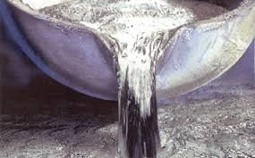
FONDERIA L.E.A. SRL
ALLOYS
EN | EN e ISO | UNI (Italia) | DIN (Germania)
EN AC 42000 | Al Si 7 Mg | UNI 3599
EN AC 42100 | Al Si 7 Mg 0,3 | UNI 8024 | G Al Si 7 Mg
EN AC 42200 | Al Si 7 Mg 0,6 | UNI 8392 | G Al Si 7 Mg
EN AC 43100 | Al Si 10 Mg (a) |  | DIN 239 A
EN AC 47000 | Al Si 12 (Cu) |  | DIN 231 A
EN AC 44100 | Al Si 12 (b) | UNI 4514 | DIN 230.1
EN AC 46400 | Al Si 9 Cu 1 Mg | UNI 7369/3

Slide 4
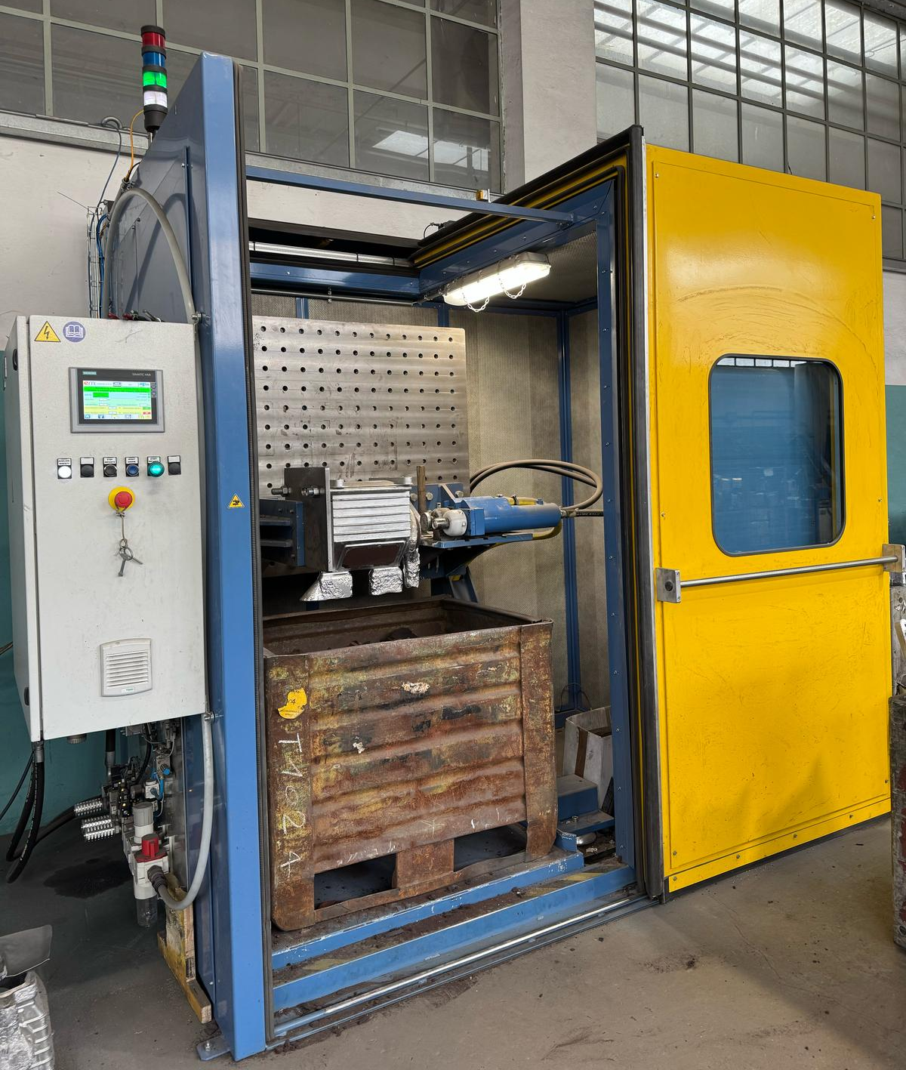
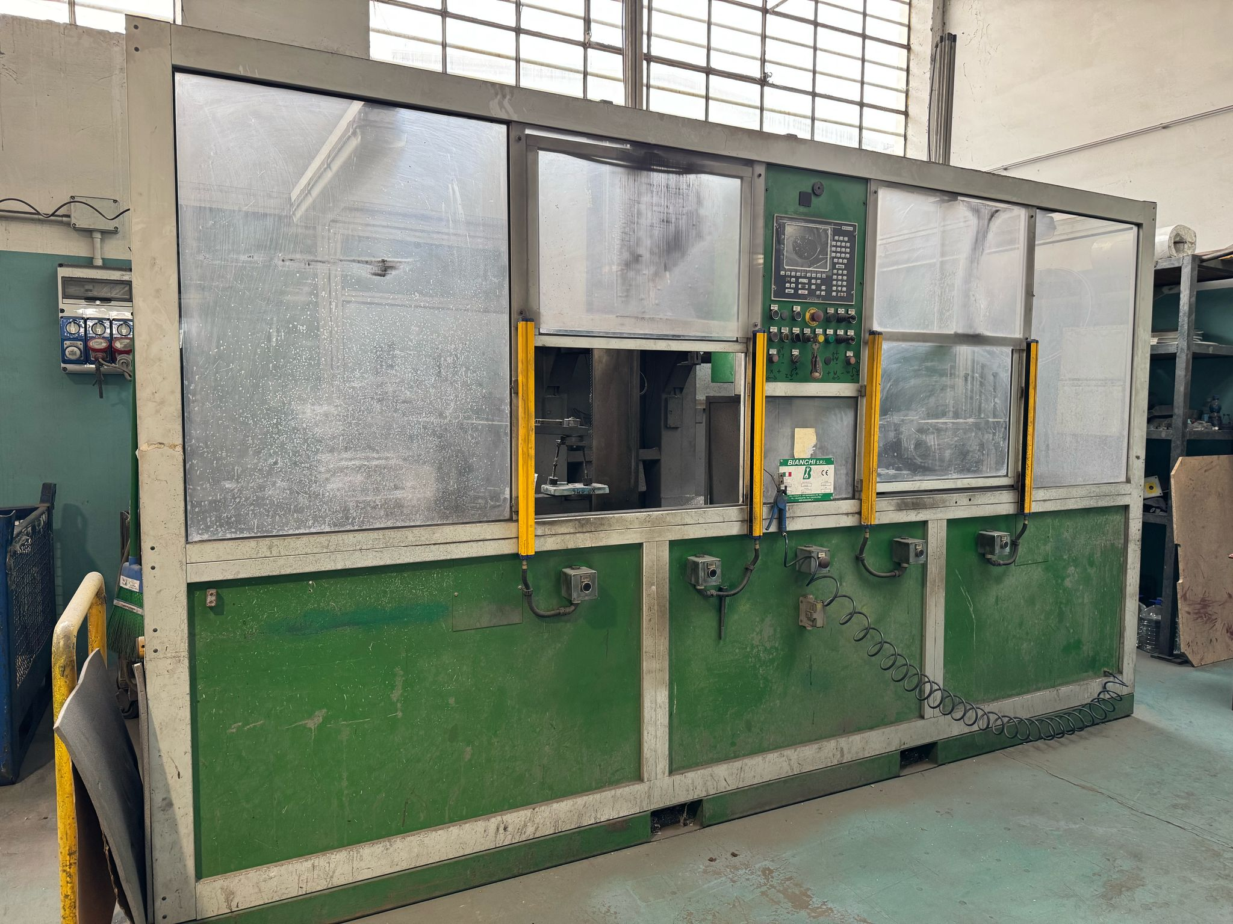
FONDERIA L.E.A. SRL
PROCESSING
CUTTING – GRINDING - BURRING
In the finishing department, procedures such as cutting, grinding, and deburring, in order to eliminate possible burrs in excess.
MACHINING – PAINTINGS - SURFACE TREATMENTS
According to customer's design, we provide machining of the parts.

Slide 5
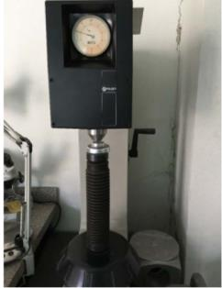
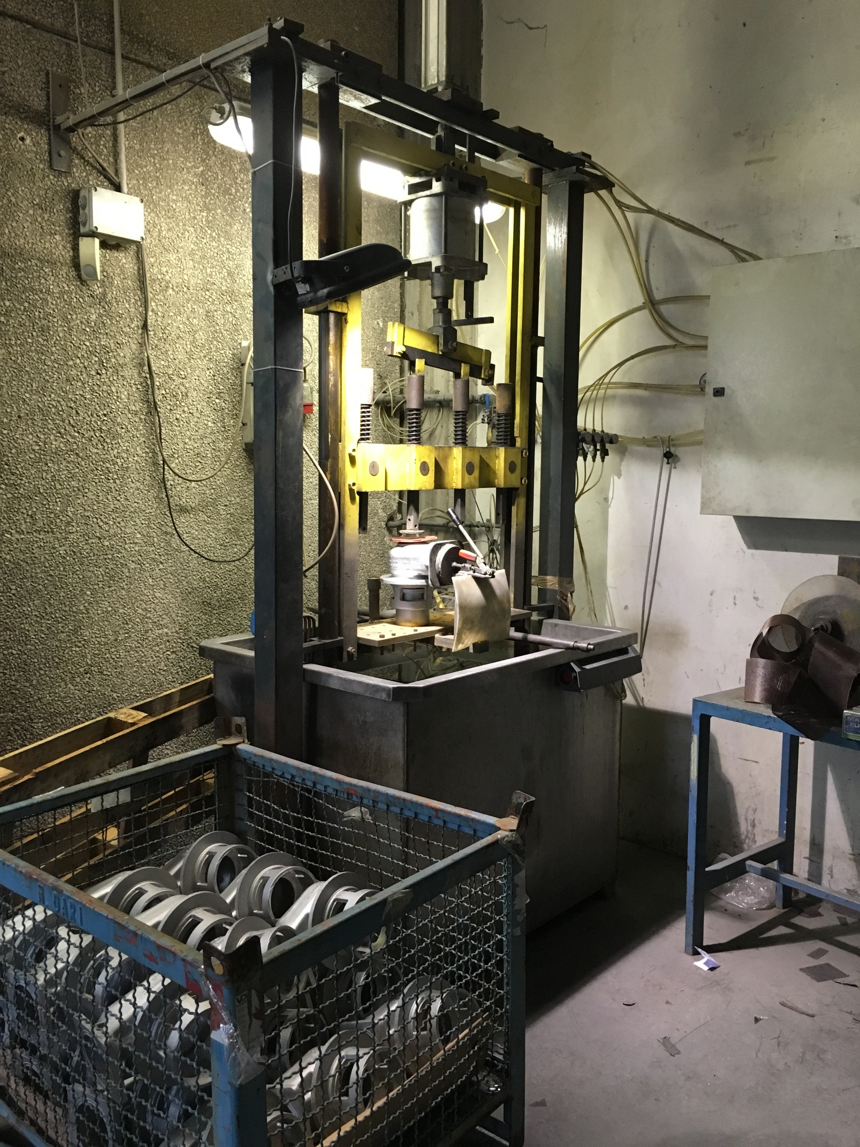
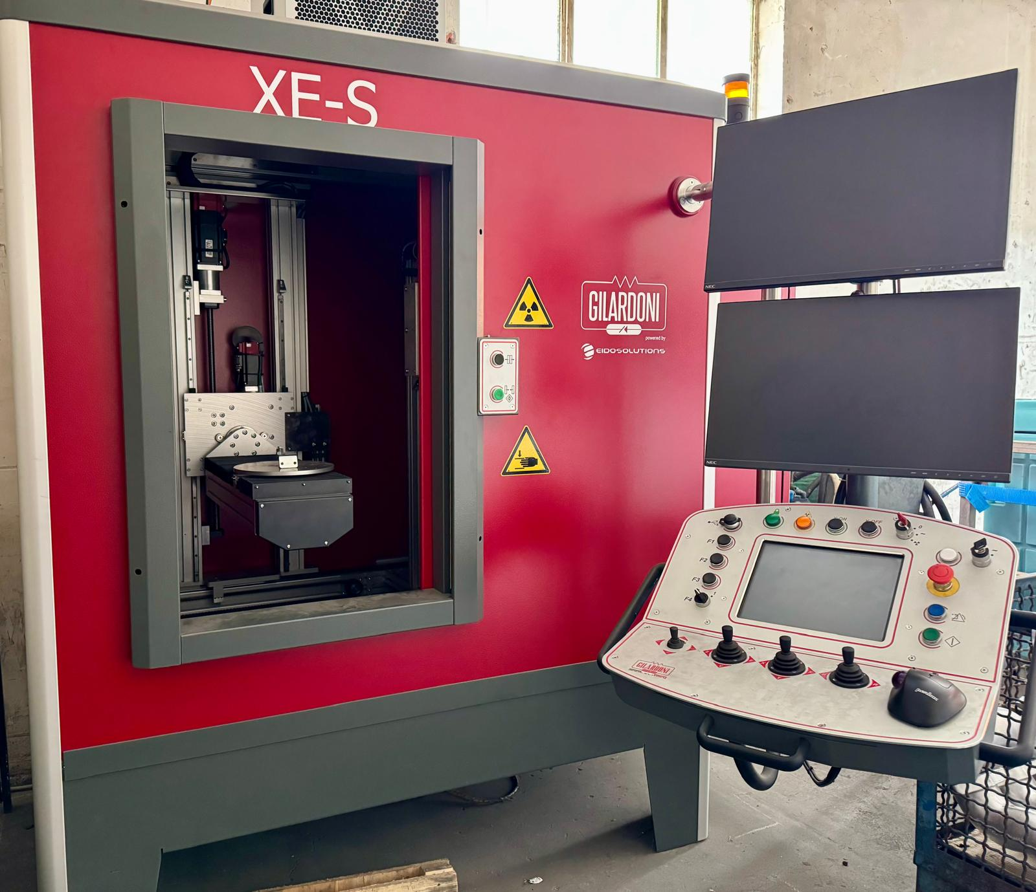
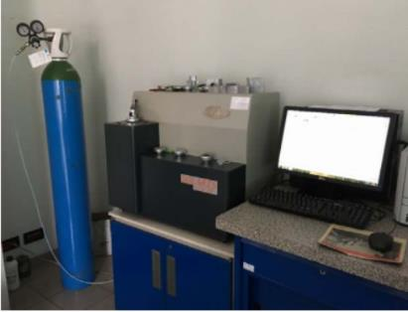
FONDERIA L.E.A. SRL
QUALITY
Our internal lab as regards both the quality and the structure of castings
LEAK TESTS
X-RAY
CHIMICAL ANALYSIS
HARDNESS TEST

Slide 6
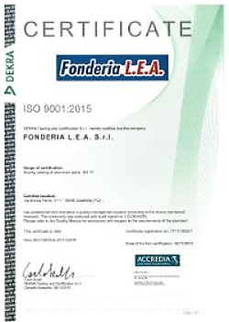
FONDERIA L.E.A. SRL
CERTIFICATIONS
We are certified ISO 9001:2015
ISO 9001 - Quality Management ensures that products and services consistently meet customer’s requirements, and that quality is consistently improved.

Slide 7
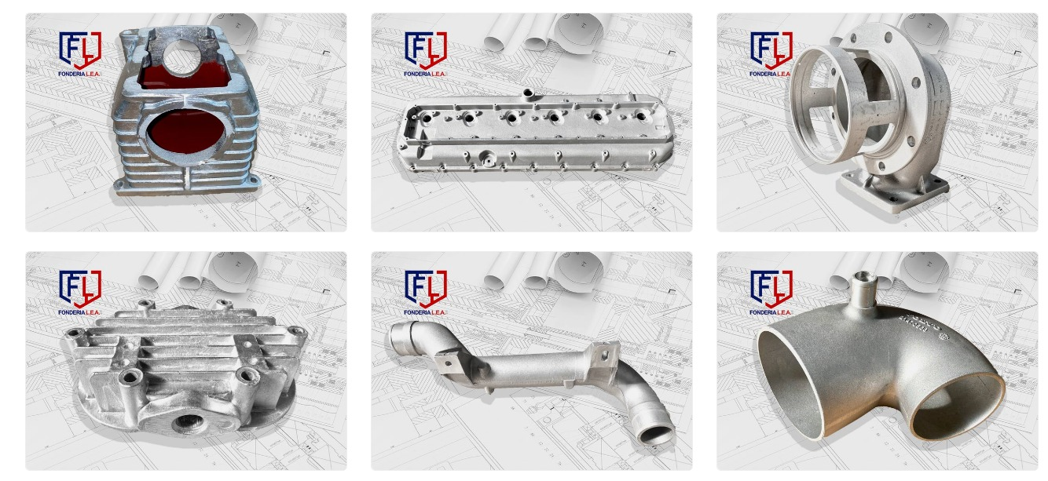
FONDERIA L.E.A. SRL
PRODUCTS
CARTER FOR COMPRESSORS
ENGINE HEAD COVER
VALVE BODY
HEAD FOR COMPRESSORS
COLLECTOR FOR HEAVY TRUCK
COLLECTOR FOR HEAVY TRUCK

Slide 8
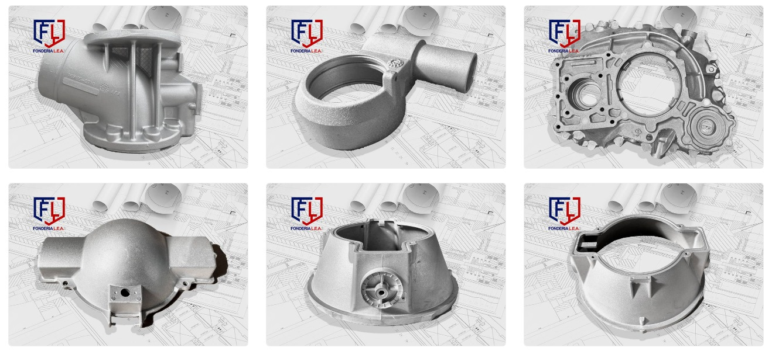
FONDERIA L.E.A. SRL
PRODUCTS
COMPRESSOR VALVE HOUSING
BREAK CYLINDER
GEARBOX
LAMP BODY
LAMP BODY
LAMP BODY

Slide 9
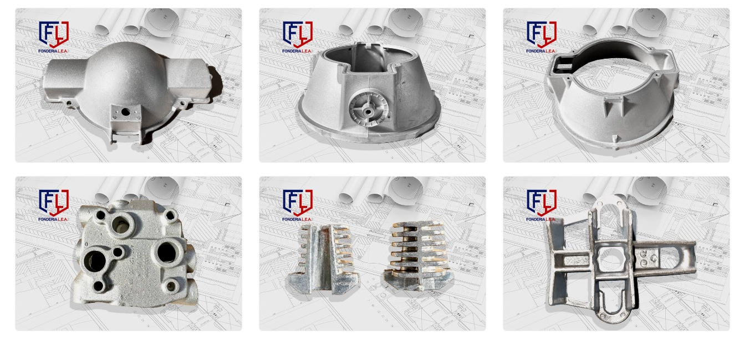
FONDERIA L.E.A. SRL
PRODUCTS
COMPRESSOR BODY
TELEPHONE CABLE CLAMPS
TELEPHONE CABLE CLAMPS

Slide 10










FONDERIA L.E.A. SRL
CUSTOMERS

Slide 11







FONDERIA L.E.A. SRL
REFERENCES
TIER 2

Slide 12
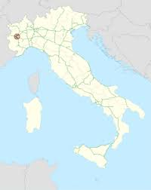
FONDERIA L.E.A. SRL
CONTACTS
Fonderia L.E.A. srl
Via E. Fermi, 4
10040 Caselette (Torino)
Tel. +39 011.968.86.91
Mail: info1@lea.it
Website: www.lea.it
Lanzo Emanuele Alberto
Technical Dept.
Tel. +39 346.22.82.872
Mail: info1@lea.it

