Slide 1
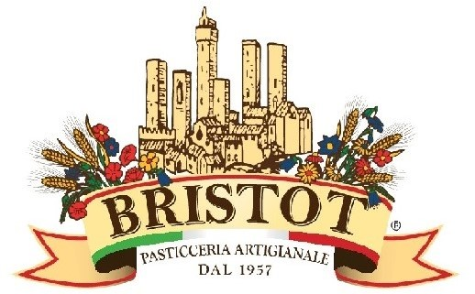
Italian Fine Pastry

Slide 2
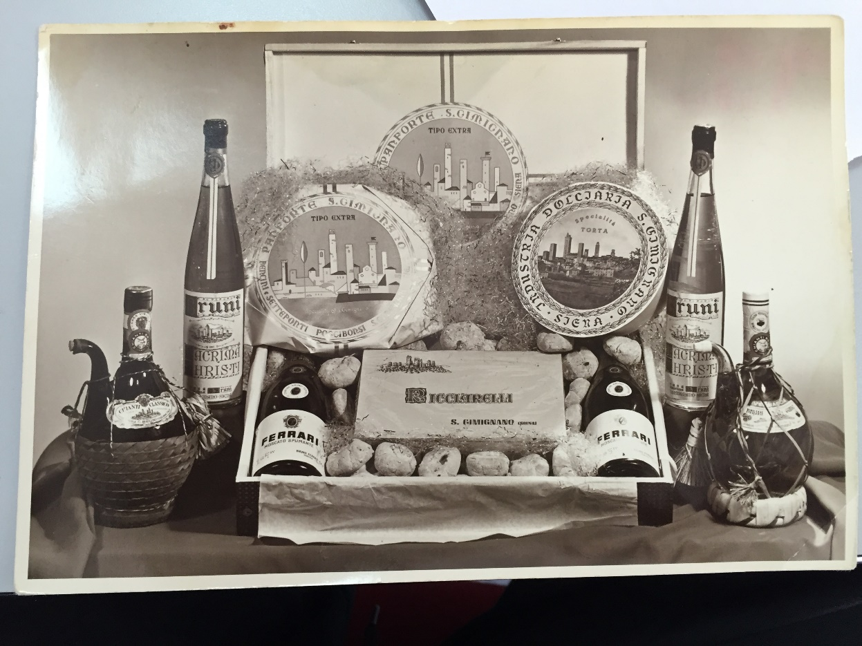
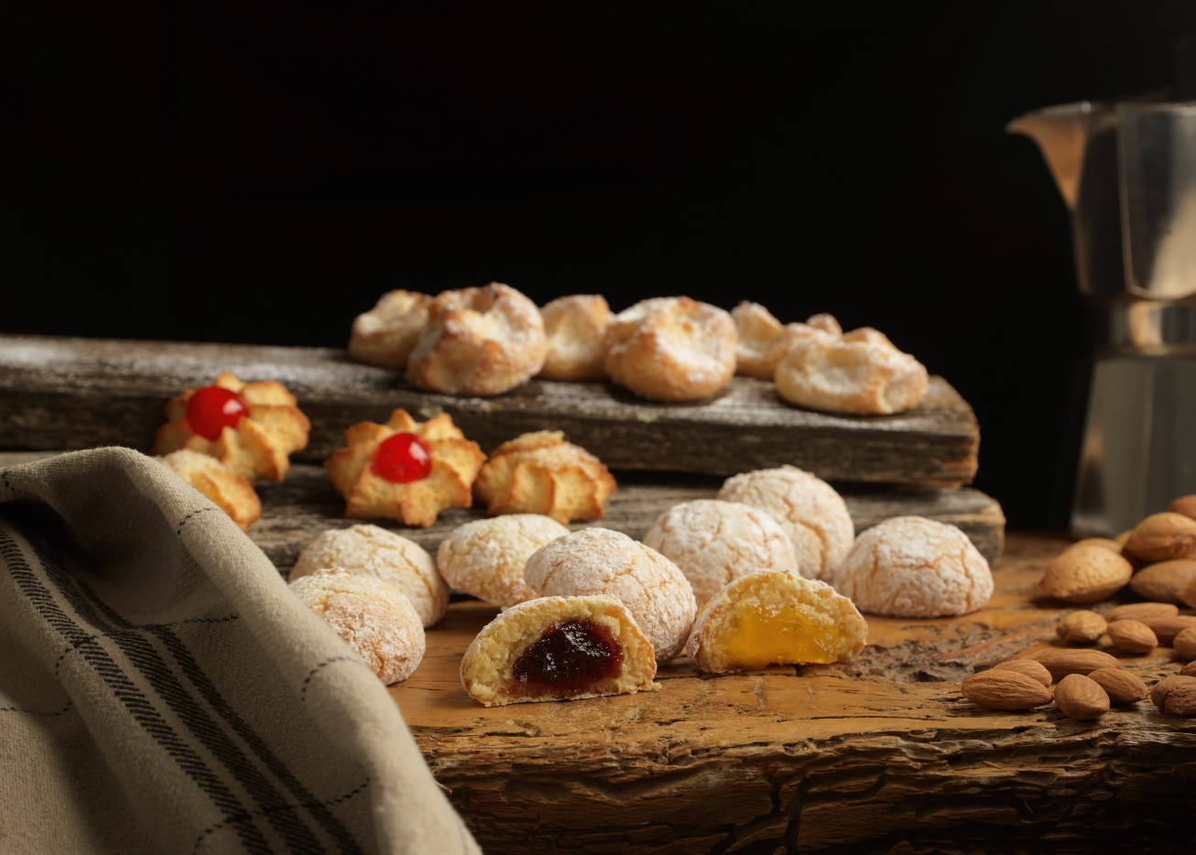
Well-made products, timeless good taste
From 1957 to Now

Slide 3
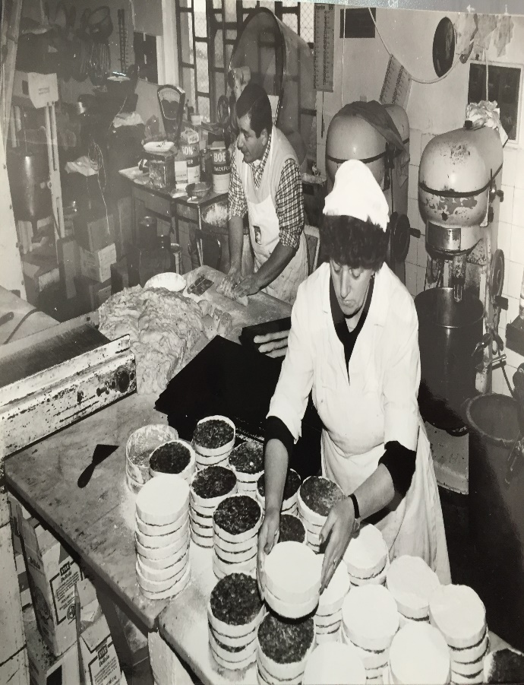
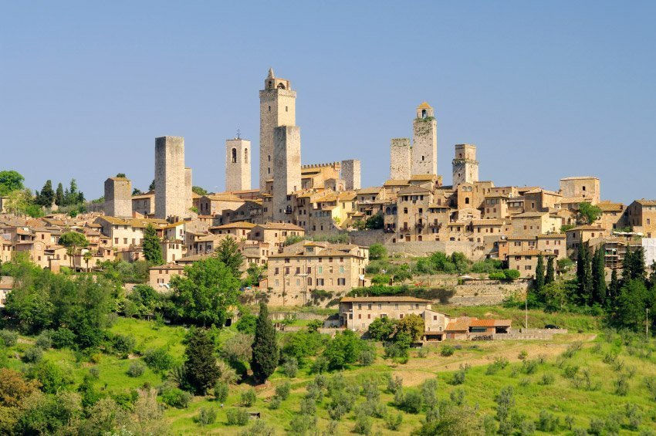
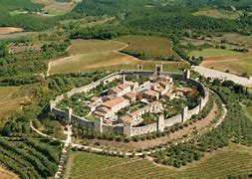
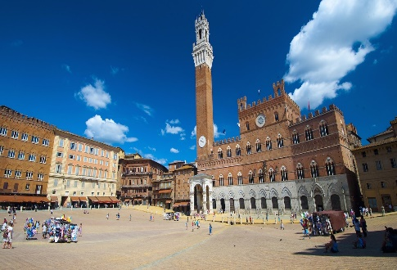
The Tradition of our Land is our Future
A Beautiful Land
News from the past
Tuscany has had from ever a strong traditional farmer colture mainly in the food. Mainly in Siena, the tradition developed many kind of sweets as Cantuccini, Ricciarelli and Cavallucci, all of that was the resoult of old recipes made from ancient pharmacists called SPEZIALI. Some of those secret recipes are arrived to us and we custody gelously inside our products.
In San Gimignano, 1957, together with two partners, Giosuè Settefonti established a bakery that produced typical cakes and of the Siena area, and specialised in special occasions.
It was called the INDUSTRIA DOLCIARIA.
It changed its name to BRISTOT just a few years later, in 1963, when the business was joined by a wealthy grandson of Giosuè, whose surname was BRISTOT. In the years that followed, the company worked, prospered and grew until 2012, when I took on the burden and the honour of continuing to run this very traditional bakery that churns out cakes and savoury products using manual skills and techniques that have been passed down through the ages.
Gianni Pieragnoli

Slide 4
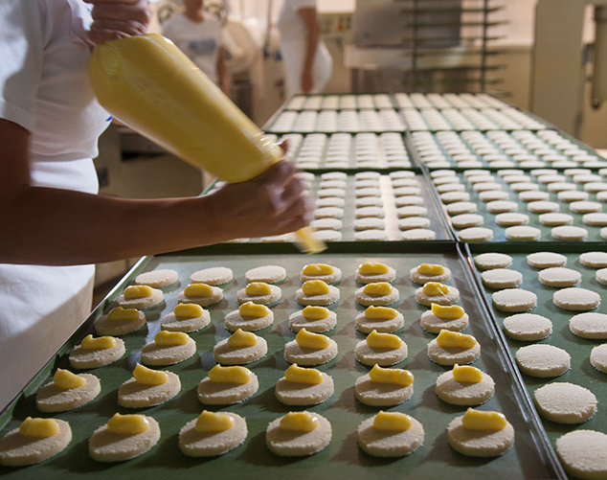
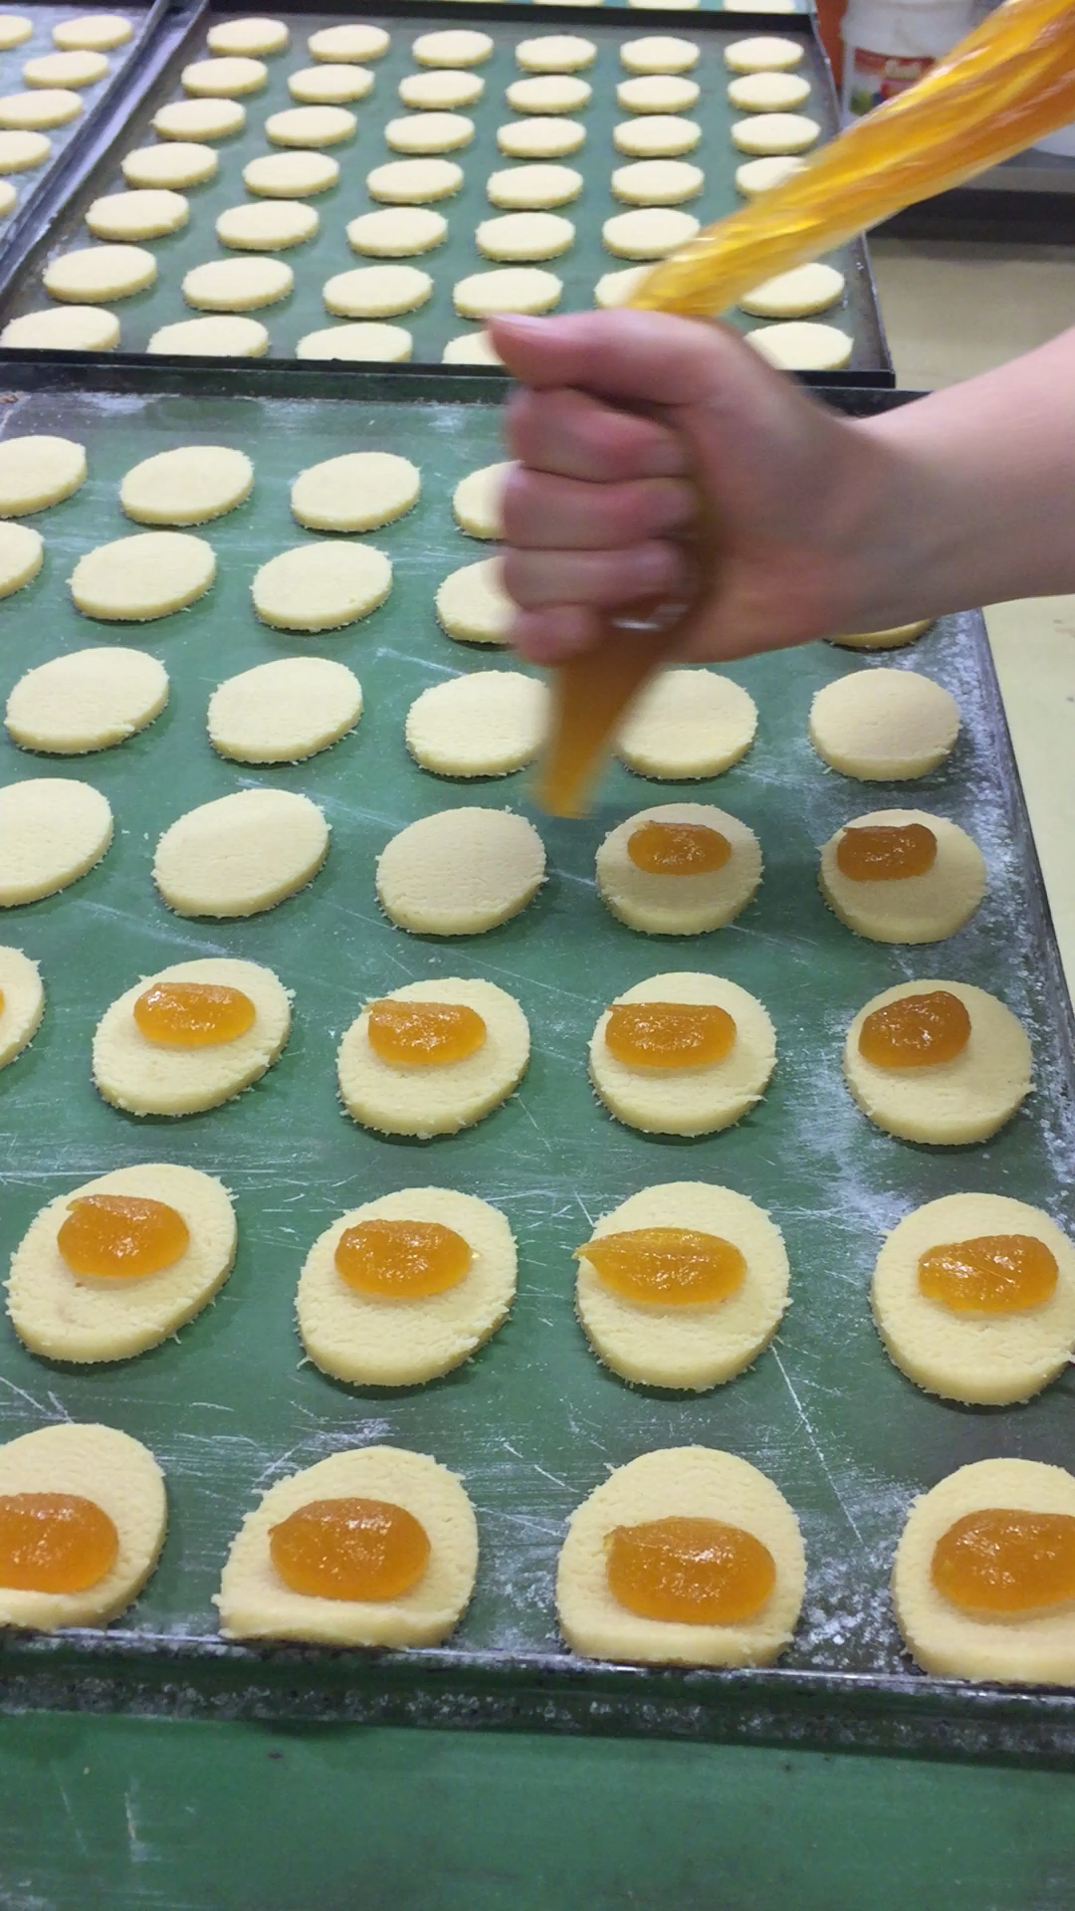
The Filling
One of the most important passage in our products is the filling, not too much but not too little, the right quantity is the sicret to optain the perfect balance for a small daily masterpiece!!
Take a Look!!!

Slide 5
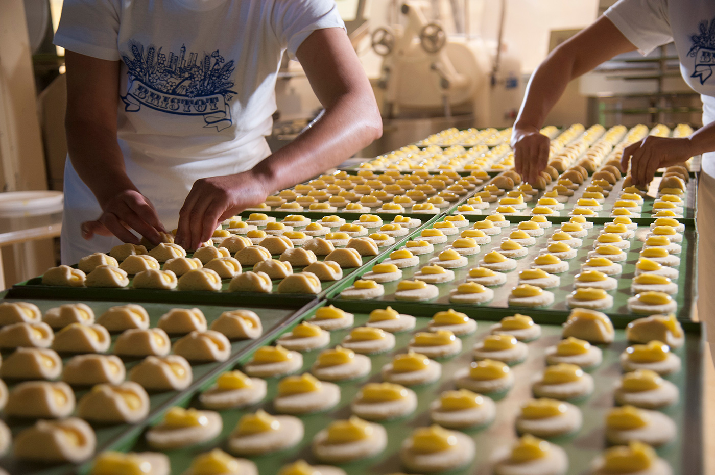
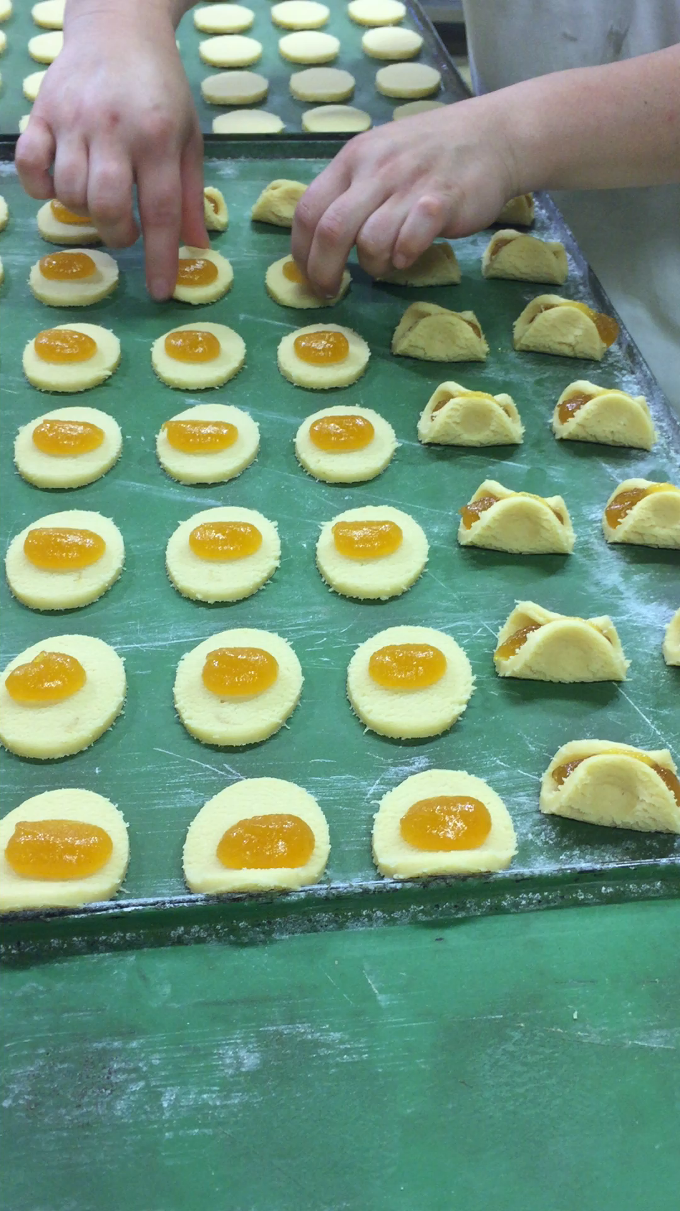
The Molding
This process is liberally inspired to biodiversity, as the humans are simiral but at the same time different, our biscuits are similar but, because molding by hands, aren’t identical.
Is the magic of the nature.

Slide 6
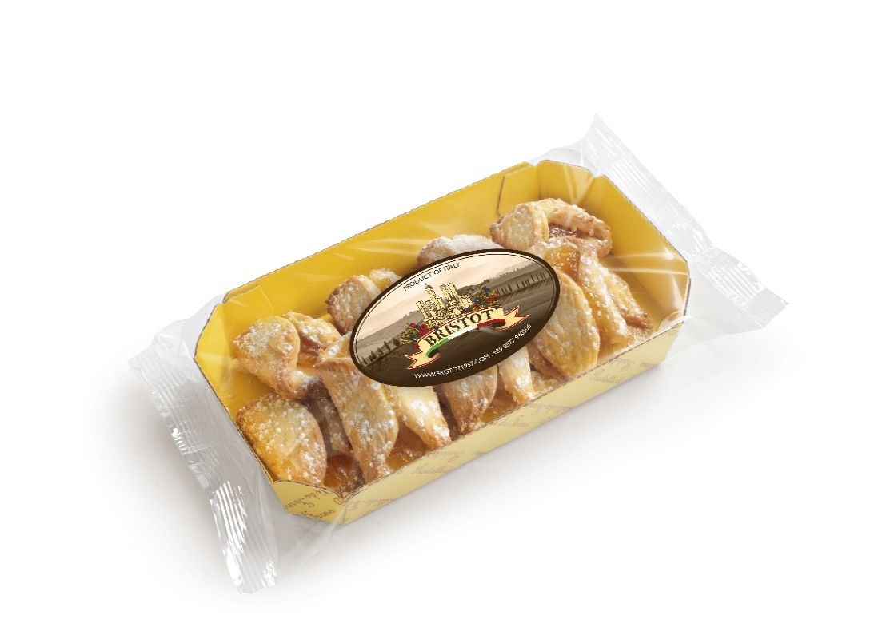
Bauletti Albicocca – Shortcrust with Apricot jam
Fine and soft pastry with italian flour, honey and butter, filled with Apricot jam composed by 45% of fresch fruit, sprinkling of powdered sugar on the top!

Slide 7
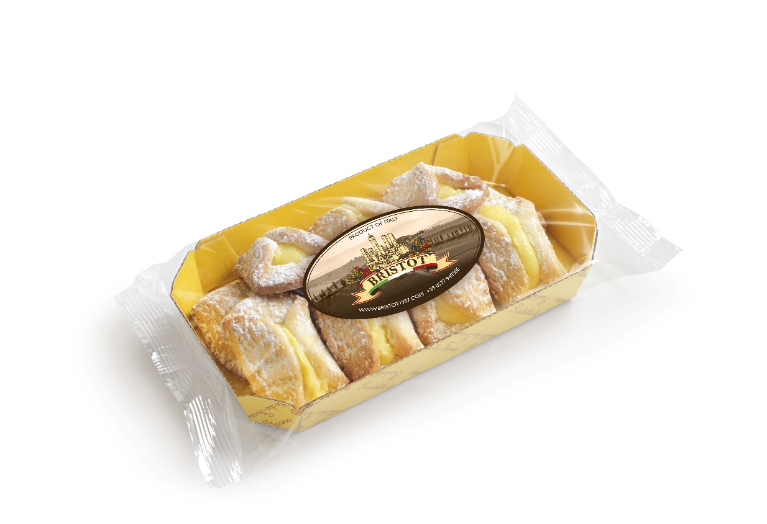
Bauletti Limone - Shortcrust with Lemon Cream
The sun in the south of Italy helps to have the most good fragrance of lemon, suitable with a cup of tea.

Slide 8
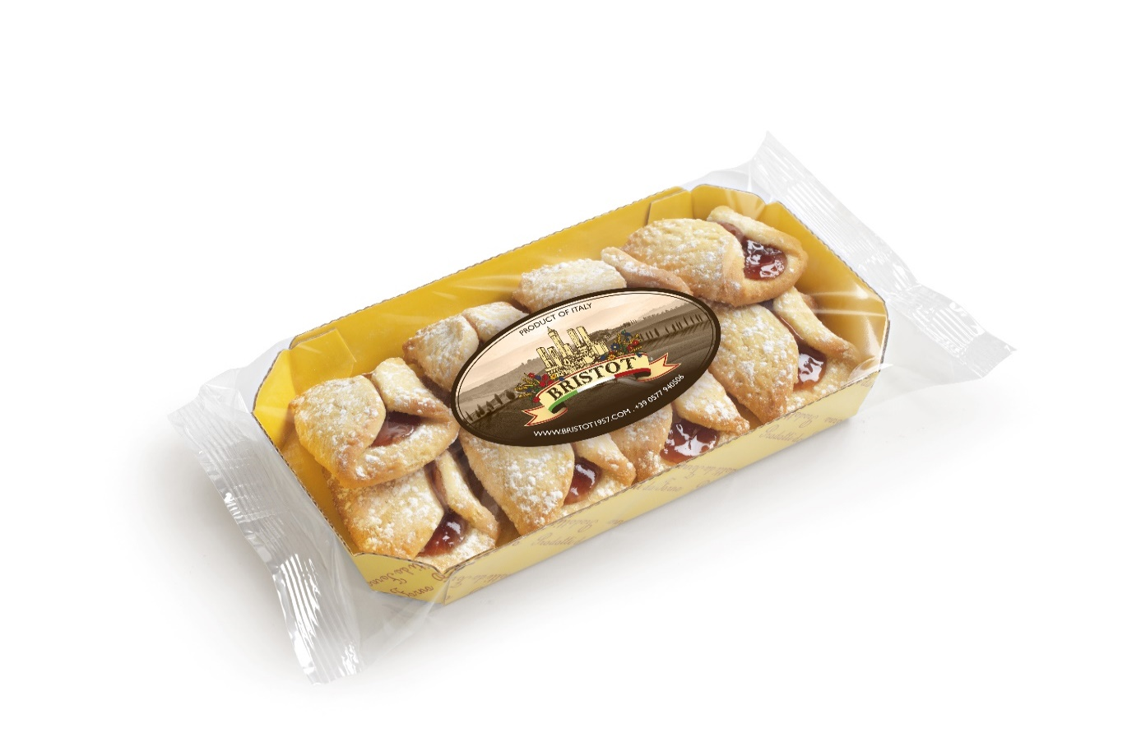
Bauletti Hazelnut – Shortcrust with Hazelnut Cream
This is one of the bestseller products in our range, hand filled biscuits with a great quality cream contains 40% hazelnut, cannot miss in a italian breakfast

Slide 9
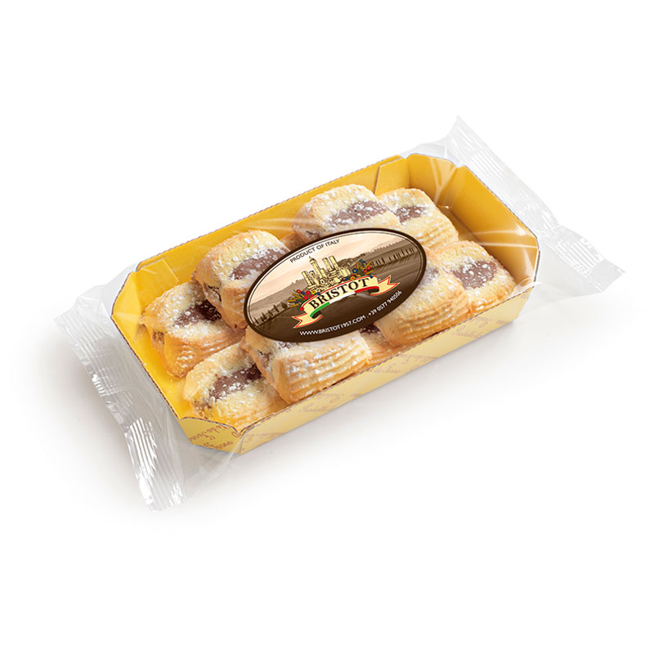
Cuscini Hazelnut – Shortcrust with Hazelnut Cream
Handmade work of art, into the heart of biscuits you can find the creamy hazelnut the taste melts in your mouth!

Slide 10
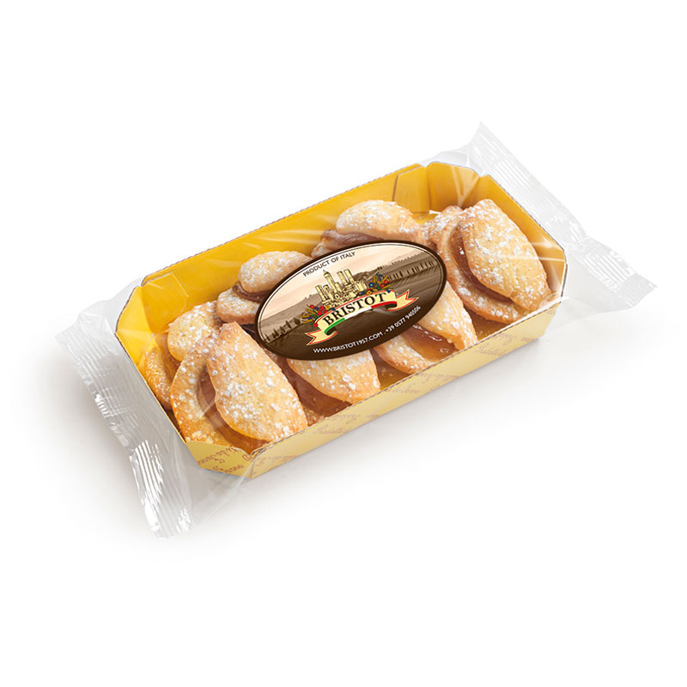
Fagottini Mela – Shortcrust with Apple Jam
This biscuits shell-shaped encloses a special Apple jam come from the Dolomites montain, Unesco world heritage site. Enjoy flavour of freschly picked apple.

Slide 11
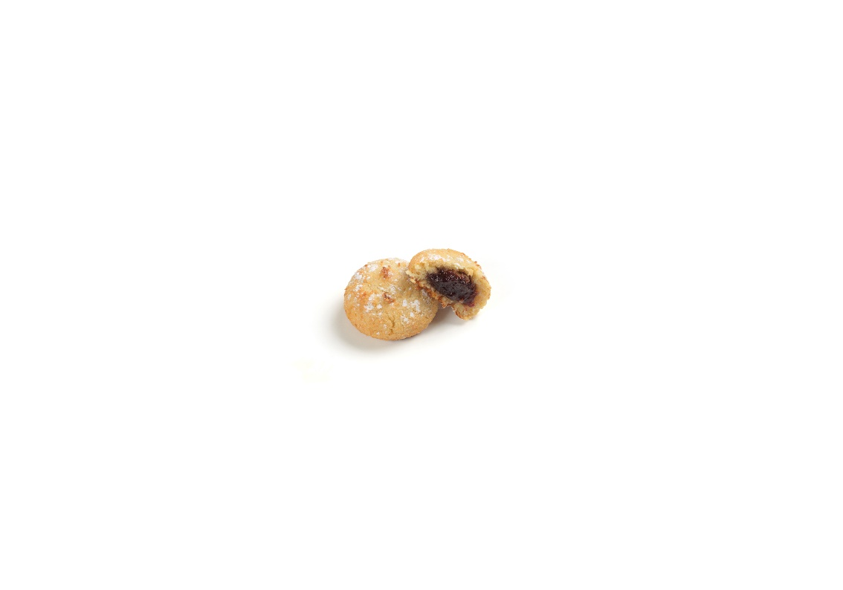
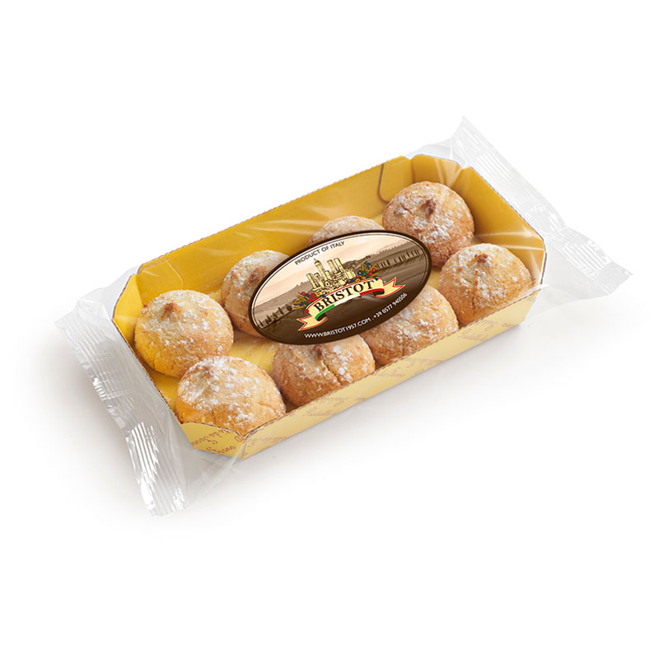
Maraschini Cherry – Almond paste filled with Cherry Jam
Rich in Almonds 10% a softly paste with a red secret inside, and everybody know the red is the colour of passion, our passion is a 45% cherry jam

Slide 12
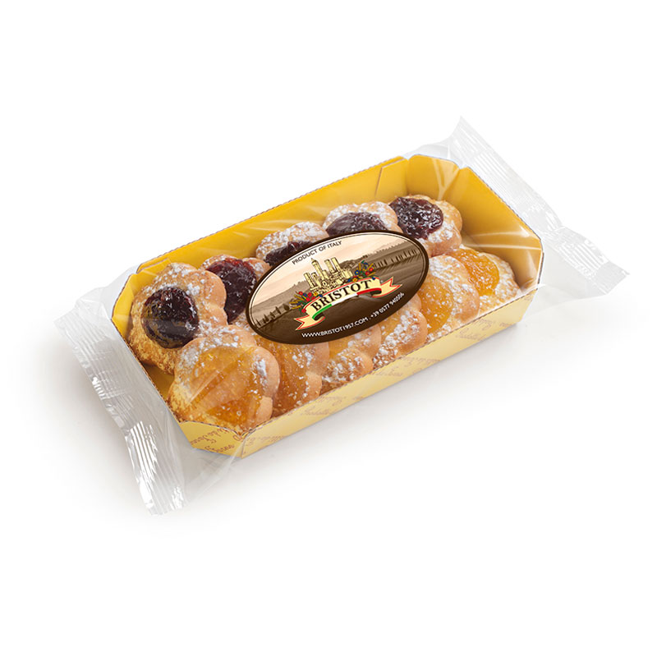
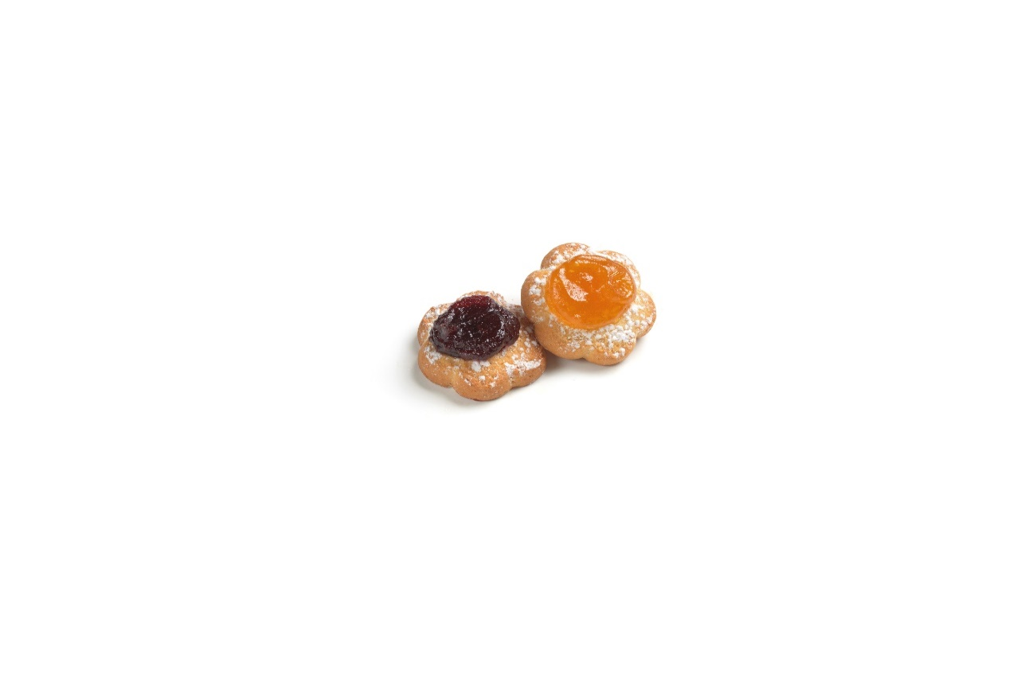
Margherite – Biscuits with apricot and cherry jam
Doulbe flavour in the same pack, flour, eggs, magarine, cherry and apricot jam you chose your favorite one

Slide 13
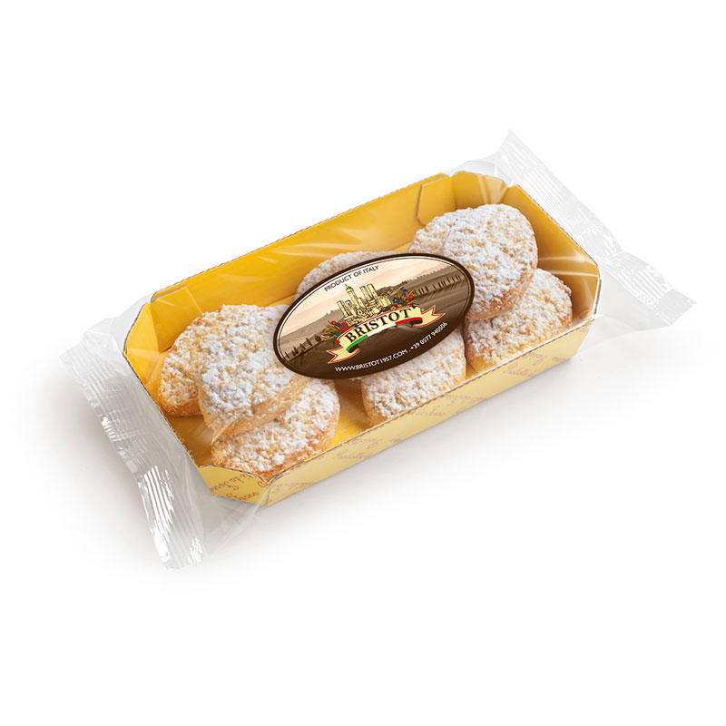
Ricciarelli – Almond paste
The older of Tuscany traditional sweets, its name is Ricciarelli, first quality almonds mixed with white eggs, levening for 1 hour for the perfect softness.

Slide 14
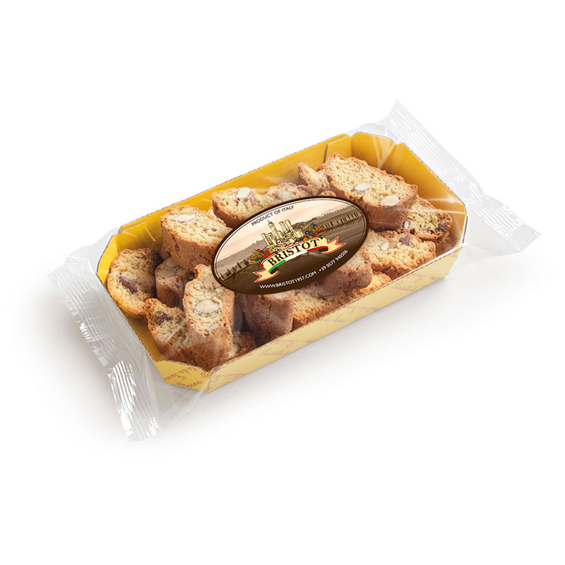
Cantuccini – Typical Italian Biscuits
The most famous italian cookies with 25% of whole almond rosted this product could be thinked like a pass in the past, it was used during the trade travel, in the middle of Medieval time, exactly like a snack.

Slide 15
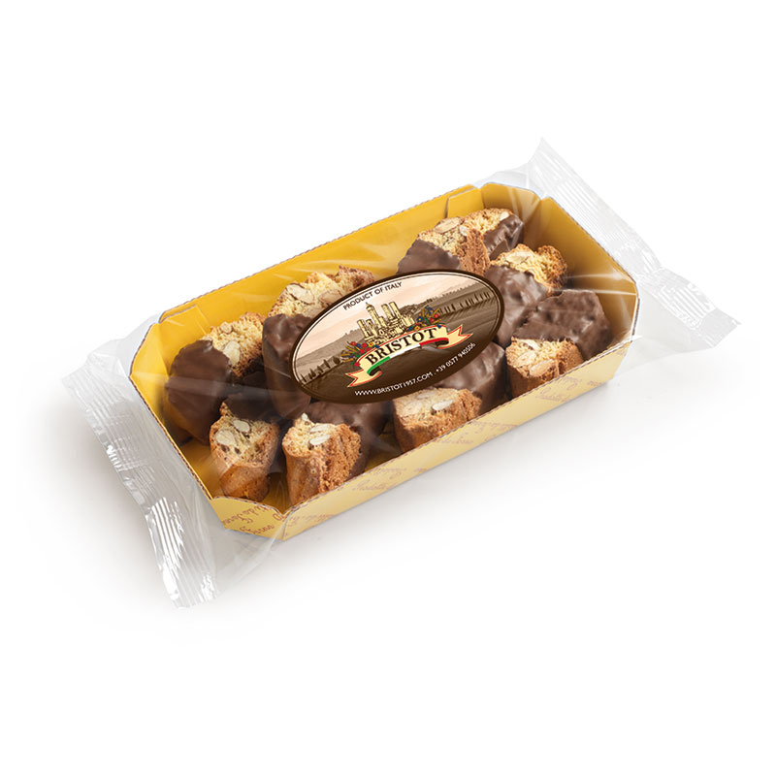
Cantuccini Ciok – Coated Cantuccini
The most famous italian cookies with 25% of whole almond rosted renewed in a new version with choccolate coating

Slide 16

Logistic Details
Boxes composed by 6 sell unit
Pallet composed by 260 boxes
Leyer for pallet 20
Boxes for leyer 13
Pallet per container 20’ 10pallet
Pallet per container 40’ 21pallet

