Slide 1

A BRIEF OVERVIEW
OF OUR COMPANY

Slide 2
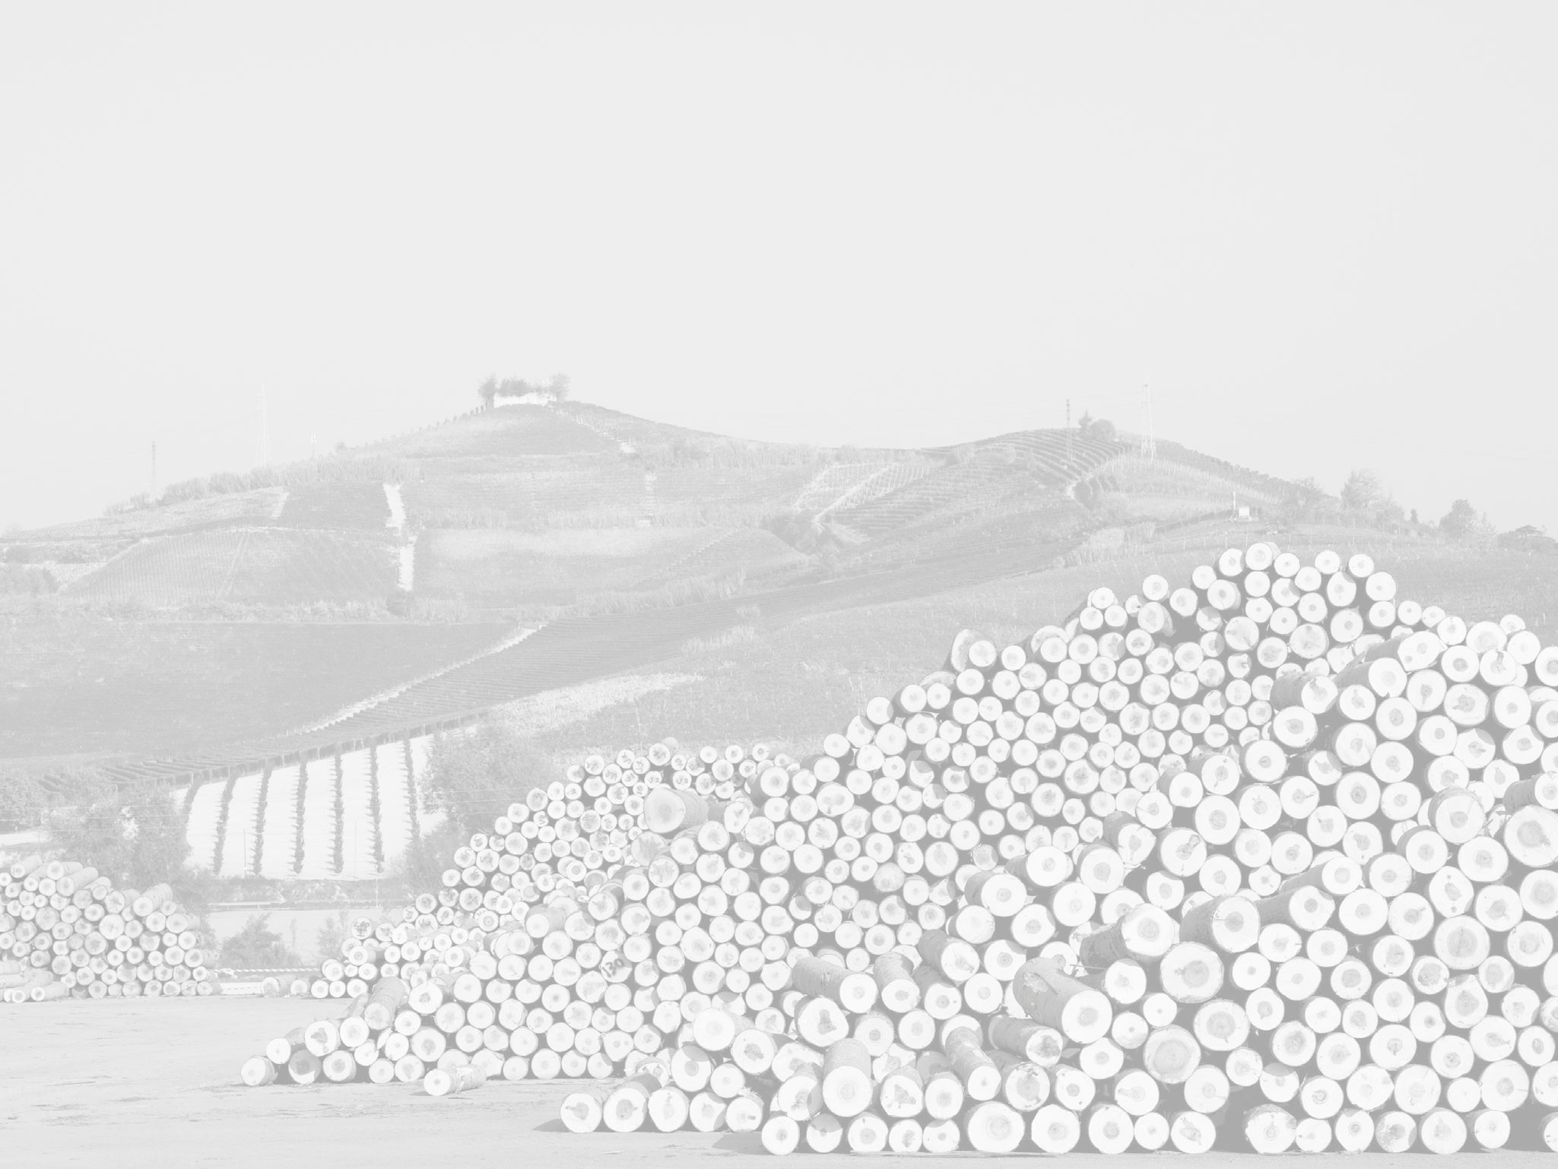
FIVE GENERATIONS IN THE WOOD SECTOR

Slide 3
VISION
Producing and supplying special lightweight panels, in high quality natural materials, in a workplace that inspires people to dare, respecting environmental and social themes and values.

Slide 4



OUR LOCATIONS
HEADQUARTER
COMMERCIAL DIVISION USA\CANADA
E. Vigolungo North America Inc. 4999 36th St SE
Grand Rapids, MI 49512 www.vigolungo.com
E. Vigolungo SpA
C.so F.lli Maccagno 25 12043 Canale (CN) - Italy www.vigolungo.com

Slide 5
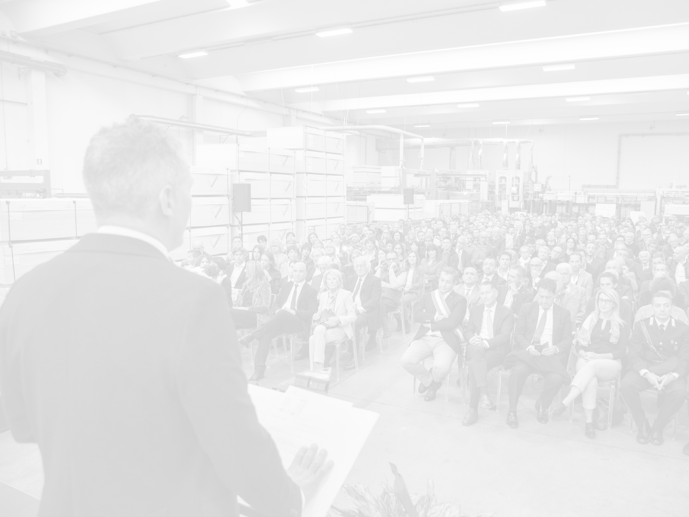



A CENTURY - OLD
FAMILY HERITAGE
Opening of new office in Grand Rapids - USA
Little workshop of Giovanni Vigolungo in Benevello (CN)
Opening of
the first mill
in Canale (CN)
Acquisition of
END OF
1947
MID
1800
1919
1960
2006
2010
2024
Pietro Vigolungo moved to Borbore (CN)
First production
of plywood
Opening of
the new mill
In Canale (CN)

Slide 6











TURNOVER AND PEOPLE TREND
50.000.000 €
45.000.000 €
146
EMPLOYEES
163
EMPLOYEES
40.000.000 €
152
EMPLOYEES
35.000.000 €
144
EMPLOYEES
139
123
EMPLOYEES
133
EMPLOYEES
EMPLOYEES
138
EMPLOYEES
30.000.000 €
136
EMPLOYEES
25.000.000 €
114
EMPLOYEES
106
EMPLOYEES
20.000.000 €
15.000.000 €
10.000.000 €
5.000.000 €
0
2013
2014
2015
2016
2017
2018
2019
2020
2021
2022
2023

Slide 7

EXTRA EU
EU
OUR SALES MARKET
Italy/The Netherlands/ Belgium/France/Germany Spain/Greece/Austria Romania/Slovenia Malta/Lithuania Poland/Estonia
USA/United Kingdom Albania/Switzerland Turkey/Israel
South Korea New Zealand

Slide 8
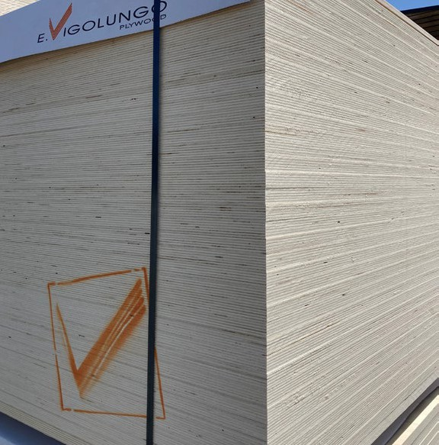
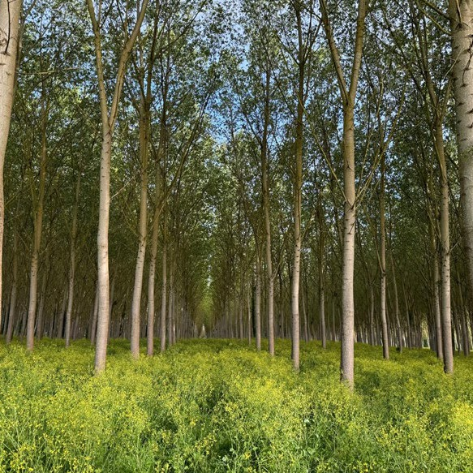
PRODUCTION PROCESS
FROM A TREE TO
A PLYWOOD PANEL

Slide 9
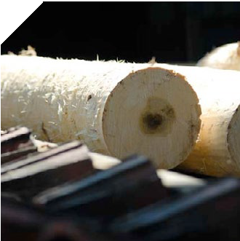
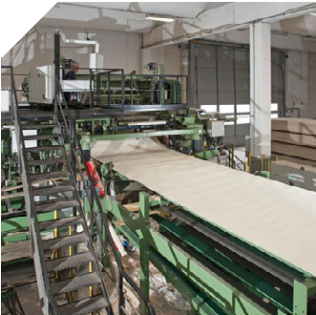
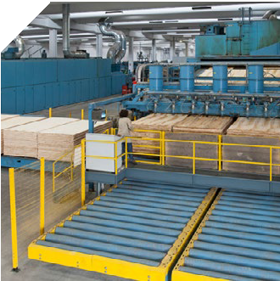
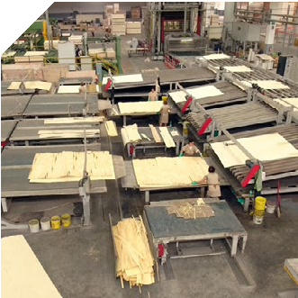
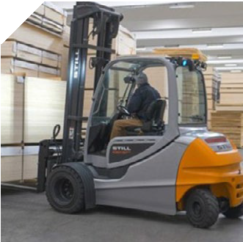
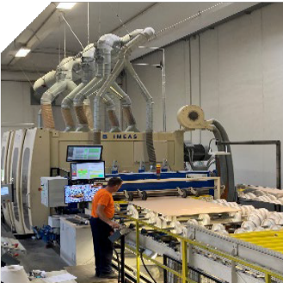
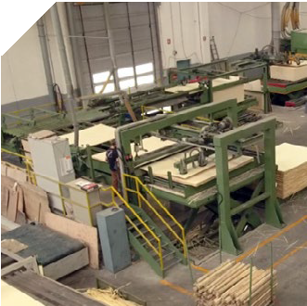
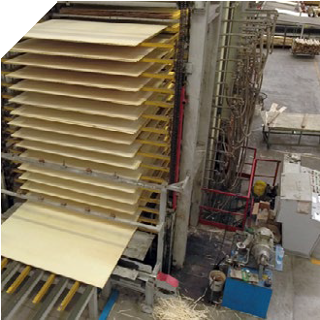
DE-BARKING
The tree bark is automatically stripped off by a rotating knives device.
VENEER CUTTING
After the bark has been stripped
off, the log gets peeled and cut
according to the required
thickness creating the so-called veneers.
DRYING
The veneers are taken into a dryer
which drastically reduces their
moisture. When they come out,
a preliminary selection is carried
out based on aesthetic,
qualitative and technical characteristics.
3
COMPOSITION
A “mattress” of veneers is obtained
by the superimposition of the odd veneers (without glue) with the even ones (with glue).
1
2
4
9
7
6
5
DELIVERY
SANDING
SQUARING
PRESSING
After being properly packed up,
the product is ready to be delivered to the customer.
Both faces of the panel are sanded
and gauged in order to eliminate
superficial defects and get the
required thickness.
Then a further selection is carried
out on aesthetic and qualitative principles.
The panel is squared up in
the required sizes by means of
high speed circular saws
in order to obtain a perfect orthogonal item.
The “ mattress” of veneers is
pressed and, thanks to pressure
and suitable temperatures, the
glue gets polymerized thus turning
the veneer into the final product called plywood.

Slide 10

OUR PRODUCTS,
YOUR PANELS

Slide 11
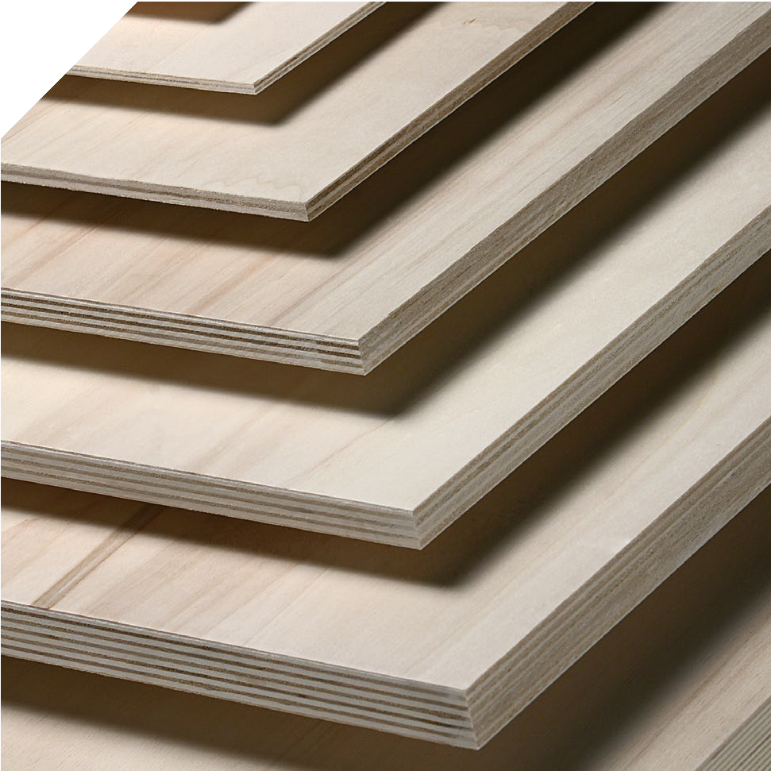
VigoPly
Your versatile and efficient poplar plywood panel.
Versatile and efficient poplar plywood panel. It is characterized by lightness, stability and easy to cut features, suitable for different uses in internal spaces.
Manufactured in compliance with
qualitative specifications EN635.
VigoPly L
Long grain multilayer poplar plywood.
VigoPly T
Cross grain multilayer poplar plywood.

Slide 12
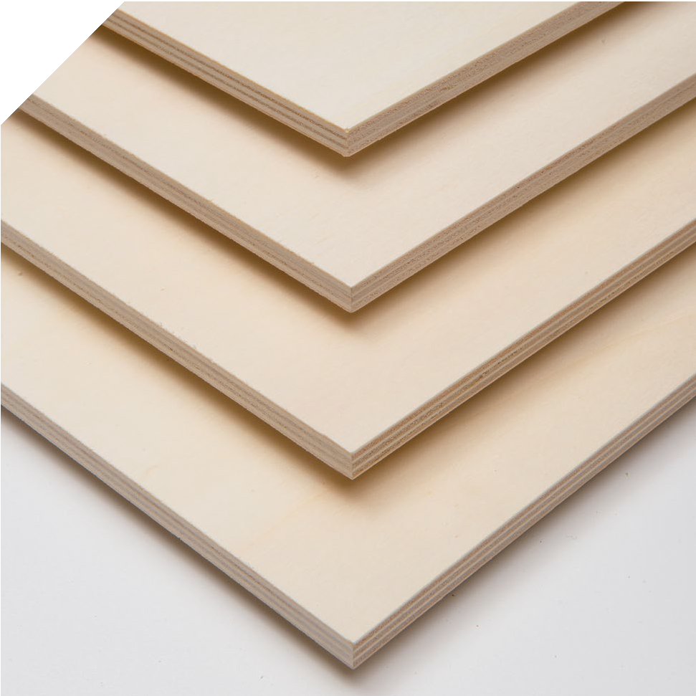
VigOverPly
Your right choice for laminating with paper, pvc, alkorcell.
Application field: special plywood for laminating with decorative papers, perfect for RV.
Features:
White and smooth faces
High quality core and composition
Lightness

Slide 13
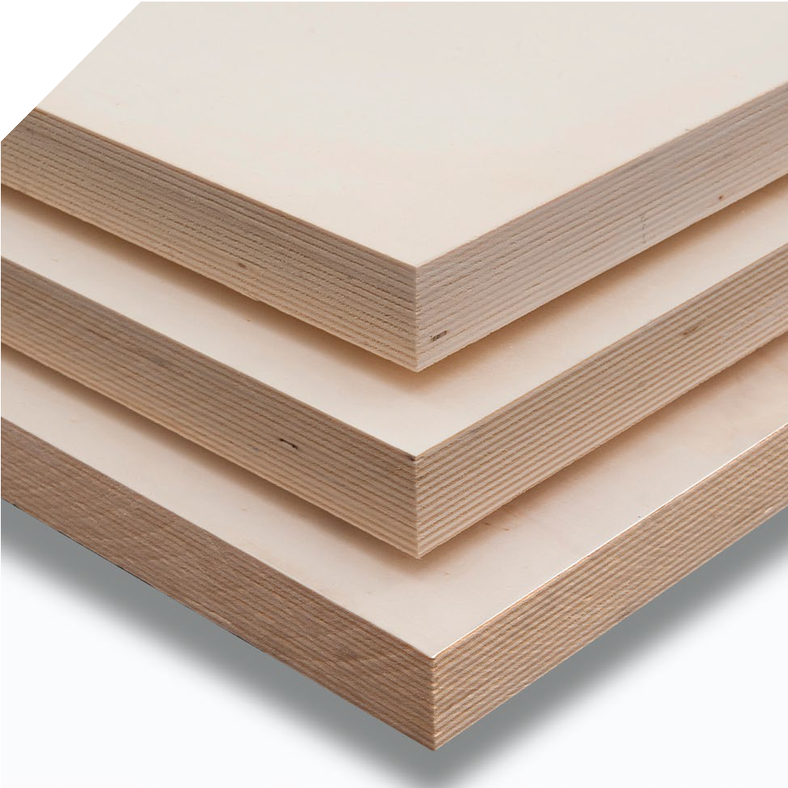
VigoPly Millerighe
Your panel when you need higher stability and mechanical features.
Multilayer poplar plywood panel with high stability and high performed mechanical resistance properties, thanks to the bigger internal stratification.
Sectors: furniture and design.

Slide 14
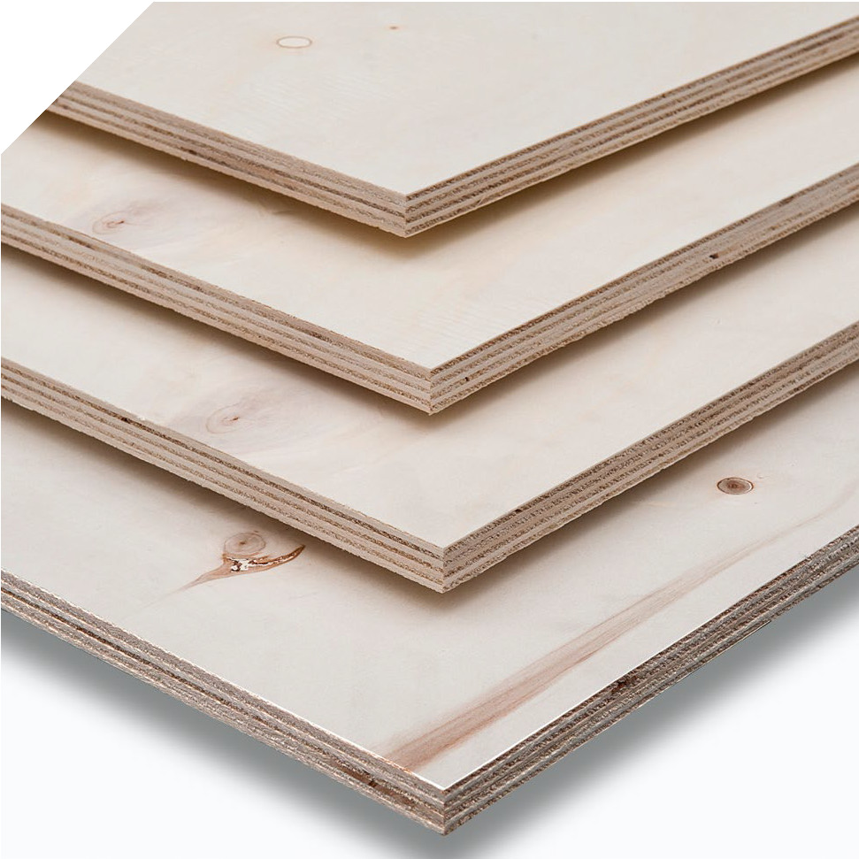
VigoPly Multiprolam
Your panel for laminating process.
Poplar plywood panel suitable for laminating with HPL/CPL.
Sectors: furniture and design.

Slide 15
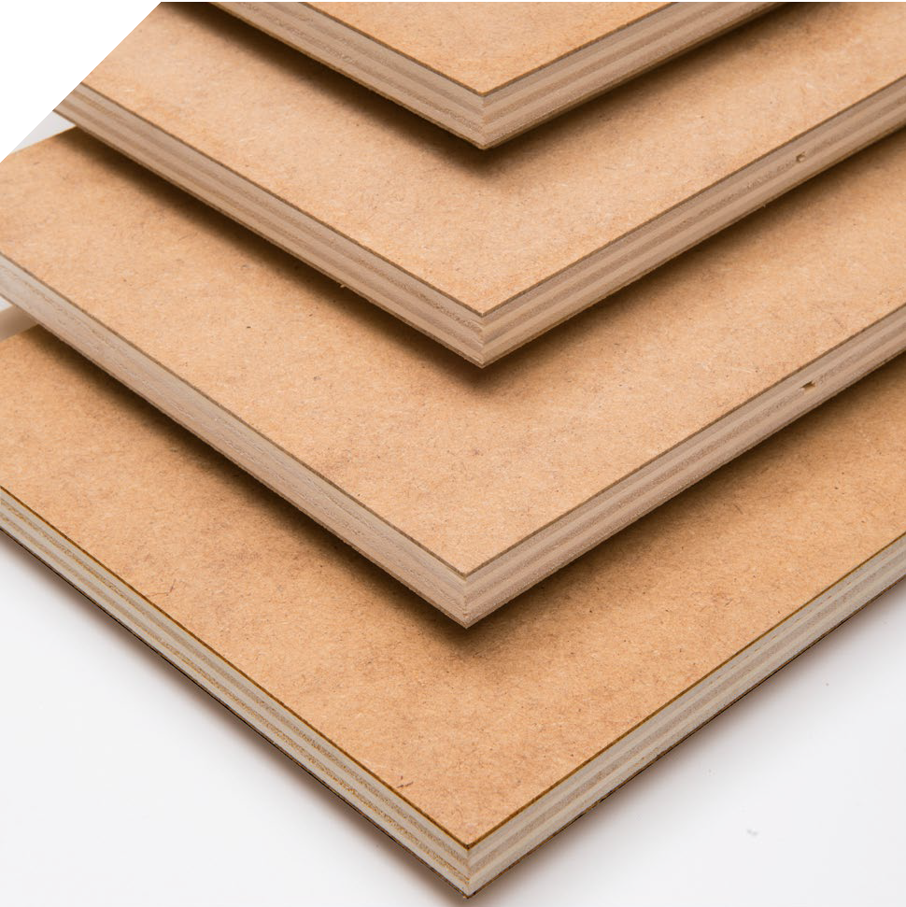
VigoHDply
Your choice for specific application in furniture industry.
Poplar plywood panel with faces covered by HDF/MDF. The combination of these materials grants mechanical performances of the plywood and exterior homogeneity of the fiber panel: the perfect choice for specific applications in furniture industry.
Sectors: furniture and design.

Slide 16
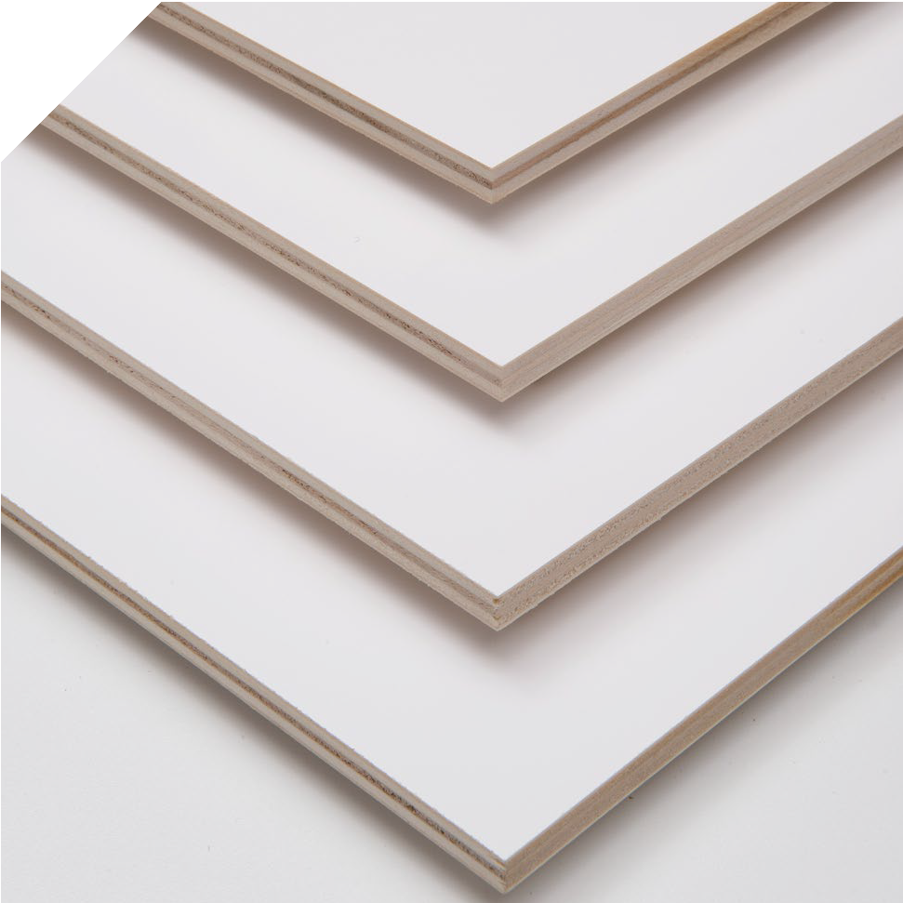
INCOPrimed
Your ready-to-paint panel.
Poplar plywood panel covered by water based acrylic varnish that can
be repaintable: the most efficient choice
for the construction industry and DIY market.
Sectors: building and construction industry, DIY.

Slide 17
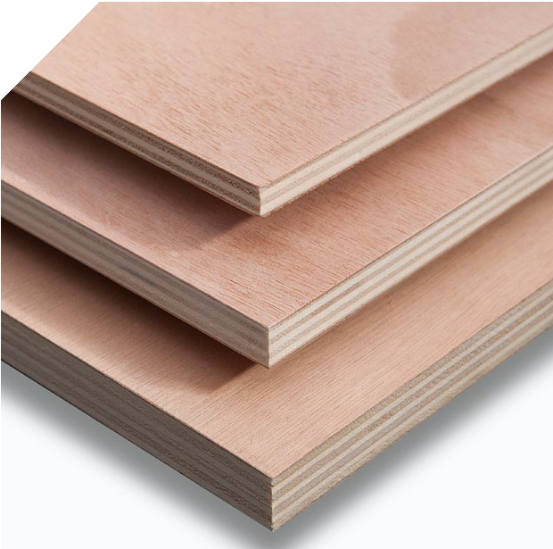
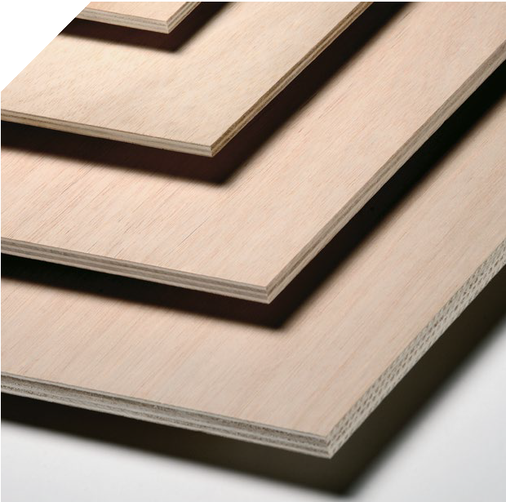
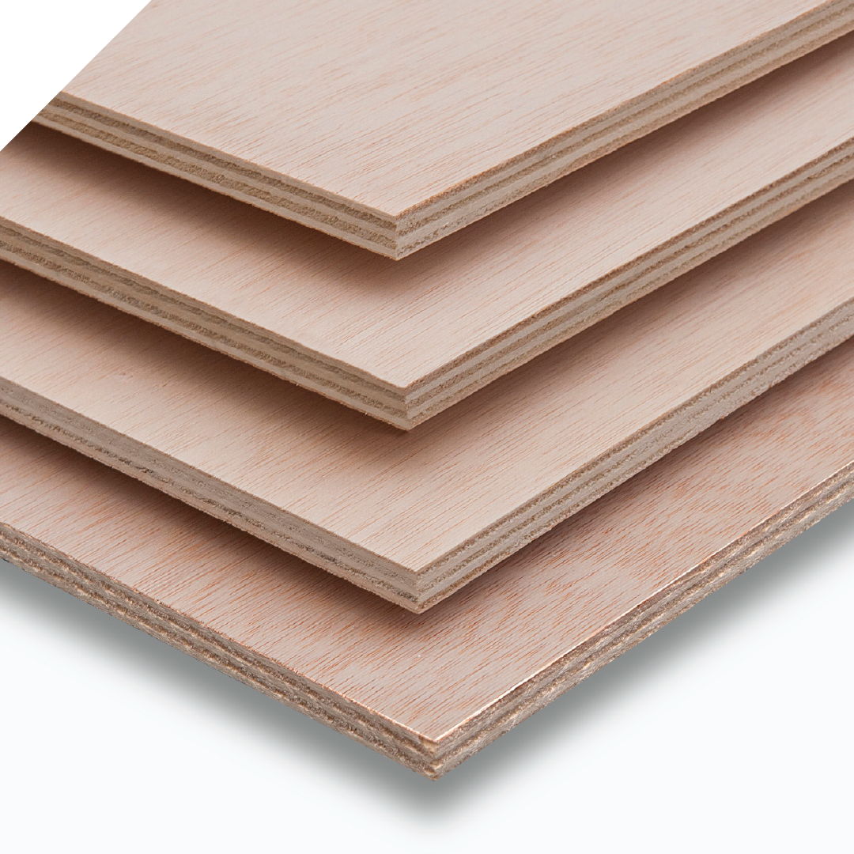
VigoTwin
The best combination between exotic species and lightness of poplar.
VigoTwinOkoumè
Poplar plywood panel with outer faces in Okoumé. It combines poplar lightness with higher hardness and exterior durability granted by Okoumé.
Sectors: nautical industry.
VigoTwinCeiba
Poplar plywood panel with outer faces in Ceiba that makes it a light panel, easy to work and with a homogeneous color.
The perfect solution for papers and coverings applications industrial grade.
VigoTwinIlomba
Poplar plywood panel with outer faces in Ilomba. Thanks to the exterior uniformity it can be covered by a wide range of decorative surfaces, and it can satisfy the specialized industry needs.
Sectors: Automotive, nautical industry.

Slide 18
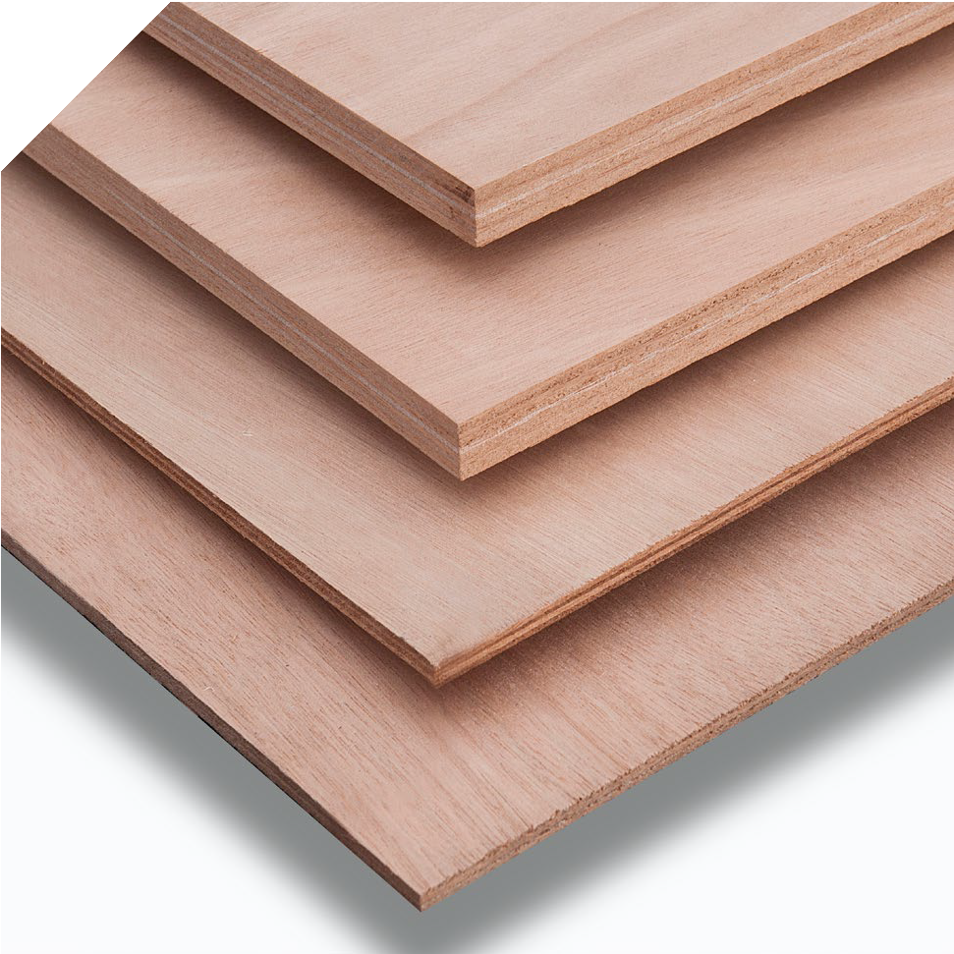
VigOkoumè
Your panel with moisture resistance and high stability.
It combines the features of moisture resistance and high stability of Okoumè together with Class 3 bonding for external use.
Sectors: nautical industry.

Slide 19
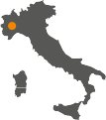
OUR VALUES,
OUR STRENGTH
FOR A SUSTAINABLE DEVELOPMENT
For Vigolungo S.p.A. sustainability
means responsibility.
Our products are 100% Made in Italy and they are the result of an eco-friendly process.
They are made of raw materials mainly purchased directly in northern Italy and manufactured in our plant based in Canale.

Slide 20










E. VIGOLUNGO is your partner in the sustainability chain process to get more Value.
CERTIFICATIONS
PRODUCT
FSC® - ICILA-COC-000370
SYSTEM
ISO 9001 – Quality Management System
WORK IN PROGRESS
ISO 45001 – Security Management System
PEFC - ICILA-PEFC-COC-000095 -
ISO 14064 – Company Carbon Footprint
ULEF GLUING
CARB Phase 2 compliant
NAF GLUING
Sustainability Report
CE2+ for structural plywood
0497/CPR/5009
ISO 14025 -EPD
for VIGOPLY L CL1

Slide 21
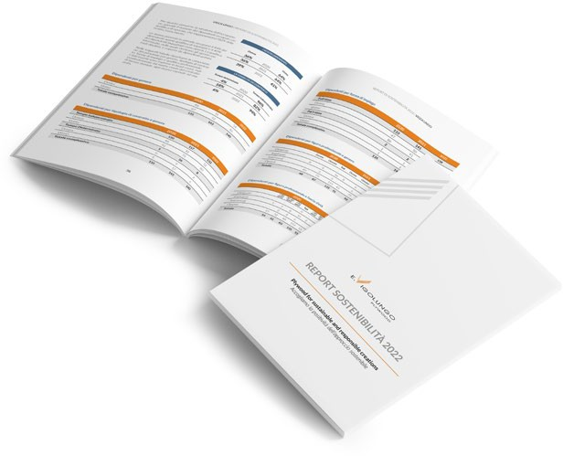

ESG CRITERIA
WE MADE OUR FIRST SUSTAINABILITY REPORT FOR THE YEAR 2023
DOWNLOAD NOW
Energy management Carbon emissions
Waste management and circularity
Employees welfare
Health and security on working place
Responsible Governance

Slide 22
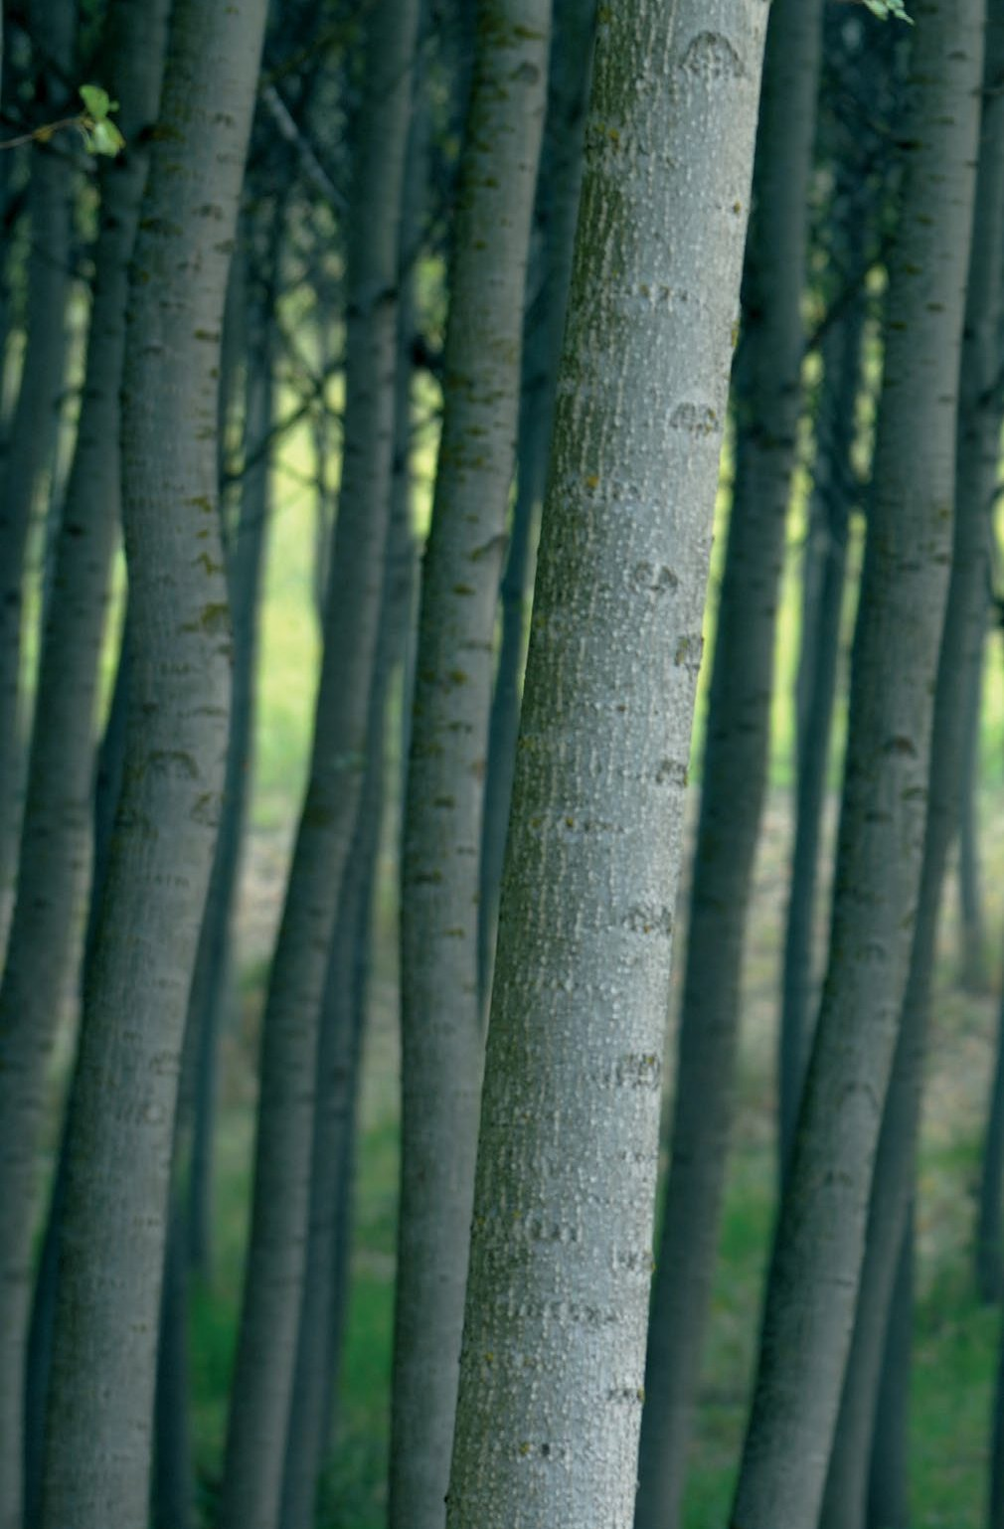
DID YOU KNOW THAT...?
1 0

Slide 23
10 years:
10 European
countries with at
least 5000 hectares
dedicated to poplar cultivation: France, Spain, Belgium, Serbia, Germany, Romania, Greece,
Poland, Hungary and certainly, Italy.
10 people who travel
by plane from Paris to New York
produce the same quantity of CO2 that one
hectare of poplar plantation can absorb”.
the life cycle of poplar; as soon as a tree is cut down, another one is planted.
10 times around the globe:
if a car travelled for 400.000 km, it would
produce the same quantity of CO2 that a poplar plantation as large as a soccer field would be able to absorb.
10 products derived from poplar:
paper, biomass, wood chips, OSB, pallets,
blanks, packing materials, toys, compost and, of course, plywood panels.

Slide 24

PLYWOOD FOR
SUSTAINABLE
AND RESPONSIBLE
CREATIONS

Slide 25
E. Vigolungo SpA
C.So F.lli Maccagno 25
12043 Canale (Cn) – Italia
tel. +39 0173 979048
fax +39 0173 97970
P.iva e C.F. 00182600049
trade@vigolungo.com
www.vigolungo.com

