Slide 1
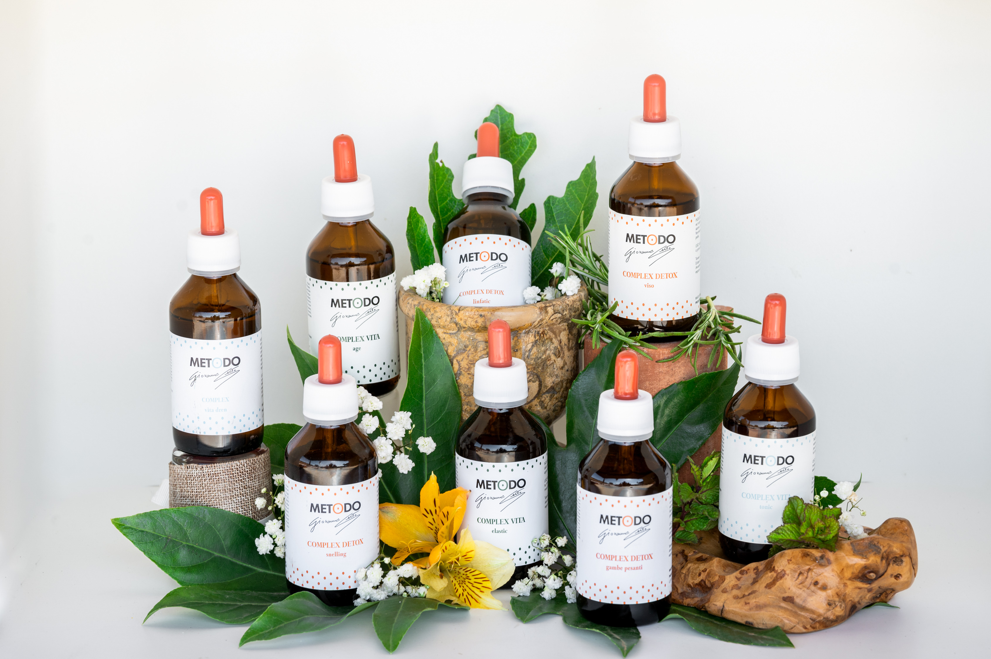
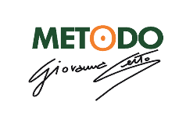

Slide 2
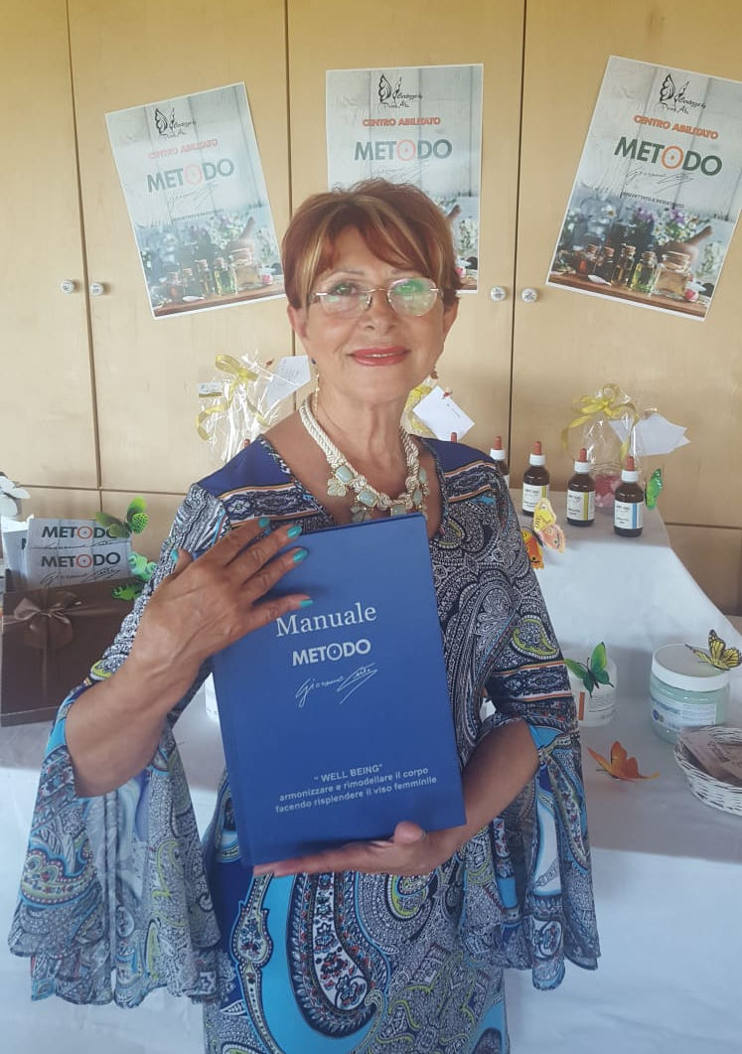
The METODO CERTO is a MIX of aesthetic, manual and vibrational holistic techniques, developed in 40 years of study by Mrs. Giovanna Certo, who registered and patented it

Slide 3
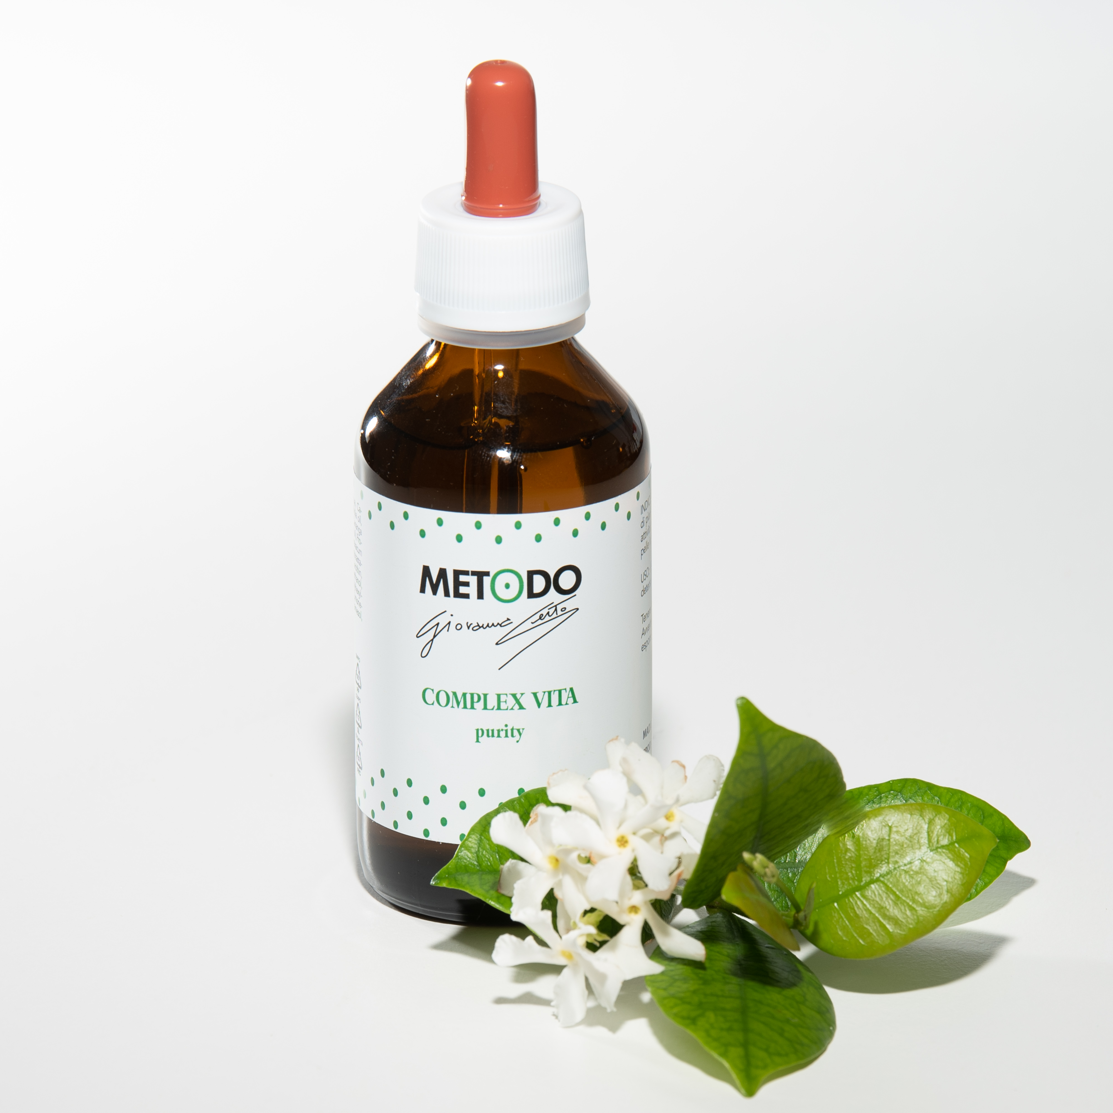
It is a Method that blends Western techniques with Eastern and shamanic techniques; it is a discipline that proposes a concept of advanced aesthetics that is not satisfied with dealing with the physical aspect alone, but also places great attention on the psycho-emotional well-being of the person.

Slide 4
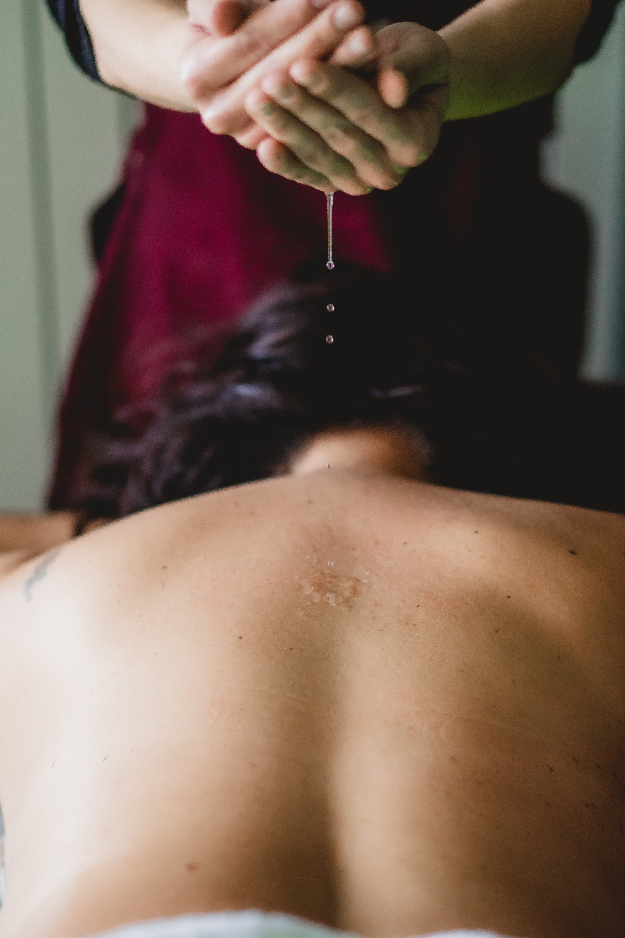
The three foundations of the Metodo Certo are:
METAMERIC MASSAGE, the "black box of our emotions";
P.N.E.I. LYMPHATIC DRAINAGE, psycho-neuro-endocrine-immunological
EXOGENOUS DISTRICT CONDITIONING OF THE MICROCIRCULATION

Slide 5
METAMERIC MASSAGE, the "black box of our emotions";
In our back there are 10 muscle segments, which are called Metameres (YU points in Chinese medicine), capable of recording and storing all information, in particular emotions because they are directly connected to the sympathetic nervous system through the spinal nerves.
Each emotion corresponds to a Metamere and each Metamere corresponds to a reflex area called Dermatomere (or MO point in Chinese medicine), which in turn corresponds to a specific organ.
By exerting connective pressure on the metamere, tension is loosened and contact between the nervous system (on the back) and the corresponding organ on the front of the body is encouraged. Therefore, if some emotion is not expressed but repressed for a long time (example: holding back anger or crying) a reaction is generated on the corresponding Metamere (example for ANGER = LIVER and GALL BLADDER) causing tension and pain.

Slide 6
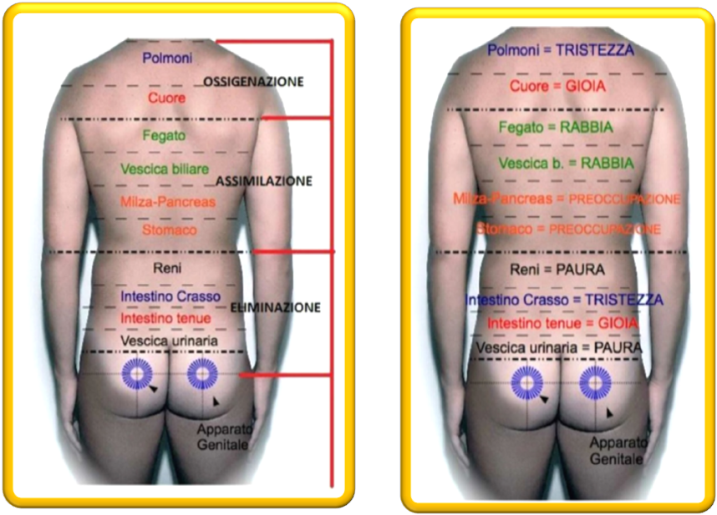
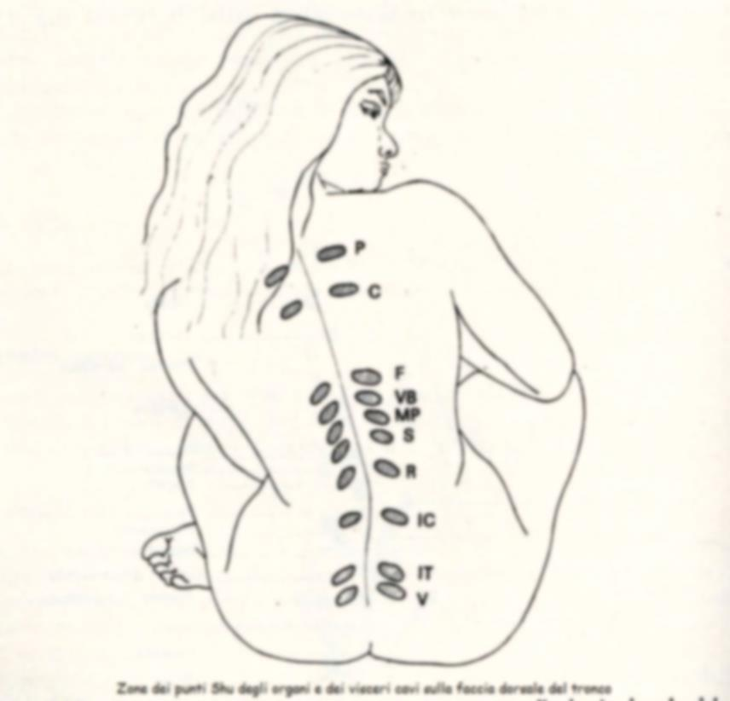
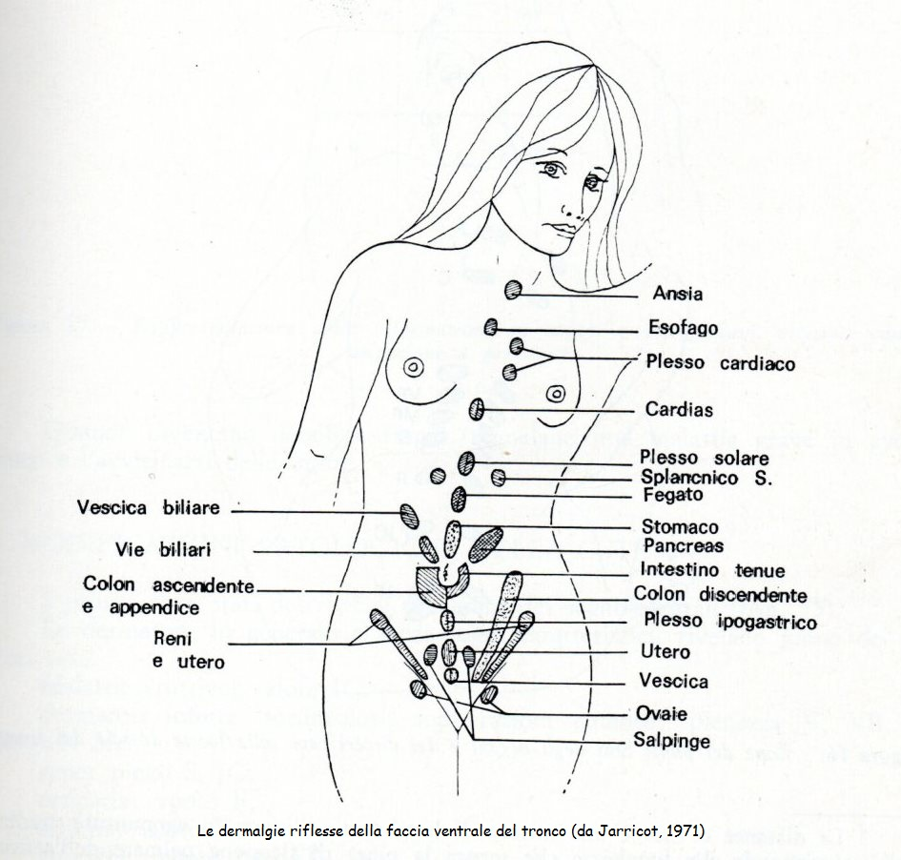

Slide 7
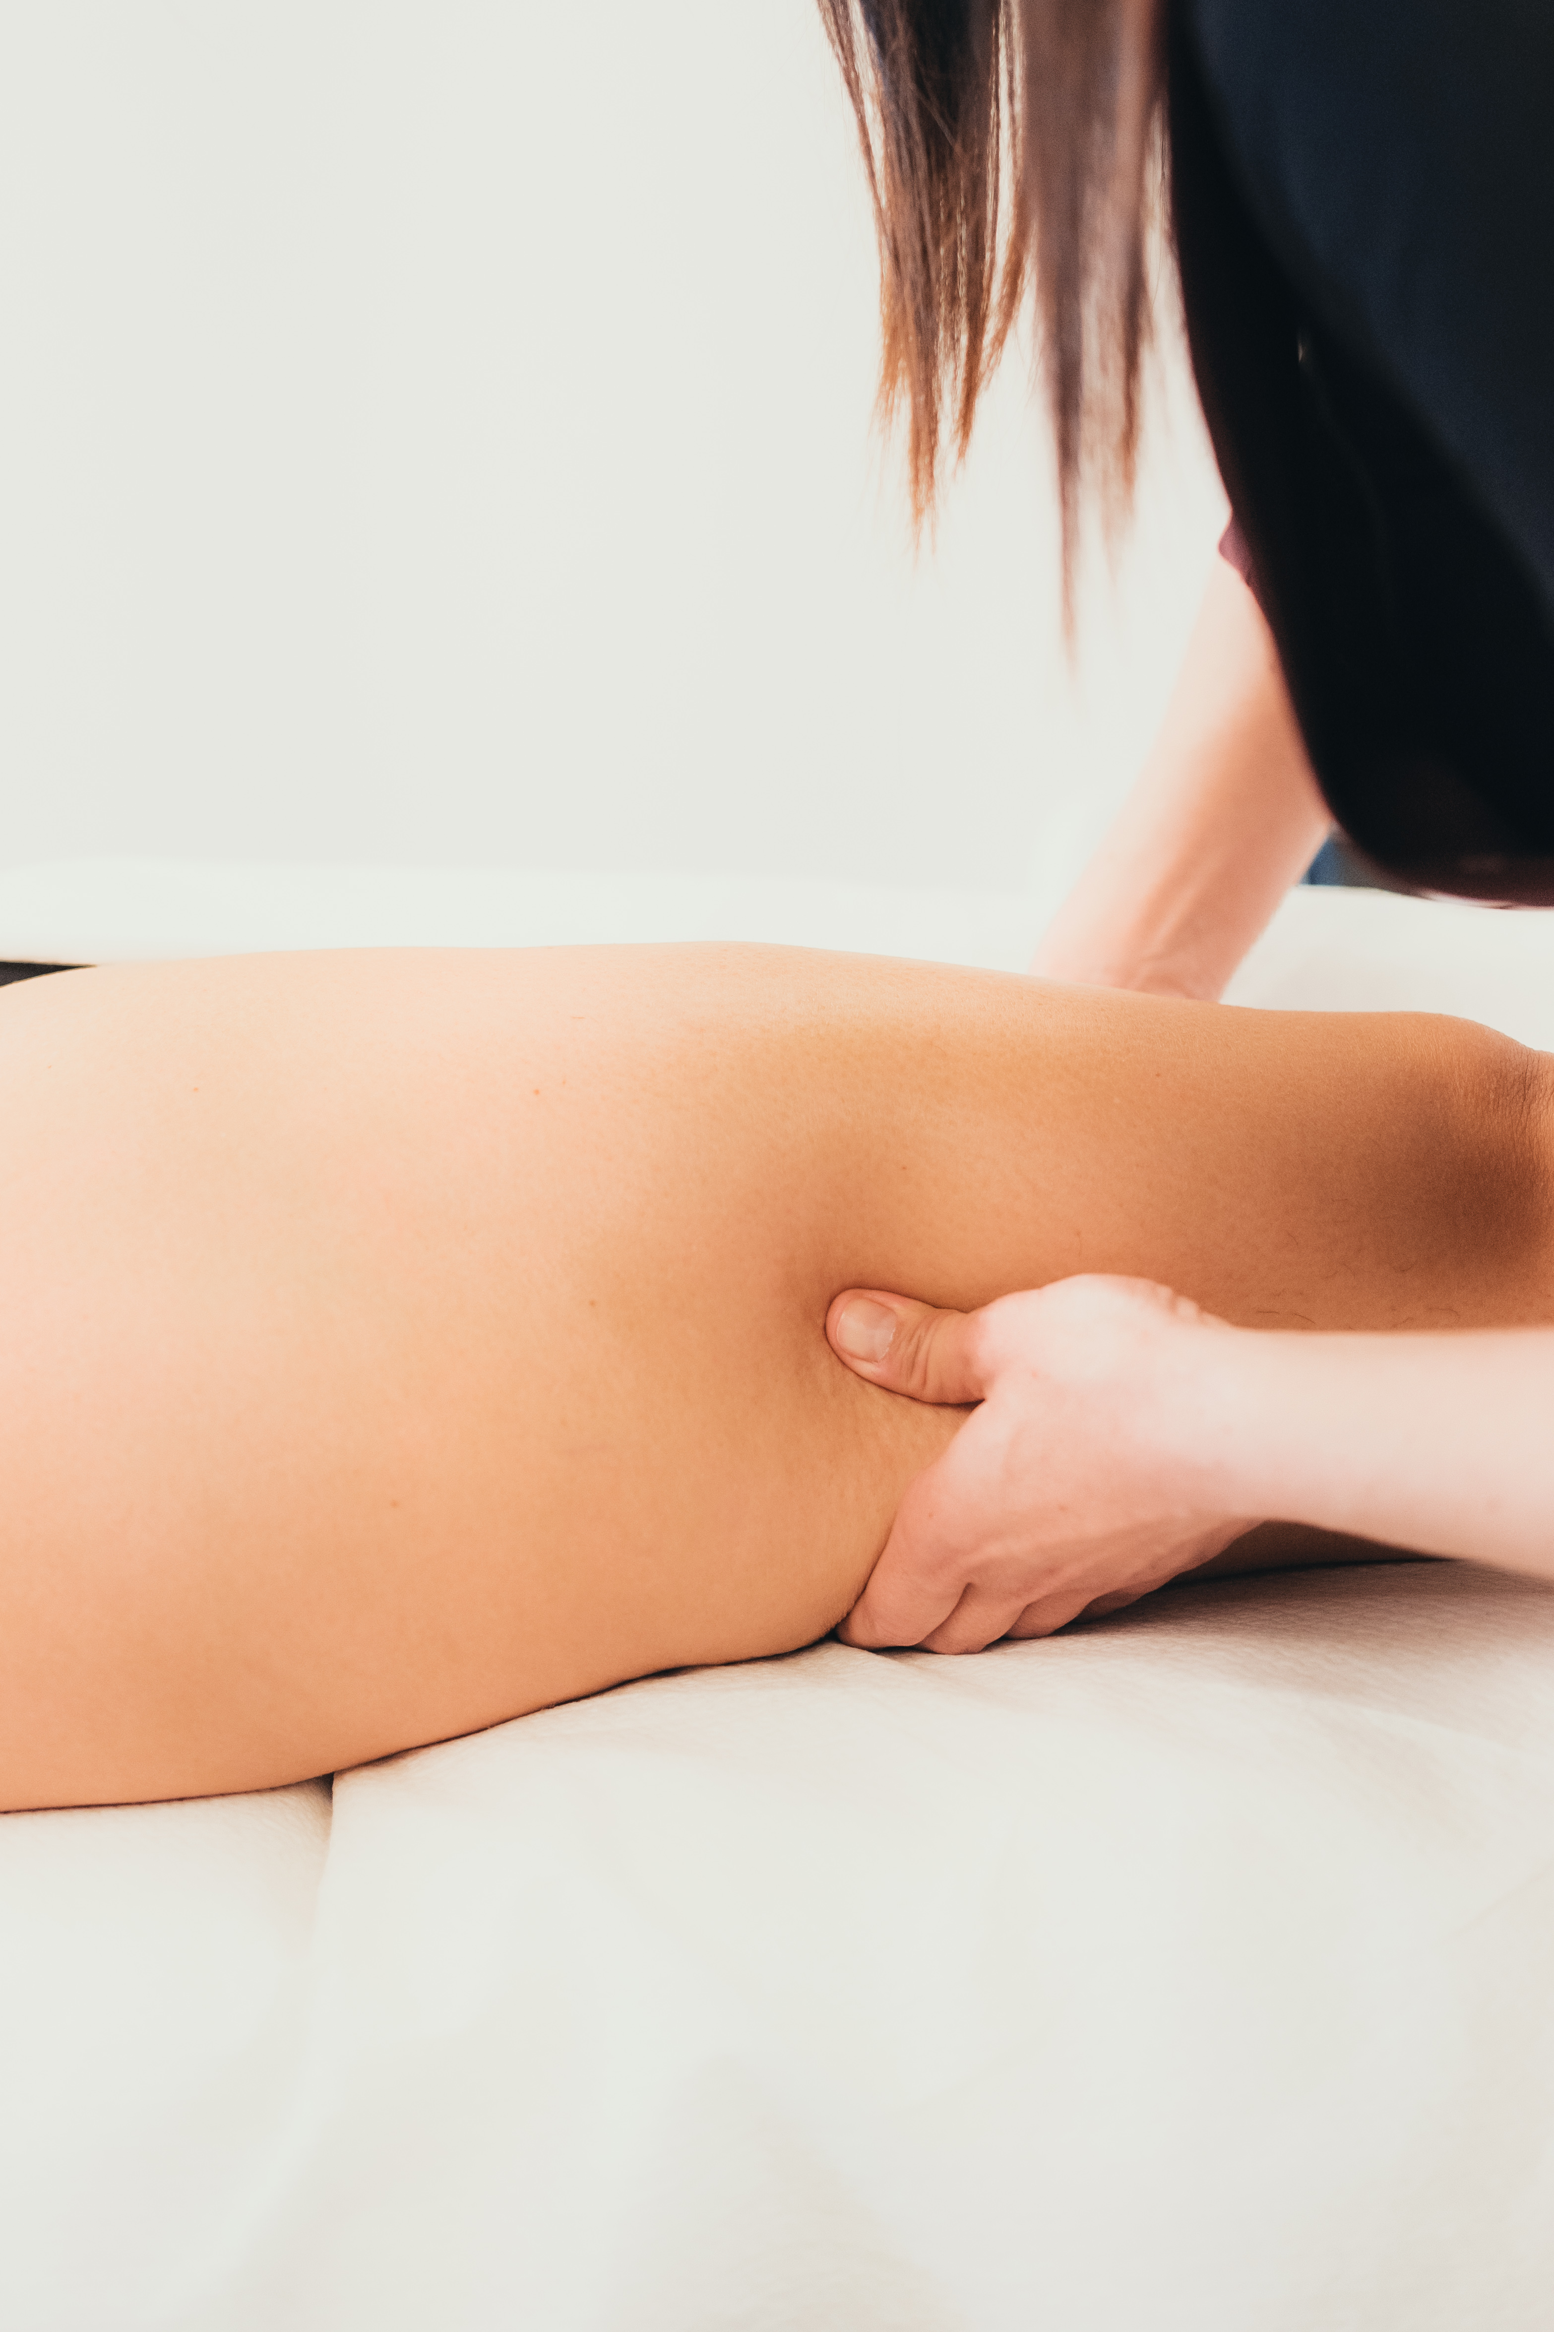
LYMPHATIC DRAINAGE P.N.E.I. METODO CERTOpsycho-neuro-endocrine-immunological
Etiogenesis of Lymphatic Stasis Related to the Psycho-Neuro-Endocrine-Immunological System (P.N.E.I.)
A Slow and Deep Lymphatic Drainage with Squeeze, Completely Different from Vodder Lymphatic Drainage

Slide 8
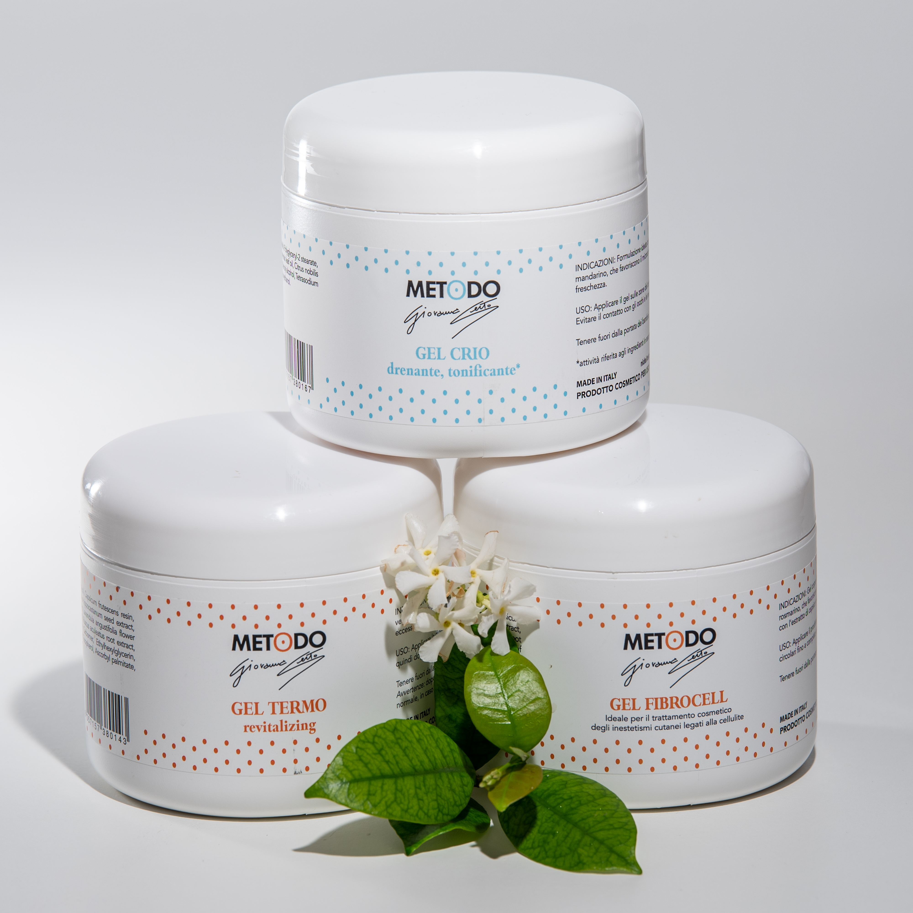
DISTRICT EXOGENOUS CONDITIONING OF THE MICROCIRCULATION
which is obtained using the Synergies of Essential Oils, Phytoextracts and Functional Principles of the Certo Method together with the three gels that activate the vasoconstriction and vasodilation receptors for the mechanical pumping of the microcirculation.

Slide 9
The METODO Certo uses natural aromatic or phytotherapeutic substances that have the purpose of improving the appearance of the skin and follow the criterion of achieving physical and nervous system well-being. The Certo Method products do not contain parabens, respect nature and the packaging is recyclable.

Slide 10
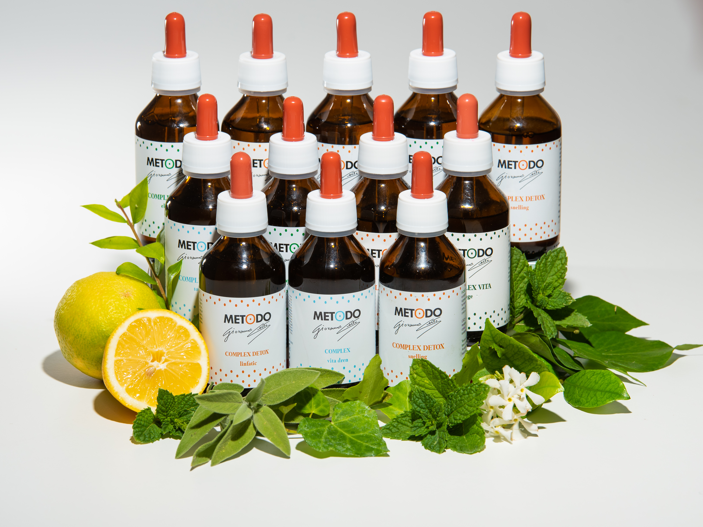
In particular, essential oils, combined together, allow you to obtain both a physical reaction and an emotional and vibrational reaction, they act on the cellular metabolism and facilitate the easing of physical and emotional tensions.

Slide 11
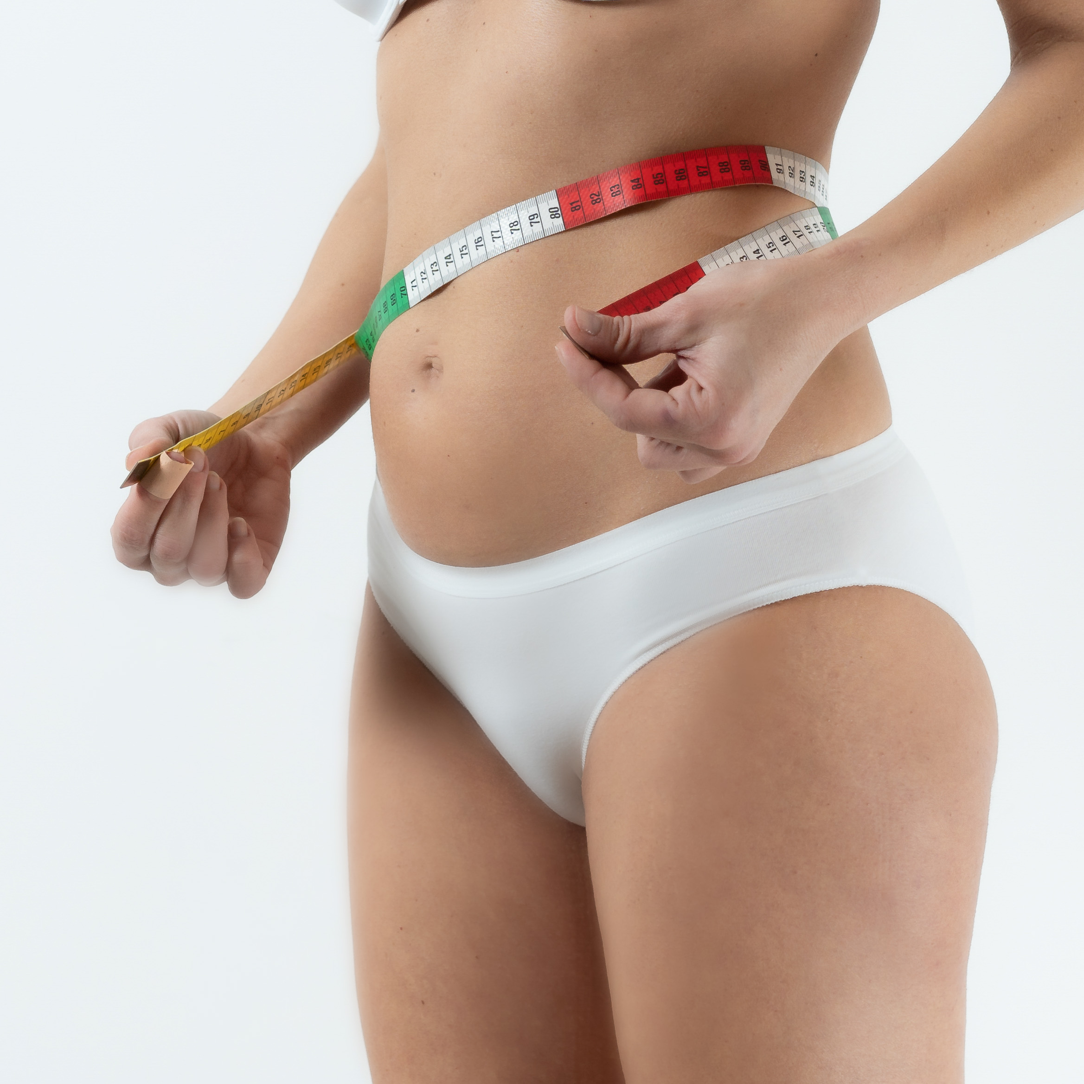
The METODO CERTO is structured through 26 face and body protocols that support the operator by giving a guideline; but the Method does not have pre-established schemes because it is adapted to the visual and tactile anamnesis of the tissue and to the BIO-TYPOLOGICAL analysis of the subject in the continuous search for the personalized and perfect treatment that the client needs at that particular moment.

Slide 12
It is important to say that Metodo Certo products can be used with any manual technique, increasing manual results by over 50%; they can also be used alongside the main aesthetic machines, enhancing them by at least 30% and allowing the benefits to be extended in the following days and then maintained over time.

Slide 13
THE METODO CERTO COURSES (theory, practice, private study and internship)
1st OPERATOR LEVEL 194 HOURS (of which 92 of theory and practice)
2nd OPERATOR LEVEL 124 HOURS (of which 48 of theory and practice)
3rd OPERATOR LEVEL 124 HOURS (of which 48 of theory and practice)
4th INSTRUCTOR LEVEL 190 HOURS (of which 92 of theory and practice)
5th NATIONAL TEACHER LEVEL 190 HOURS (of which 92 of theory and practice)

Slide 14
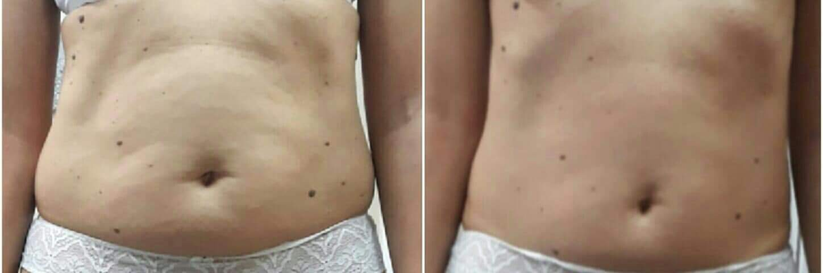
Detox body treatment from 90’

Slide 15
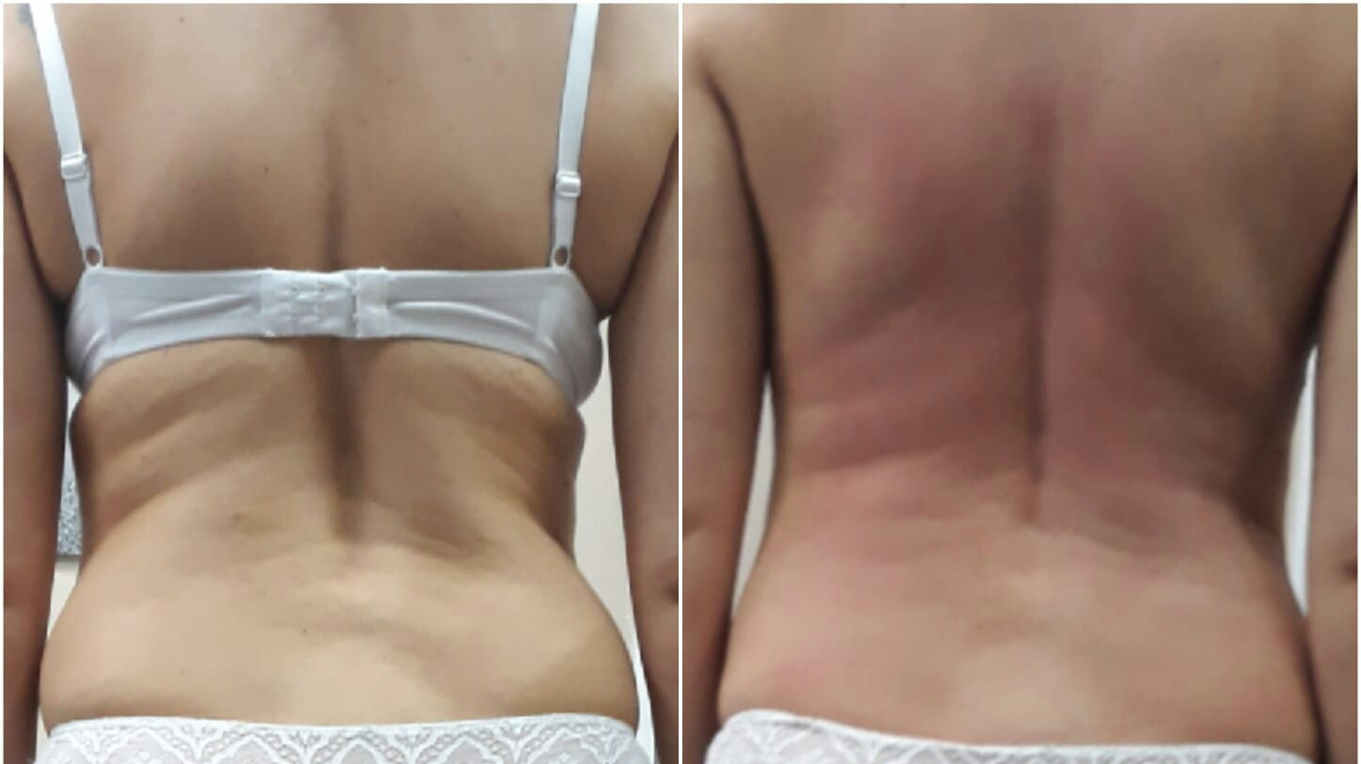
90’ after the first detox treatment

Slide 16
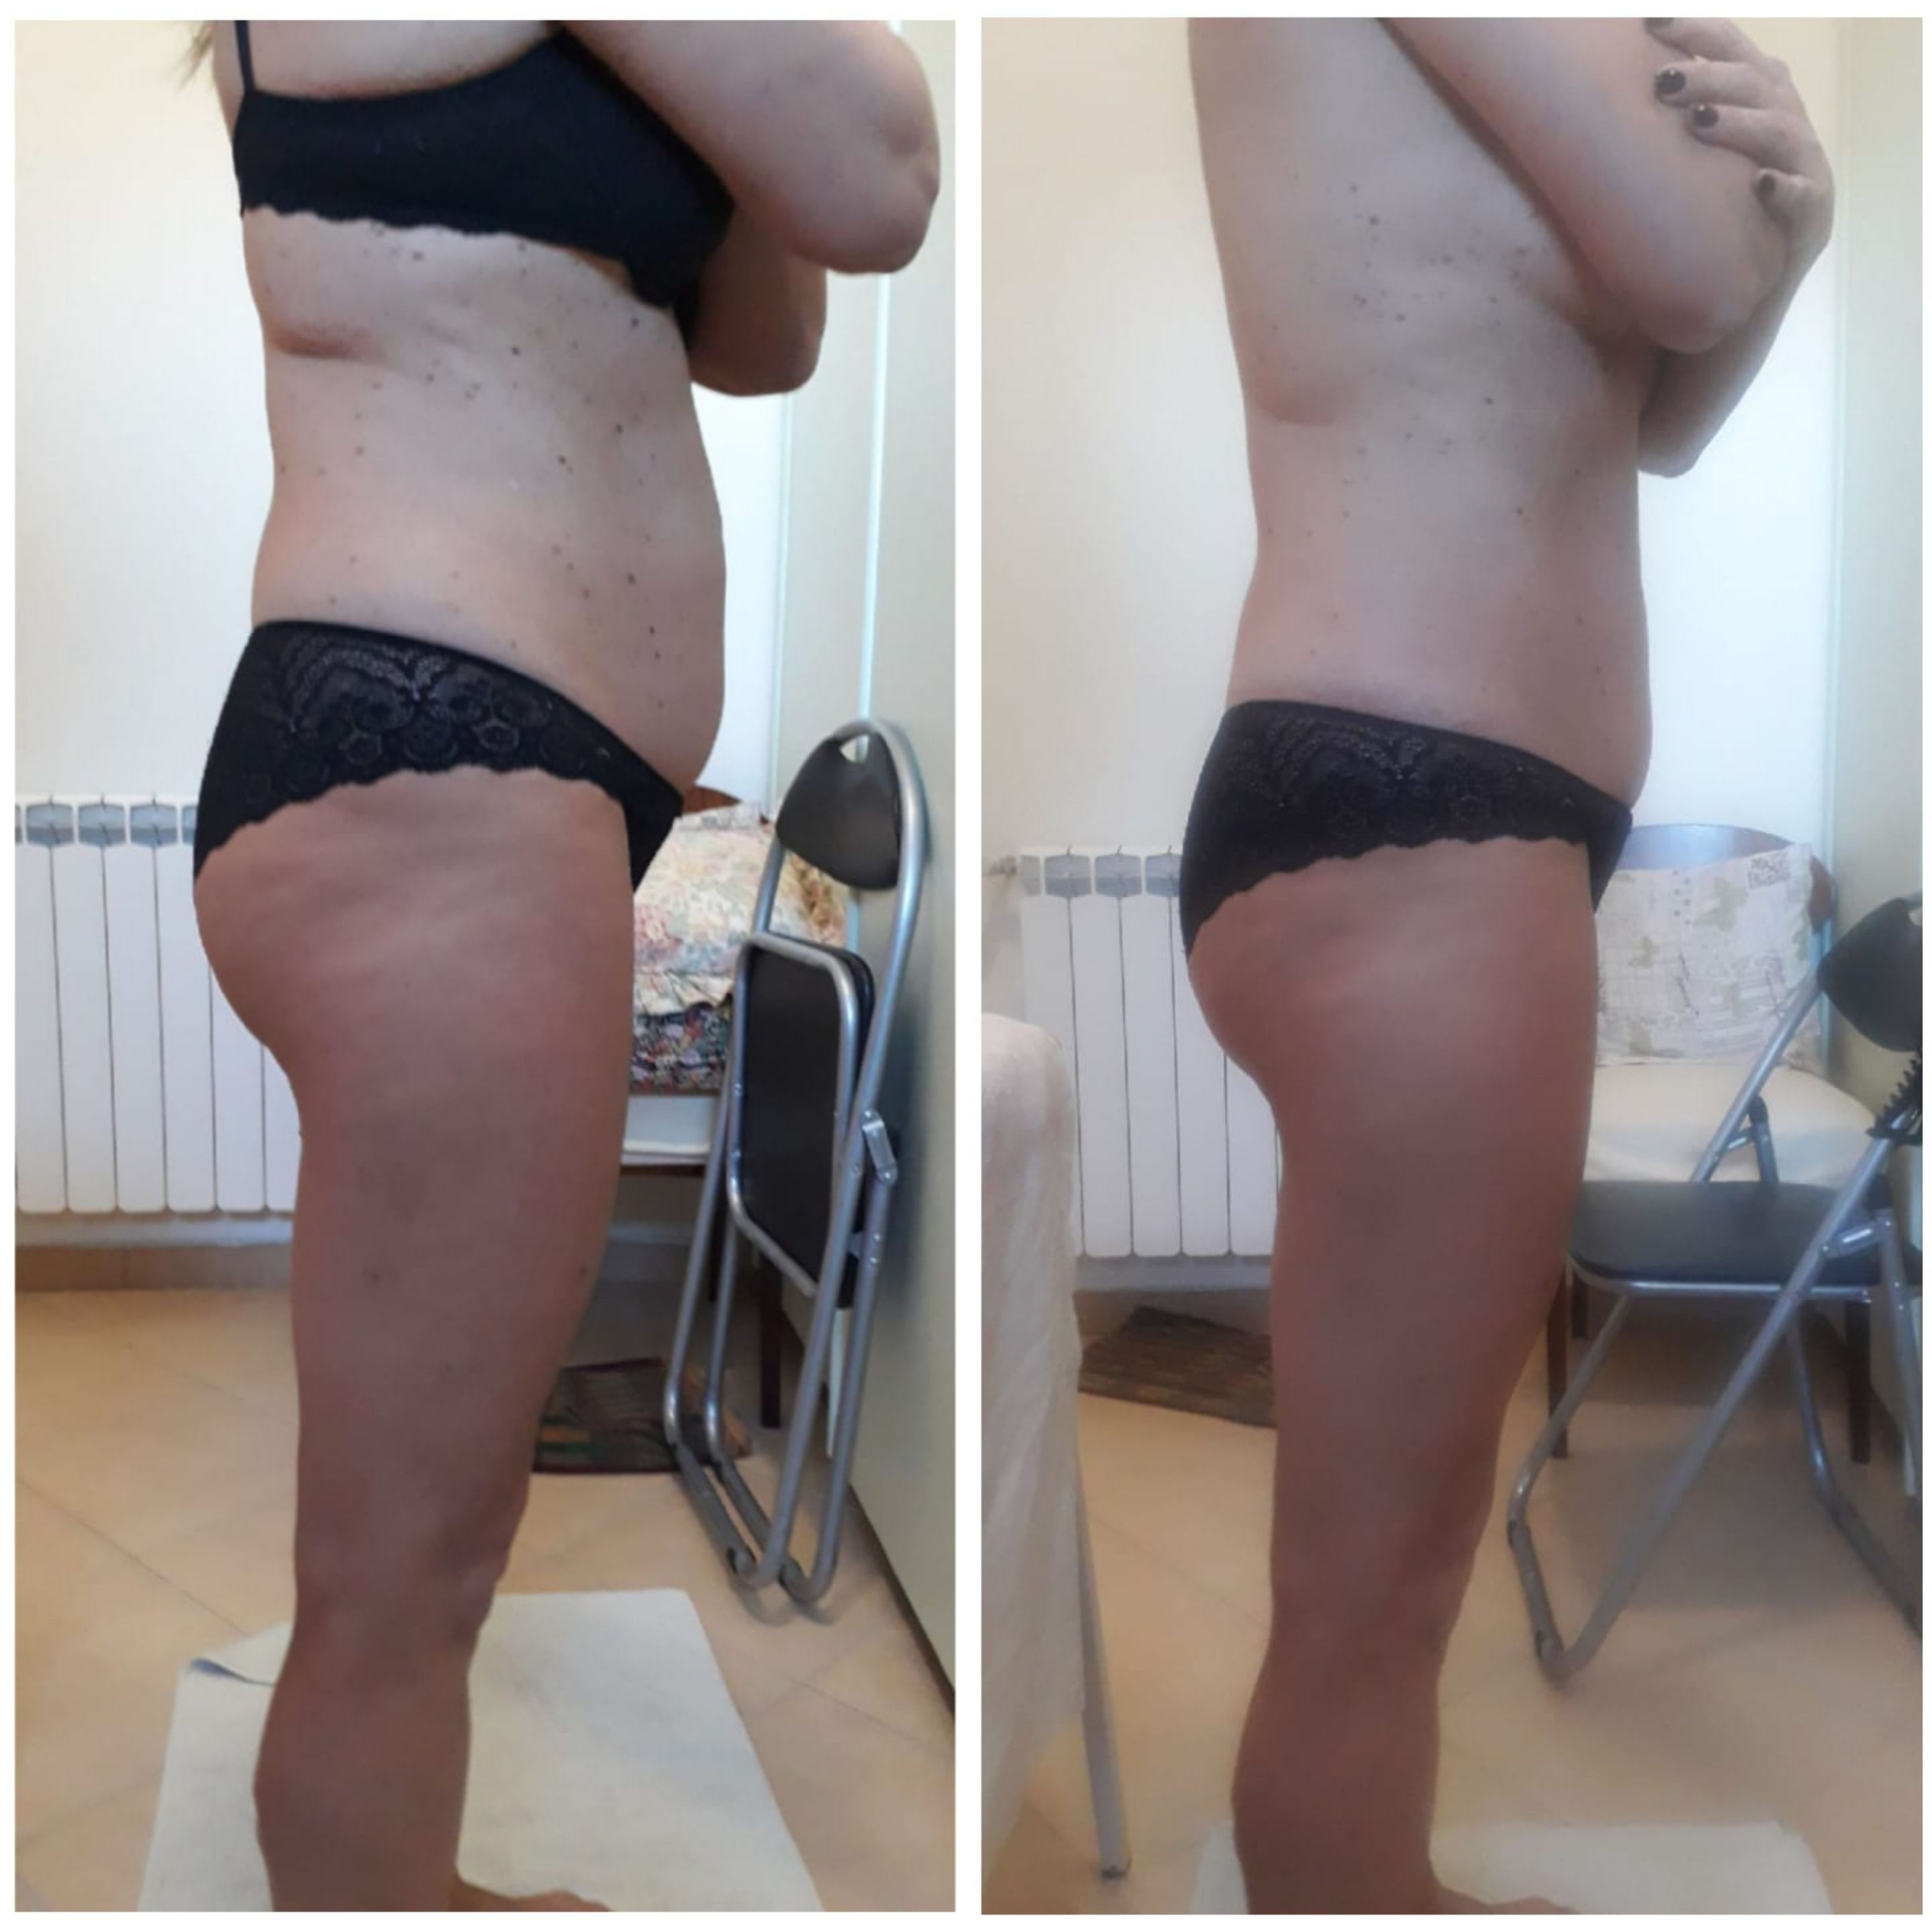
…1° trattamento Reset Corpo..

Slide 17
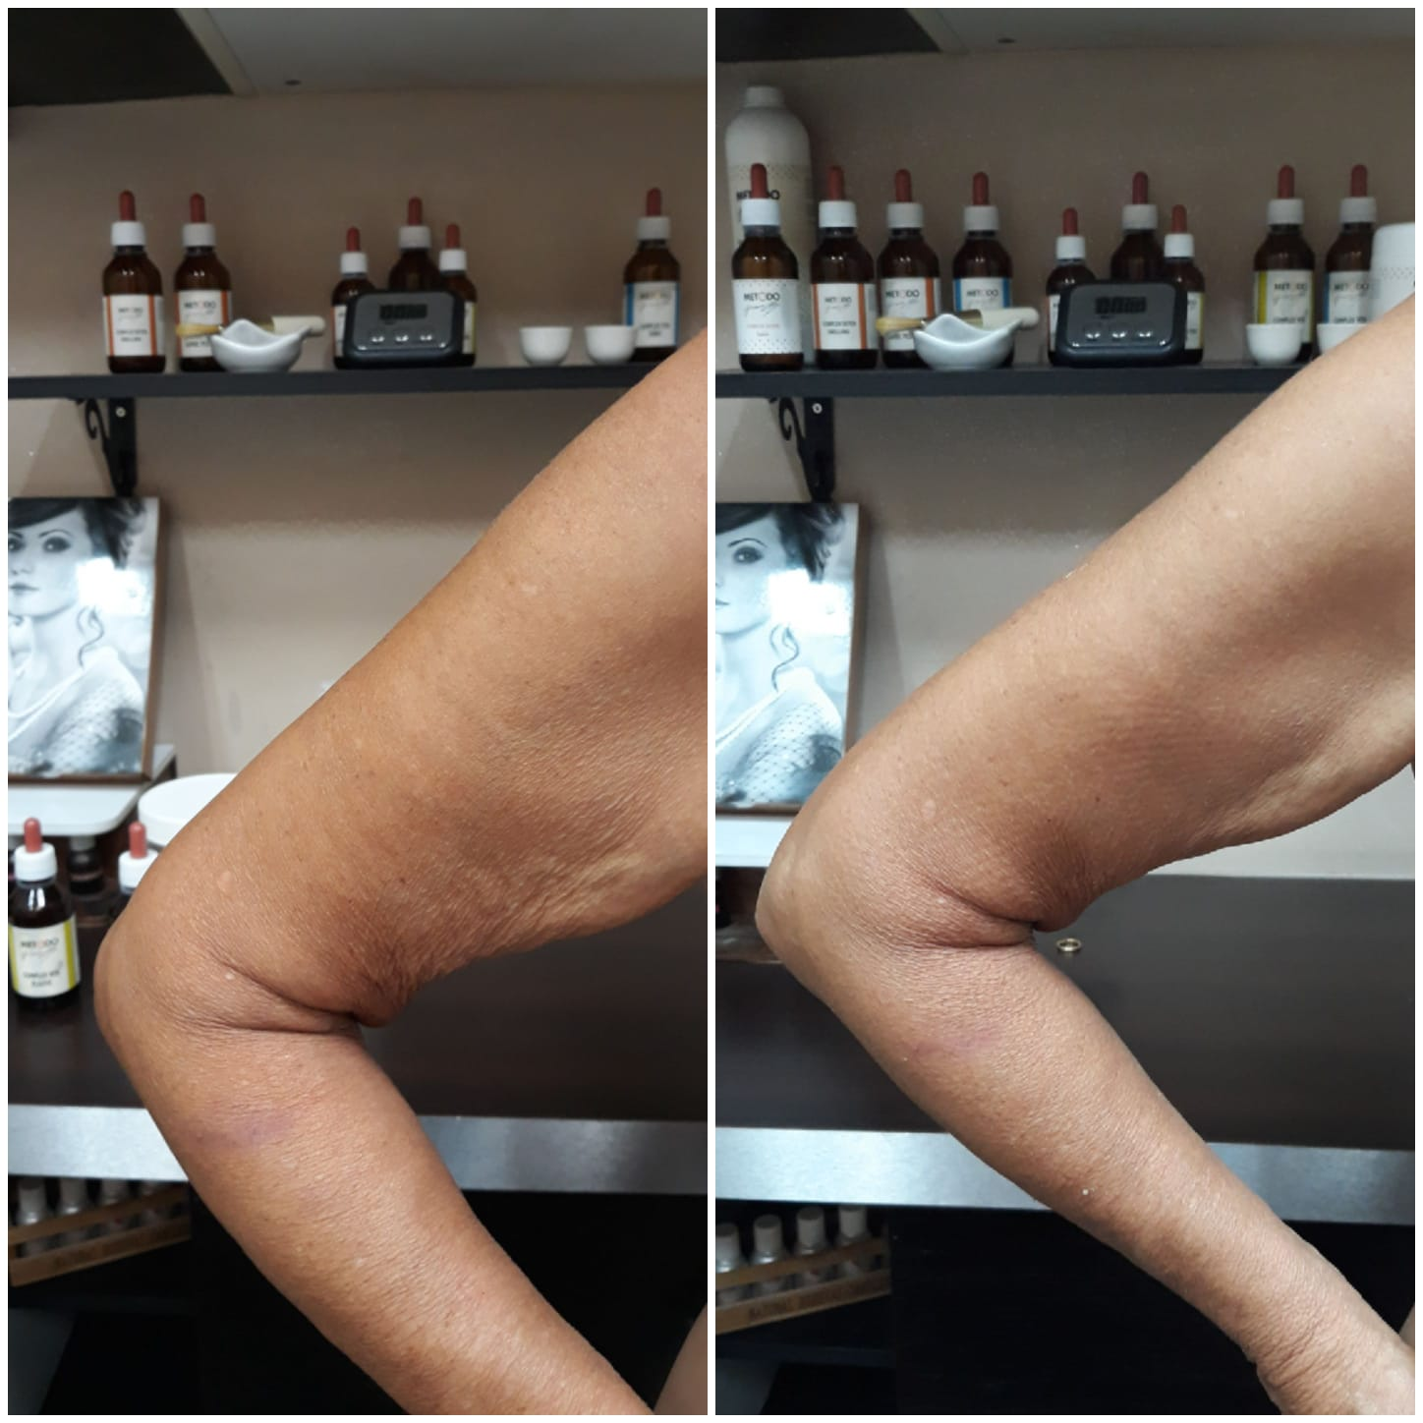
…1° trattamento Rassodante..

Slide 18
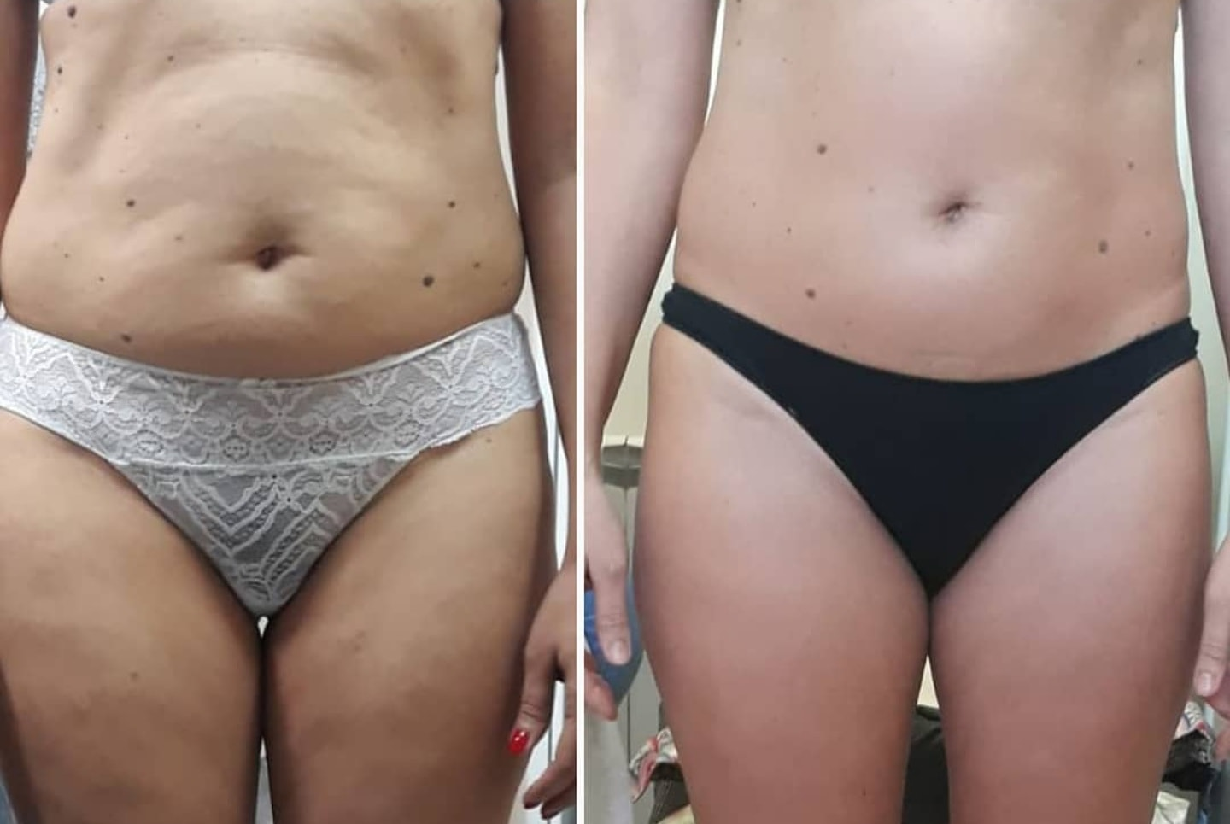
Before and after 3 personalized treatments!

Slide 19
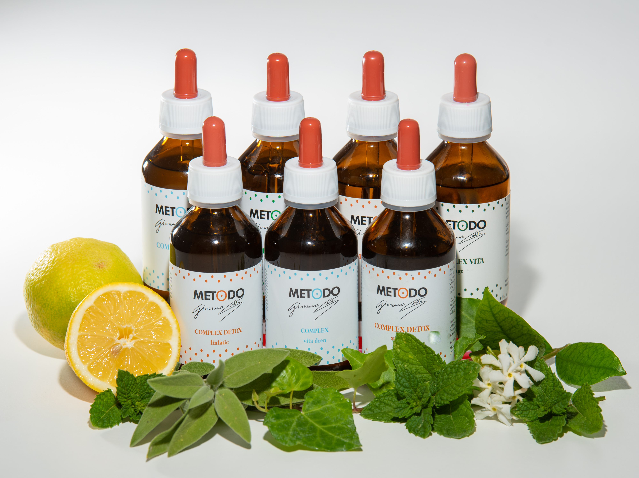
“….i prodotti per tutti……………
……………….il metodo per pochi”

