Slide 1
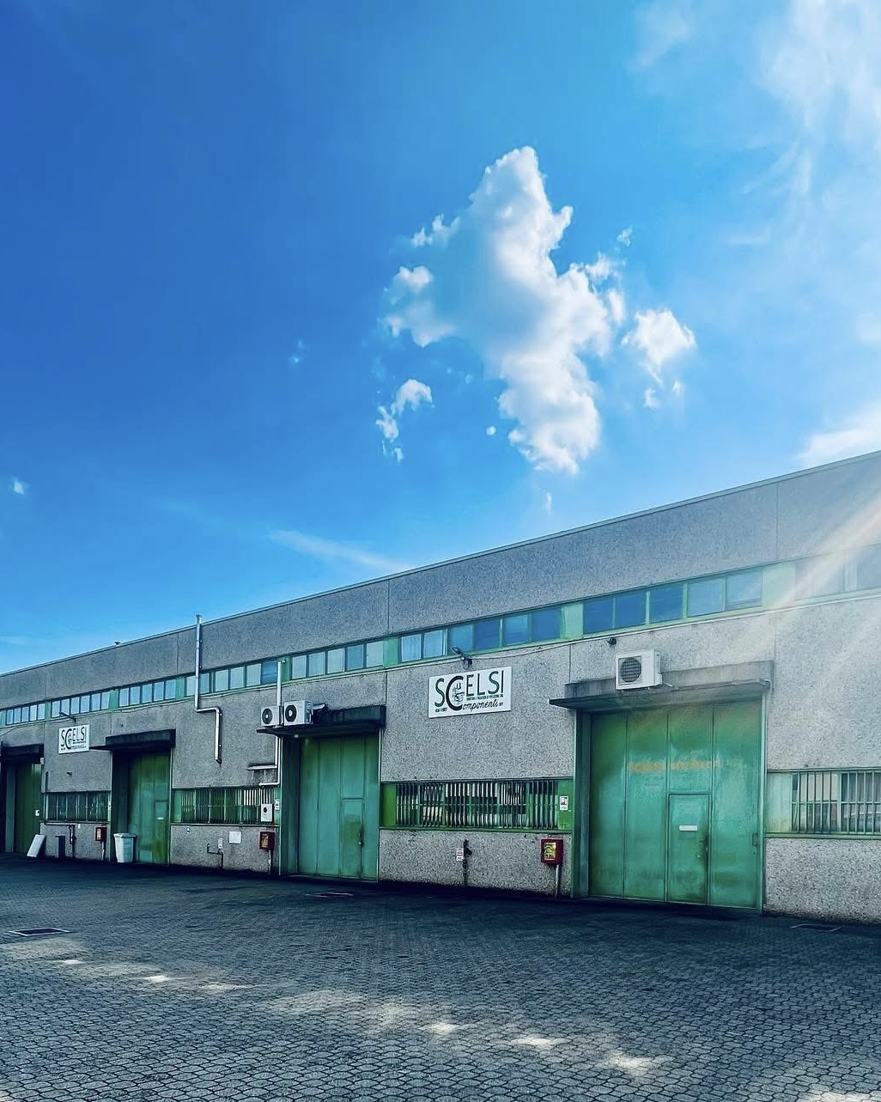









Contact
info@scelsicomponenti.it
+ 39 02 92.444.03
+ 39 340 9101512
www.scelsicomponenti.it
Via Amilcare Ponchielli, 2
Cernusco sul Naviglio – Milano - ITALY
Scelsi Componenti SRL
SCELSI COMPONENTI S.R.L.
scelsi_componenti_srl
Scelsi Componenti s.r.l.
About us
Founded in 1987, specializes in C.N.C. TURNING and MILLING for the production of mechanical components for various industries such as Catering, Automotive, Hydraulics, Medical and Construction.
Due to our experience in the mechanical industry, we are able to machine a wide range of materials, from steel to plastic, bronze, copper and aluminum.
We consistently apply rigorous quality control plans at every stage of production, from the selection of raw materials to the finished product.
This commitment is recognized by ISO 9001: 2015 certification.
We listen carefully to our customers' needs, offering customized solutions and providing assistance at every stage of the job order.
We also offer prototyping techniques through the use of advanced design software.

Slide 2
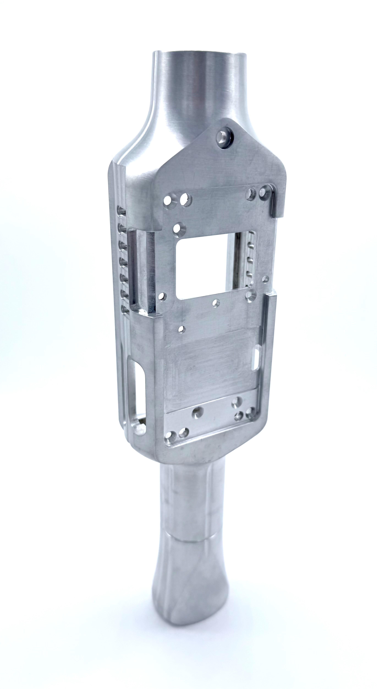
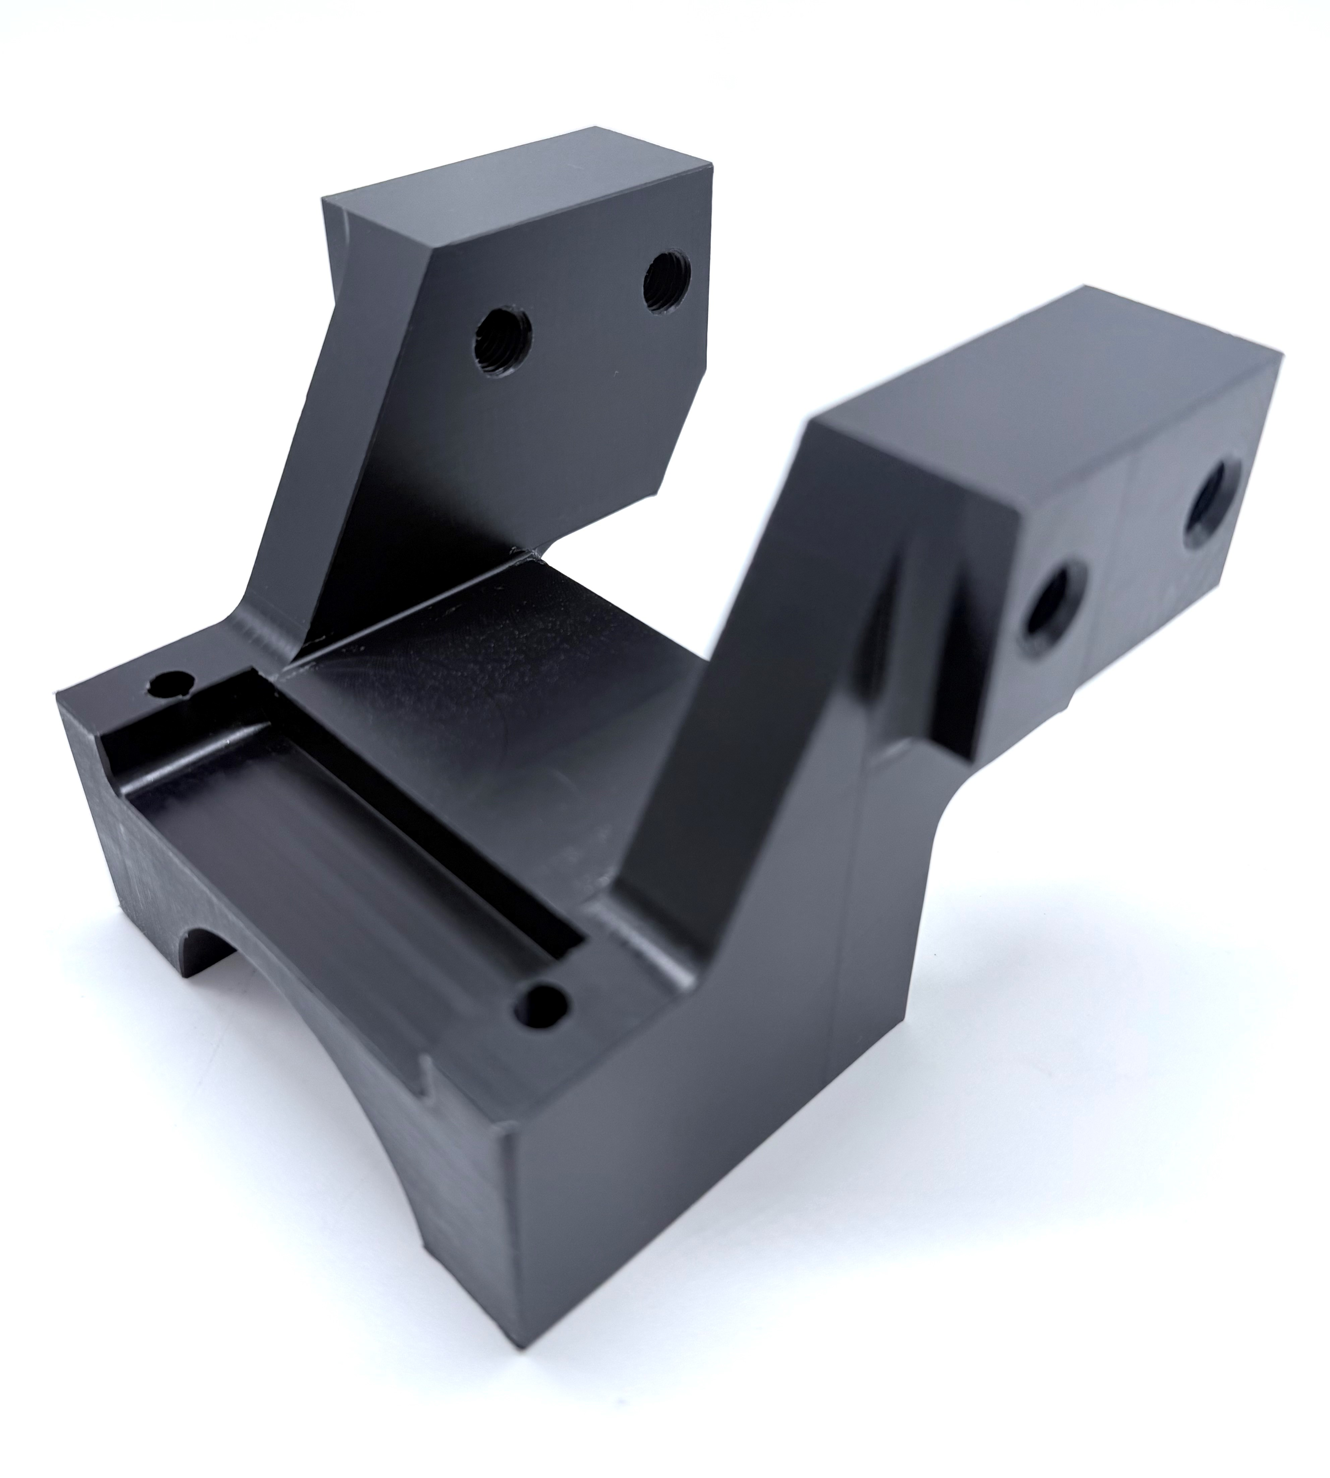
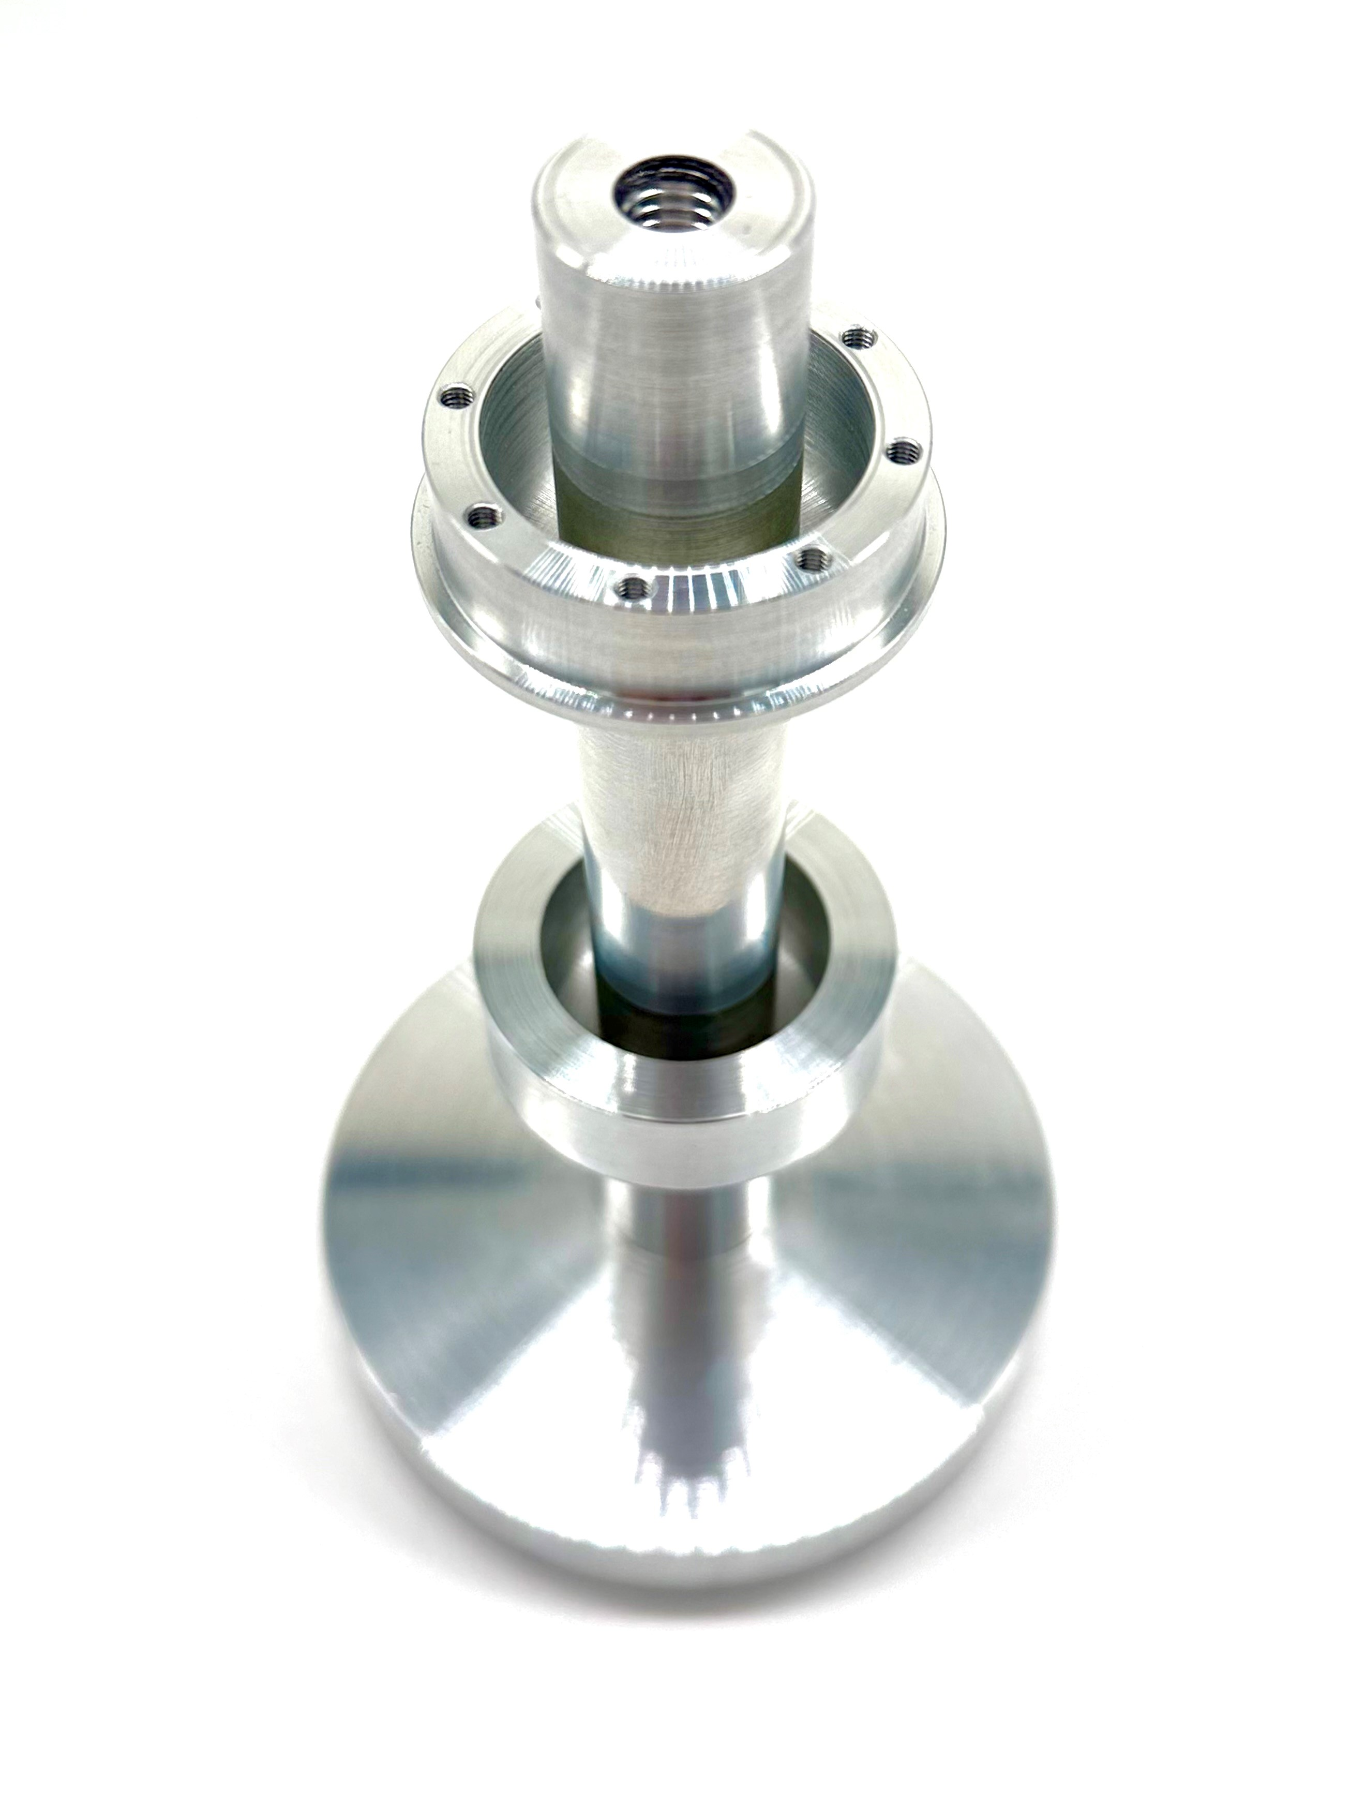
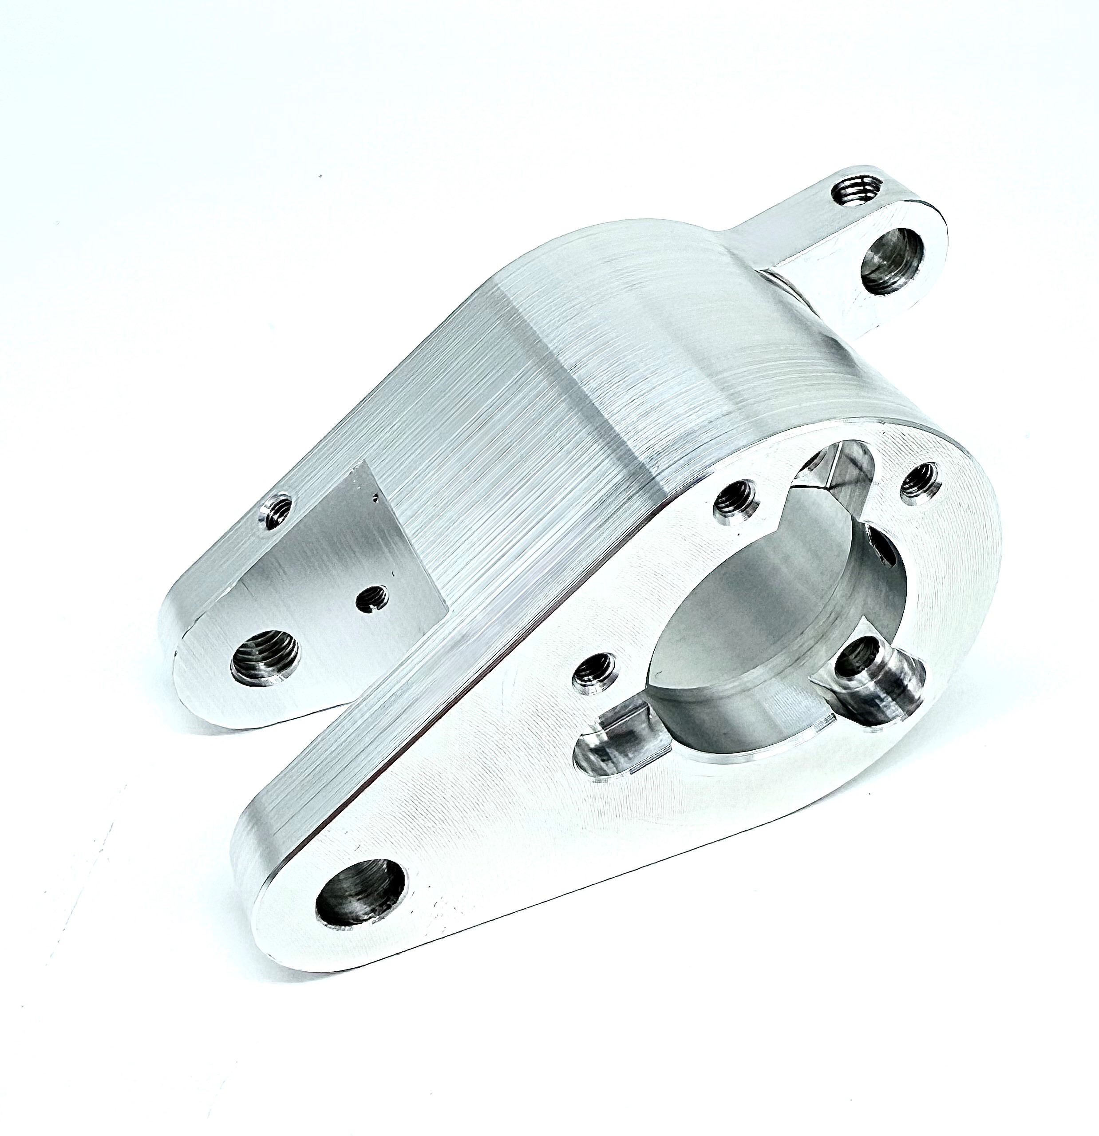
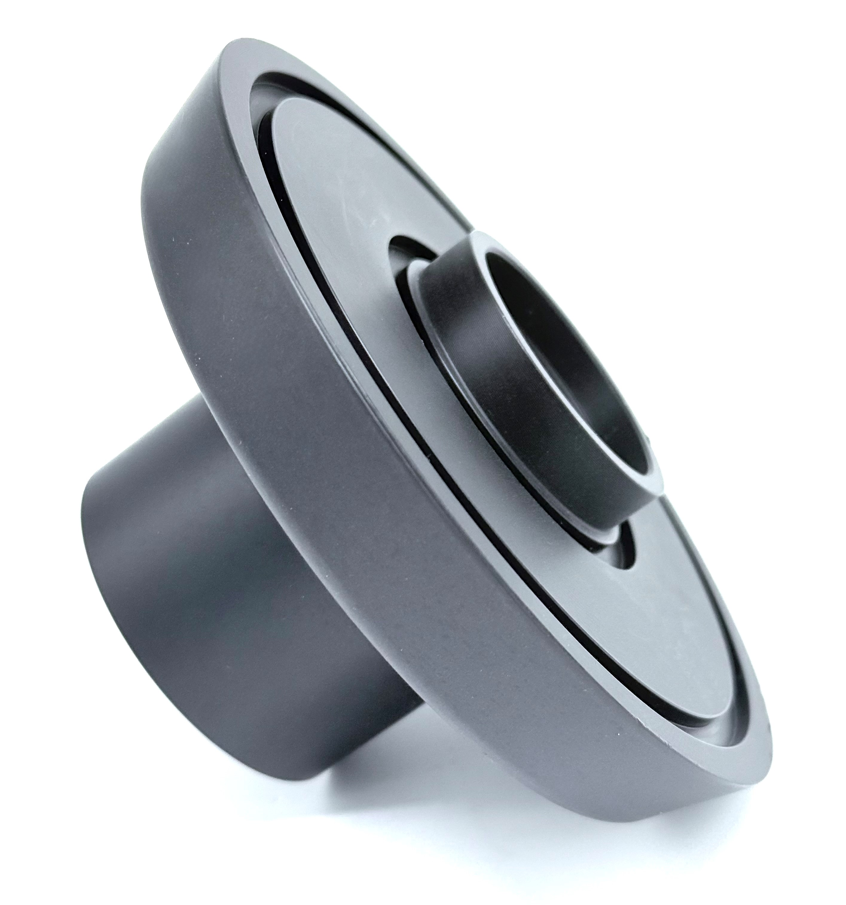
Our Services
SCELSI COMPONENTI SRL gives you a complete service:
feasibility study and quotations
sourcing of raw or semi - finished materials
machining with horizontal machining centers
machining with vertical machining centers
machining with CNC lathes equipped with motorized tools and y – axis
heat treatments (hardening, stress relieving, tempering, etc.)
anodizing, galvanic , painting, nickel plating, etc.
certifications
We offer customized machining solutions for a wide range of materials. Thanks to the experience and high technology of our milling and turning departments, we are able to perform precise and customized machining on steels, special alloys, aluminum, plastics and more.
Whether it is complex machining on hard metals or high-precision operations on lighter materials, our team of experts ensures quality results, meeting the specific needs of each customer.
Steel alloys are specially formulated blends of iron and other elements designed to provide greater strength and durability. These alloys offer superior resistance to wear, corrosion and heat, making them ideal for precision parts and components that require high performance and reliability.
1
2
4
3
5

